Slide 1



19th June 2026
  Pet Clouds
  Printing

Slide 2

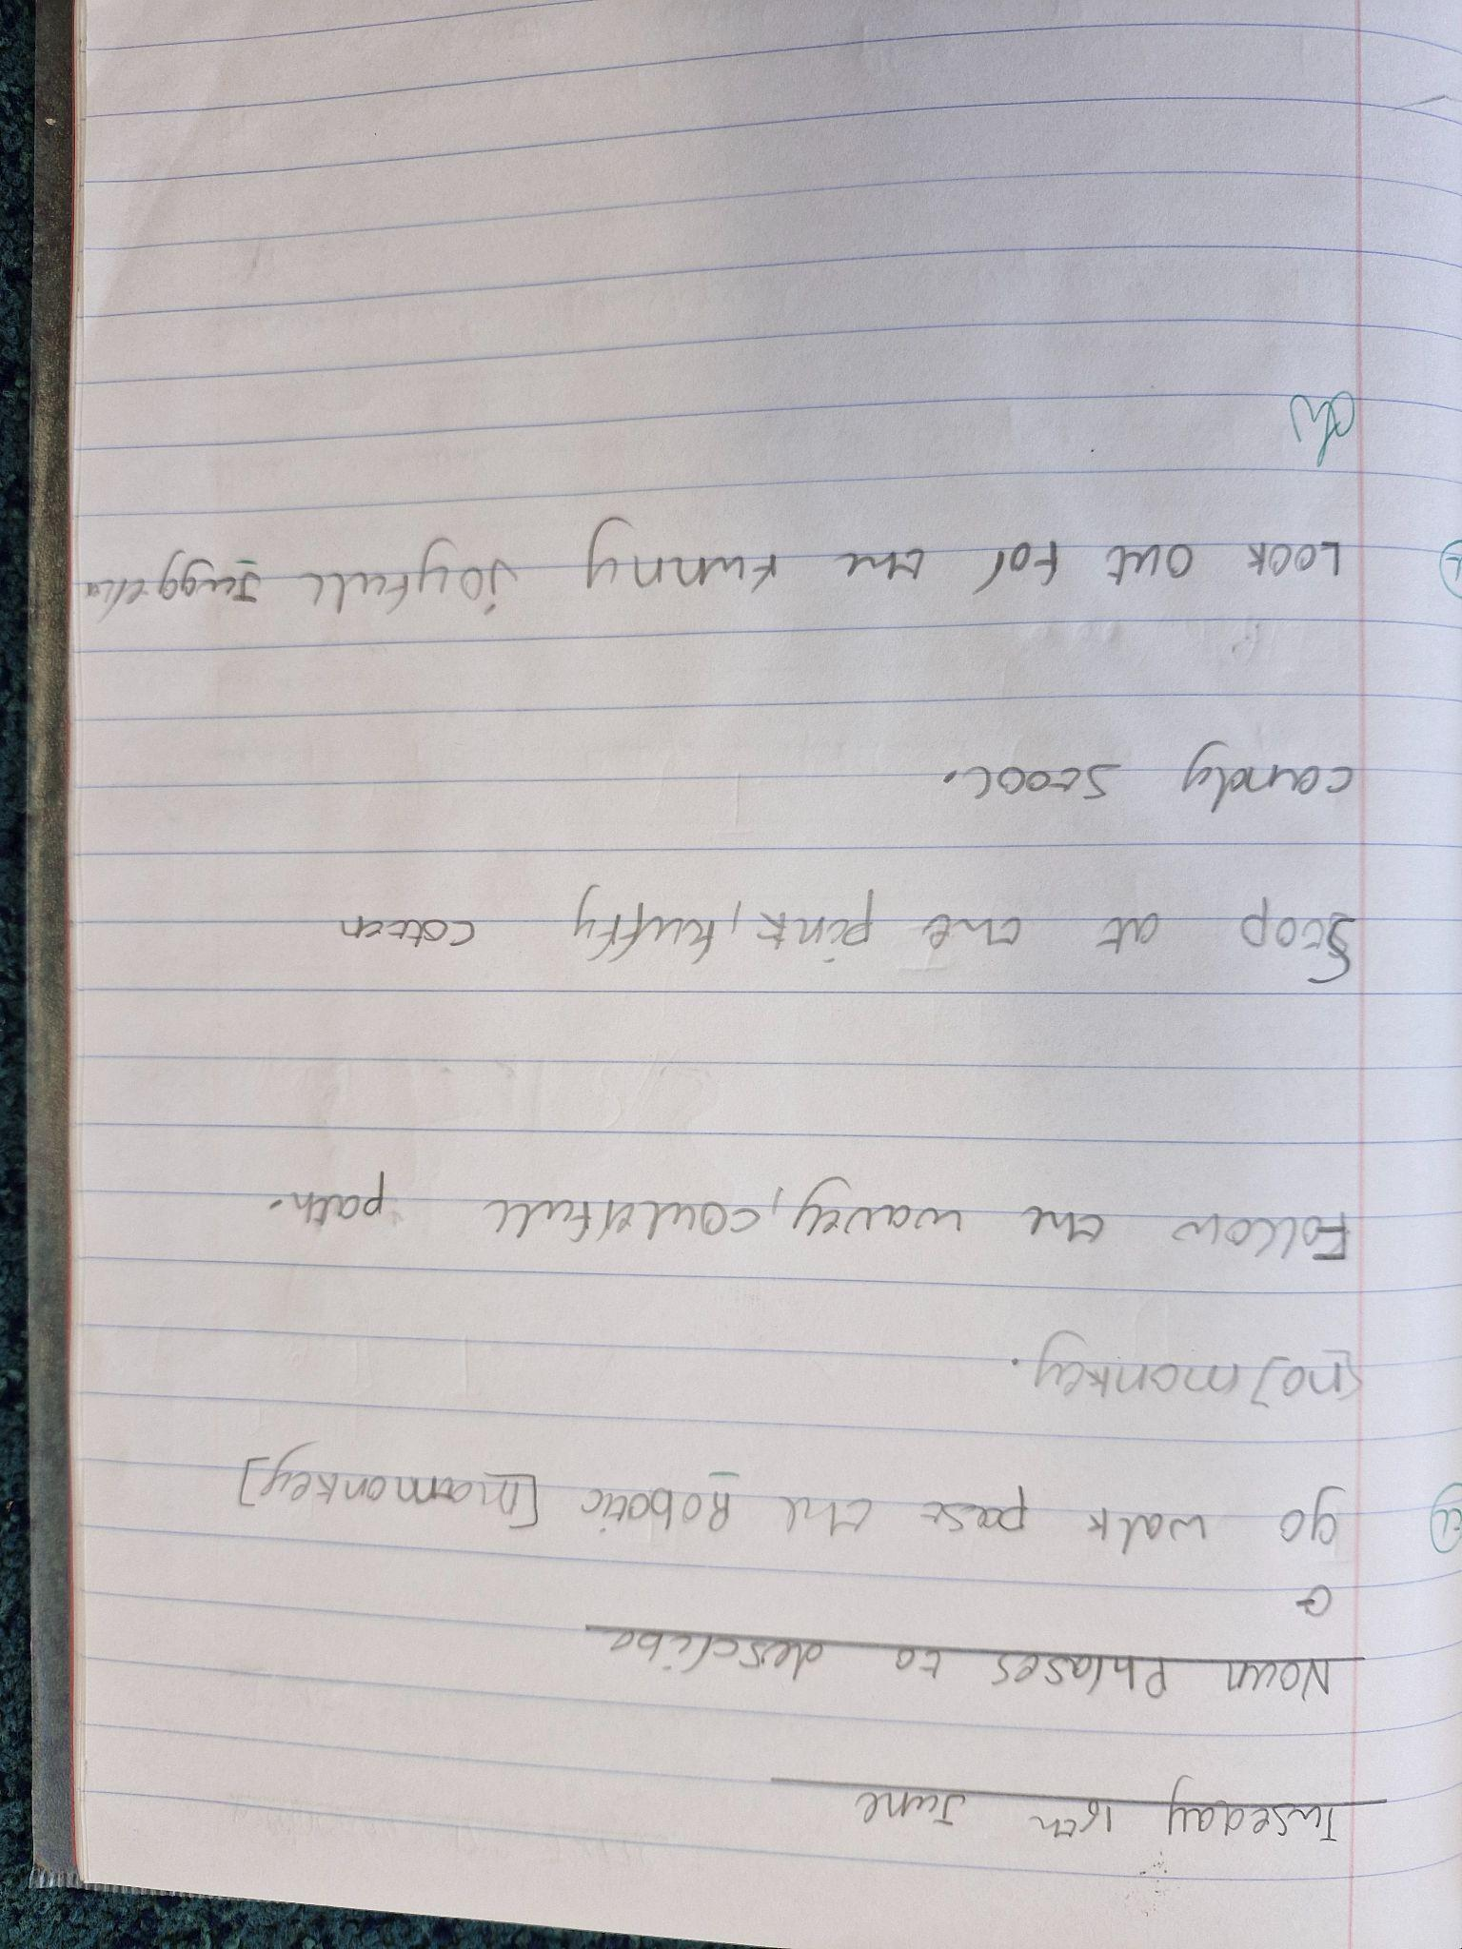
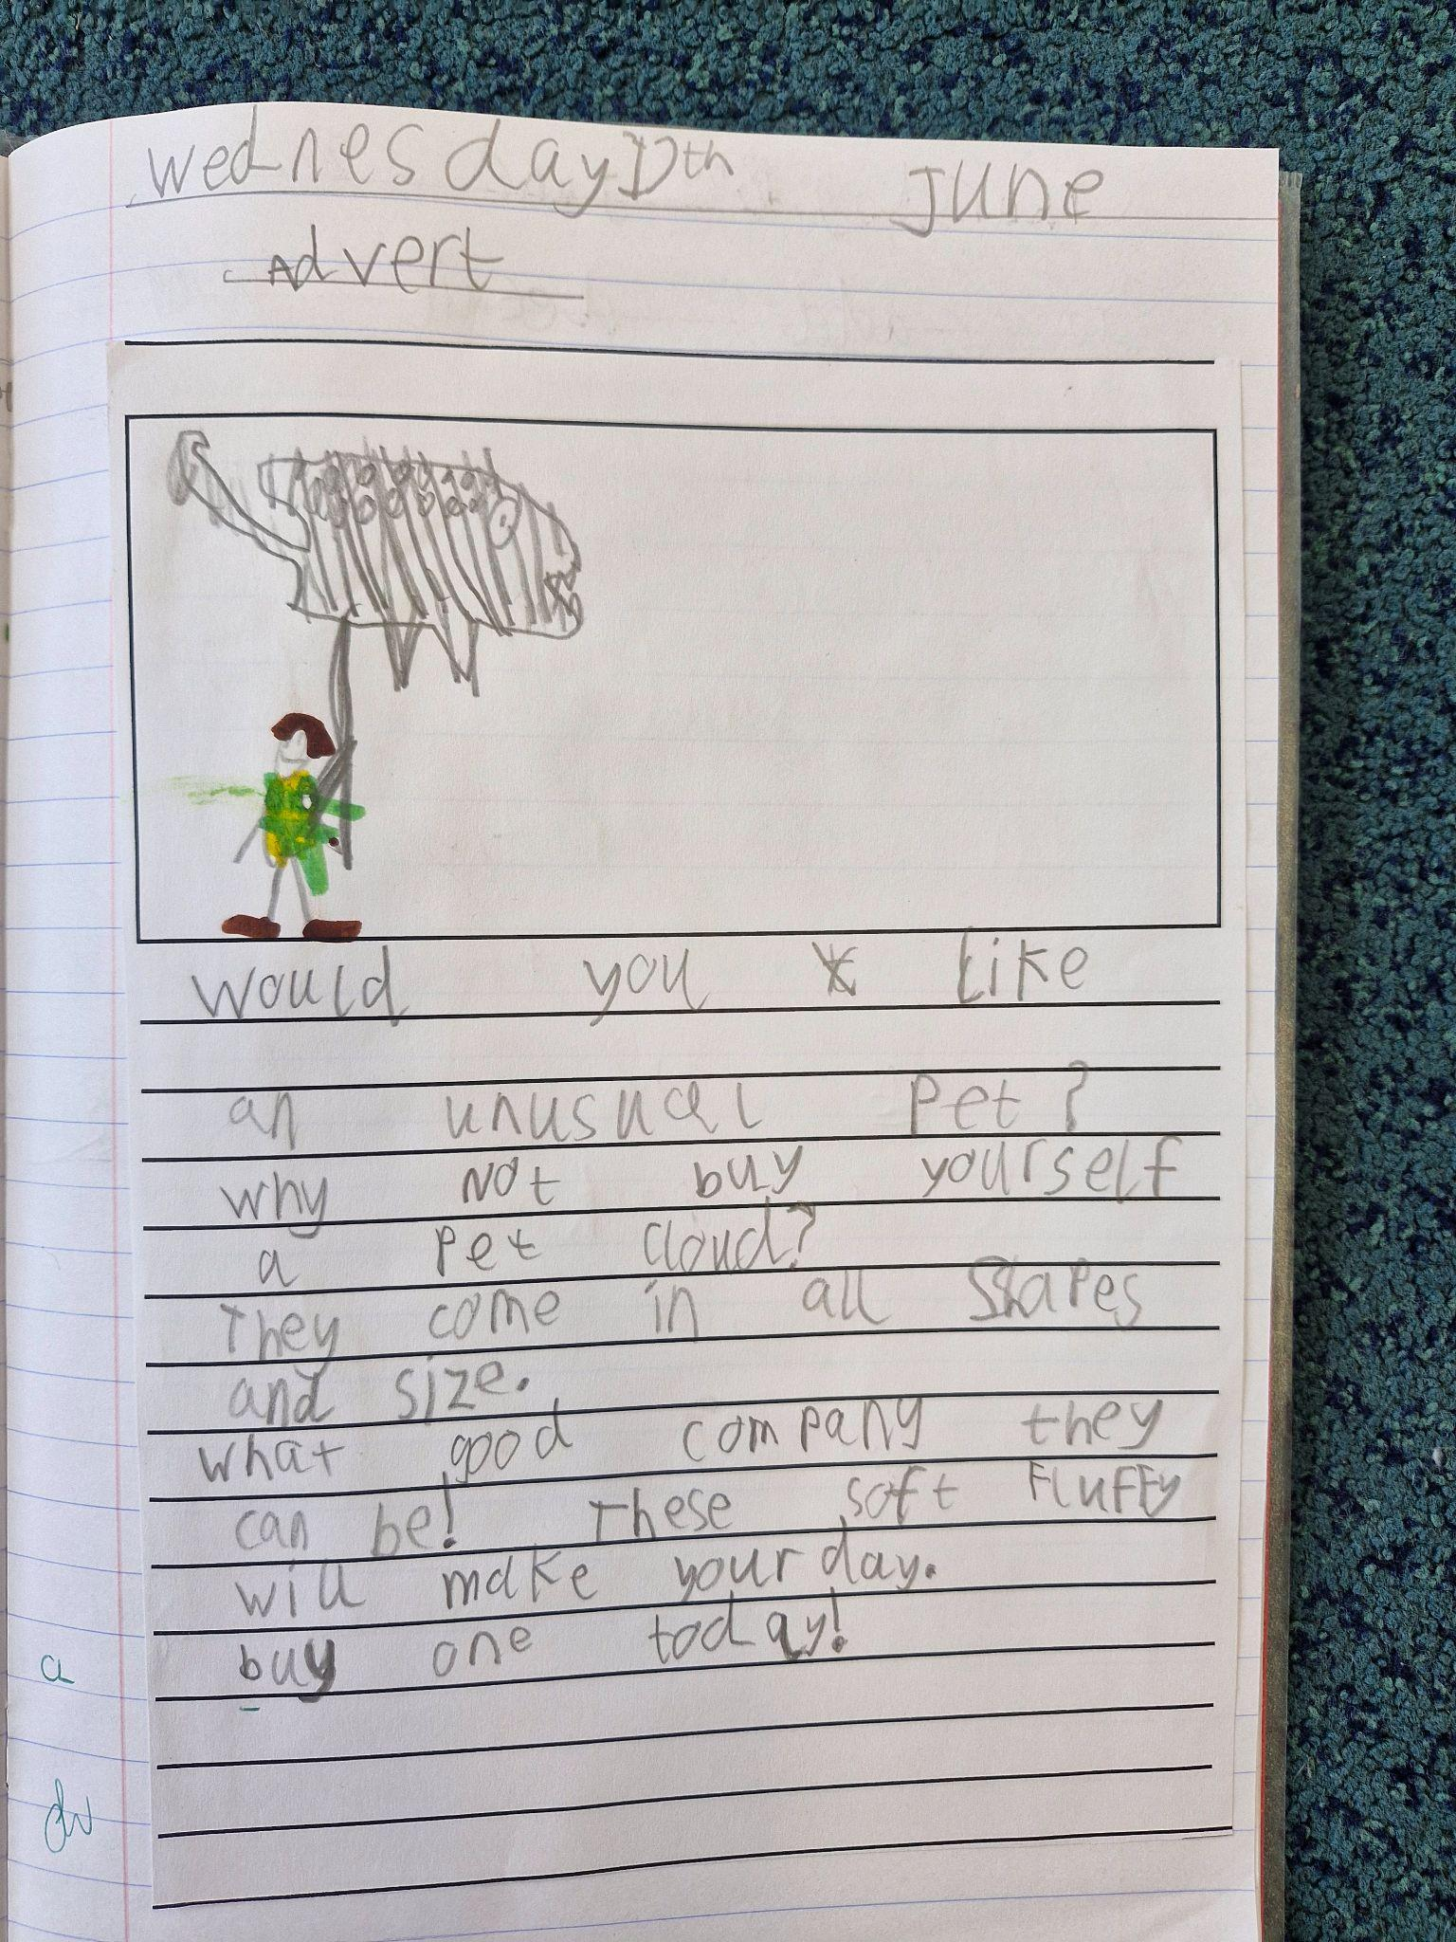
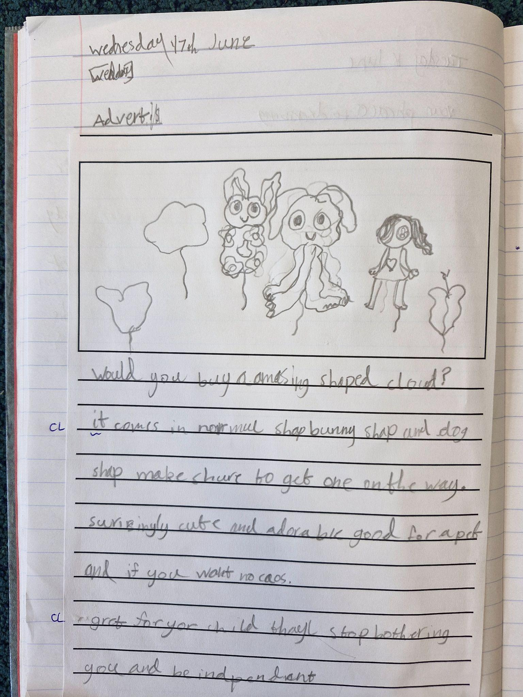

Year 2
This week, Year 2 had a mysterious box to open. Inside was….a cloud that needed looking after!
We have been thinking about what an unusual pet a cloud might be and how to convince others to buy one for themselves! They come in all sorts of shapes and sizes and are much more interesting than a boring old cat or dog.
Our next job is thinking about how to take care of our pet cloud properly and make sure it doesn’t float away.
Wish us luck…

Slide 3
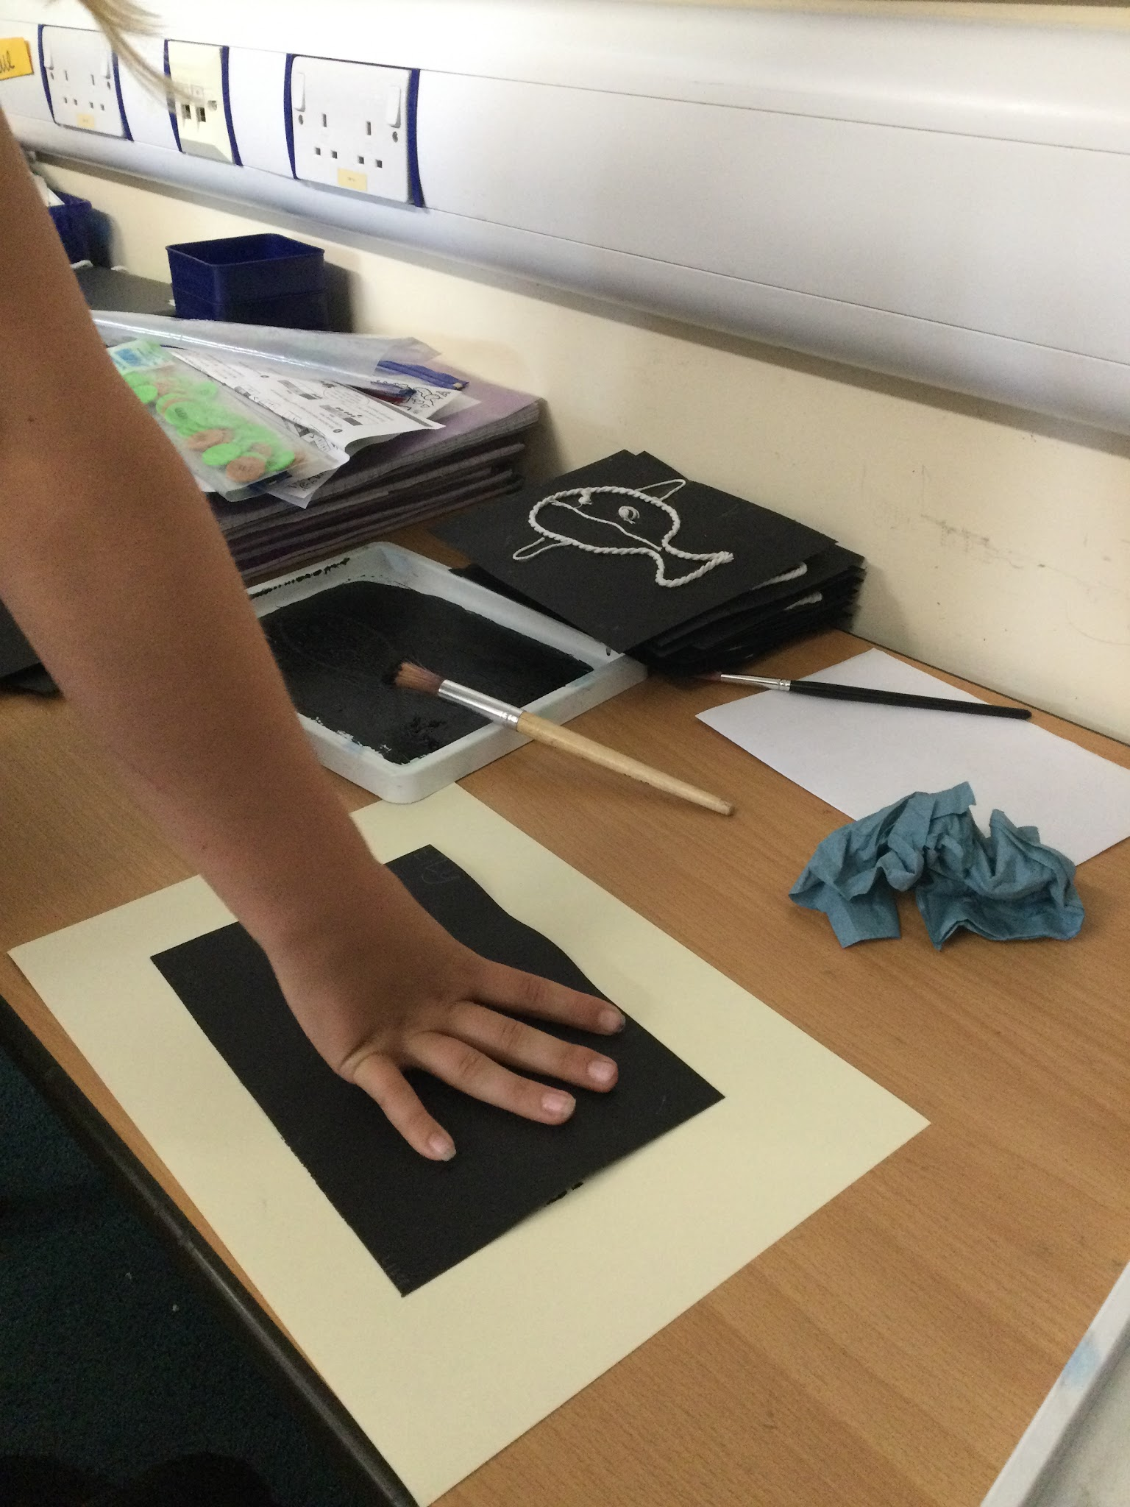
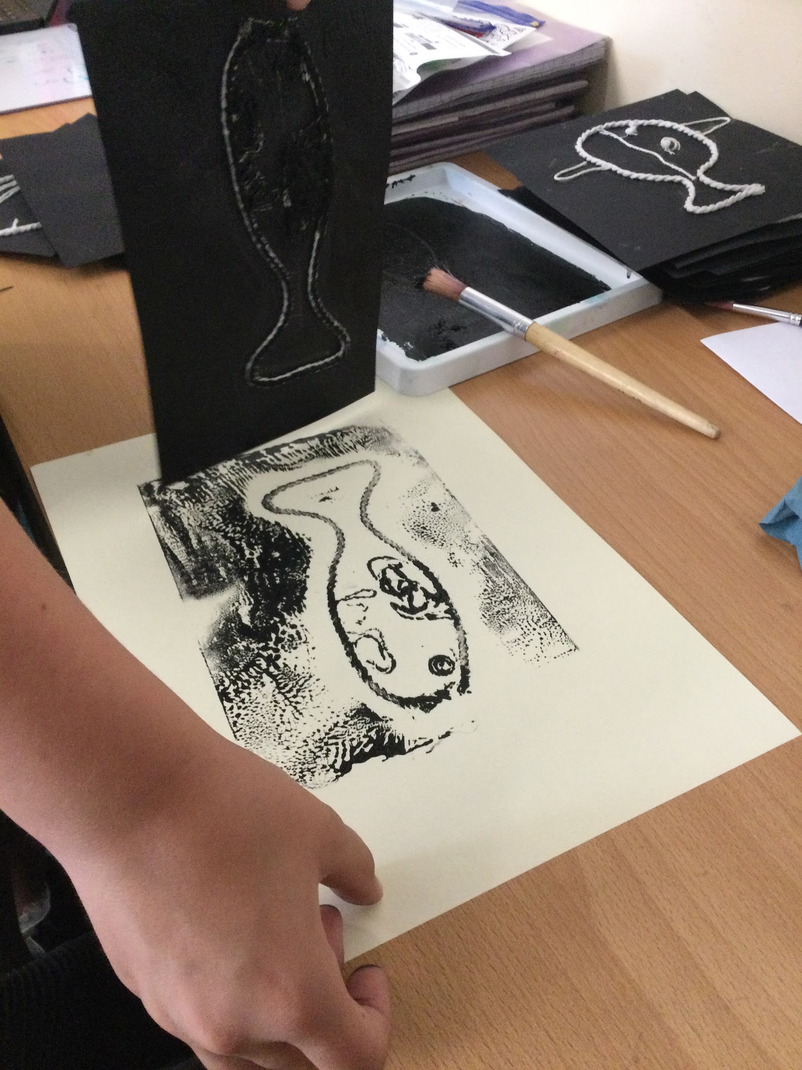
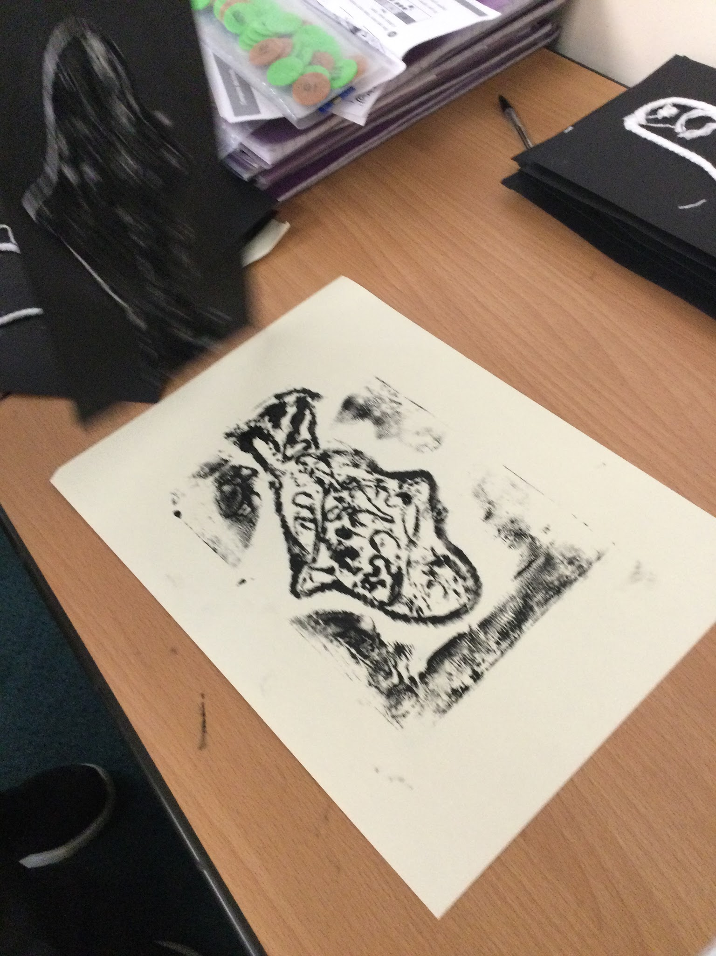
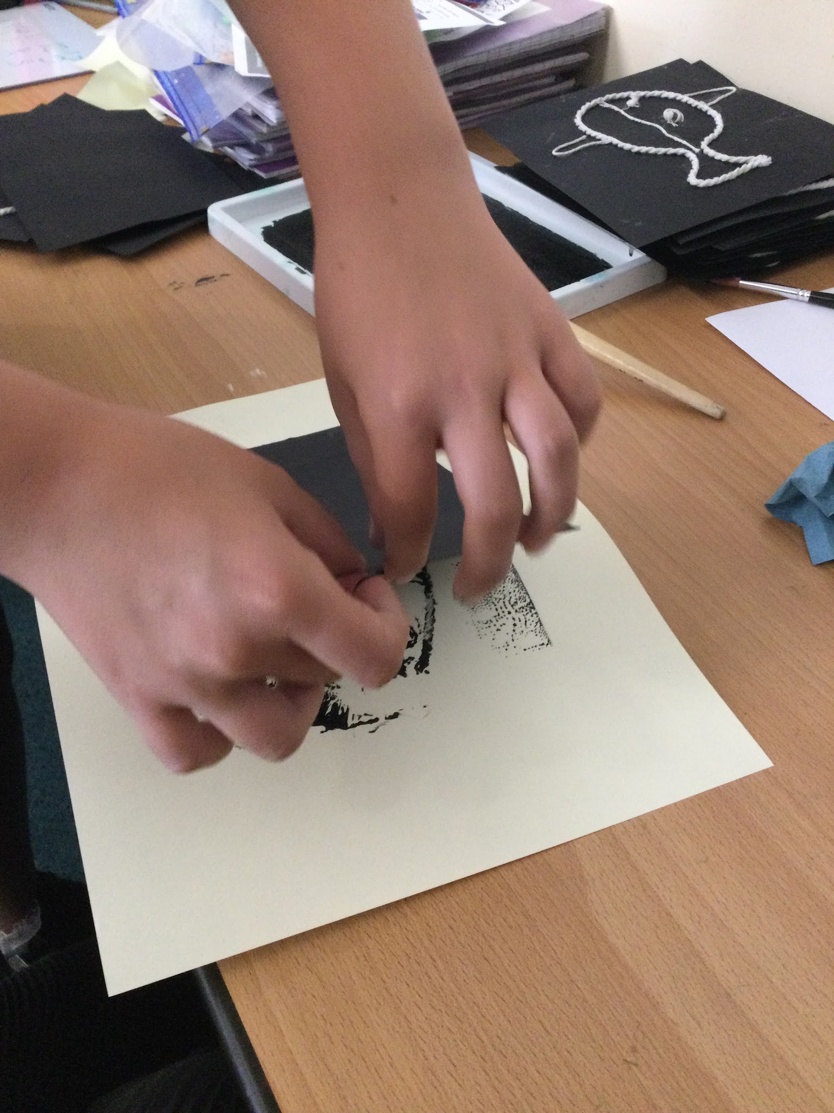
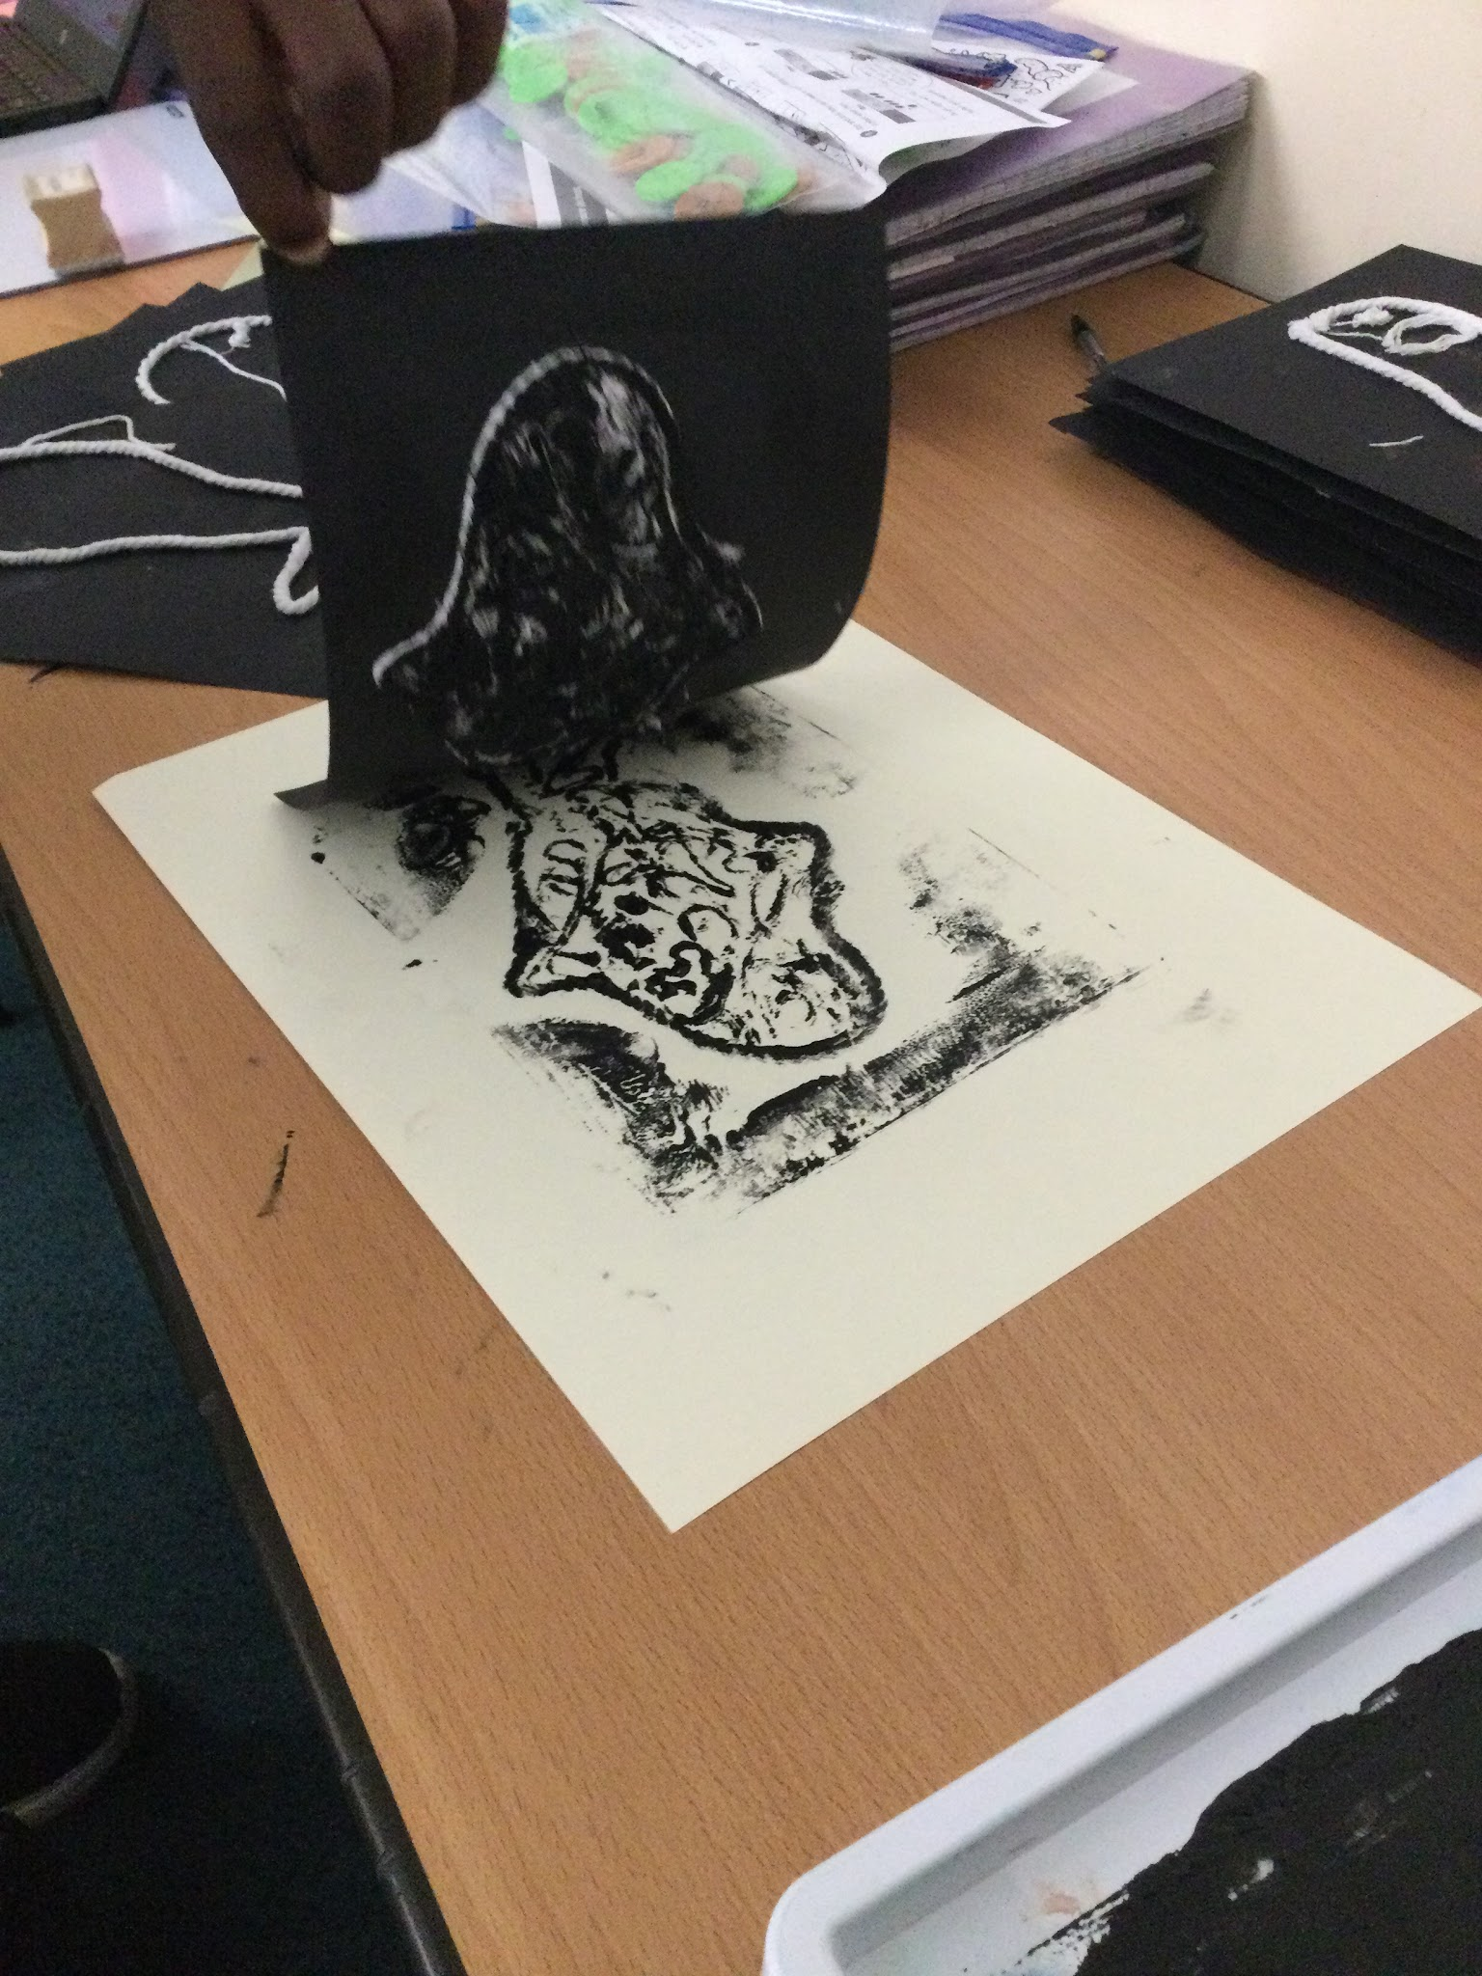
Year 4
In Year 4 this week we have been continuing our Art project on the theme of fish. We have been creating relief prints.
The children created their printing block on card and used the lino printing rollers and ink to create their print.
The results were very impressive!

Slide 4







Word Wizard Winners:
Year 3 - Class 7 (133,135)
Year 4 - Class 9 (277,377)
Year 5 - Class 11 (551,893)
Year 6 - Class 13 (491,906)
Mrs Witts recommends
Fred says ‘Well done’ to Miss Jones’ group you are working super hard on your speedy reading!
This is a lovely story about how the friendship of four boys evolves throughout their childhood, and as adults.
Mrs Owen recommends…

Slide 5

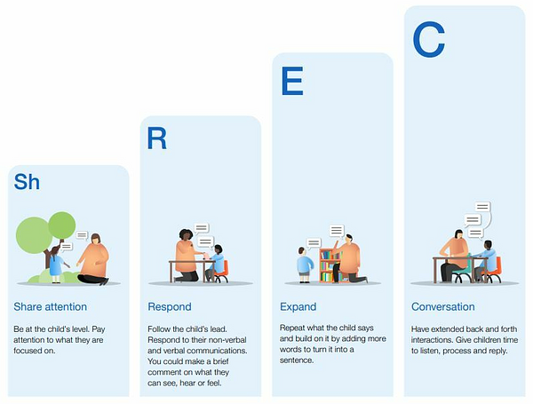
Cavalry are proud to be part of the Great Talking Project, an evidence-informed programme aimed at improving the language and communication skills of children. We will be sharing ideas for conversation starters, interactive reading and much more in our weekly newsletters from now on. Here’s a bit about the ShREC approach…
We are aiming for 97% attendance.
This week, our classes with the highest attendance are…
KS1 - Class 2 97.04%
KS2 - Class 9 97.24%
WELL DONE

Slide 6



Cavalry Food Festival week 22nd -26th June
Nursery Summer Festival Weds 24th June
1-2.30pm
Summer Fair Friday 26th June 3.30 - 5pm
Rec Vision Screening Tuesday 30th June
Swimming Gala Thursday 2nd July
Yr 3 Burwell House 8th - 10th July
Yr 1 Church Farm trip 2nd July
Summer Concert Wed 1st July 1:30-3pm
Jump up Day Wednesday 15th July 9.30-10.30
Reception trip to Sandringham 16th July
Sunshine is the best medicine!

Slide 7



Cavalry Website
Contact us:
Cavalry Primary School
Cavalry Drive
March
Cambridgeshire
PE15 9EQ
office@cavalryprimary.org
Tel: 01354 652814

