Slide 1
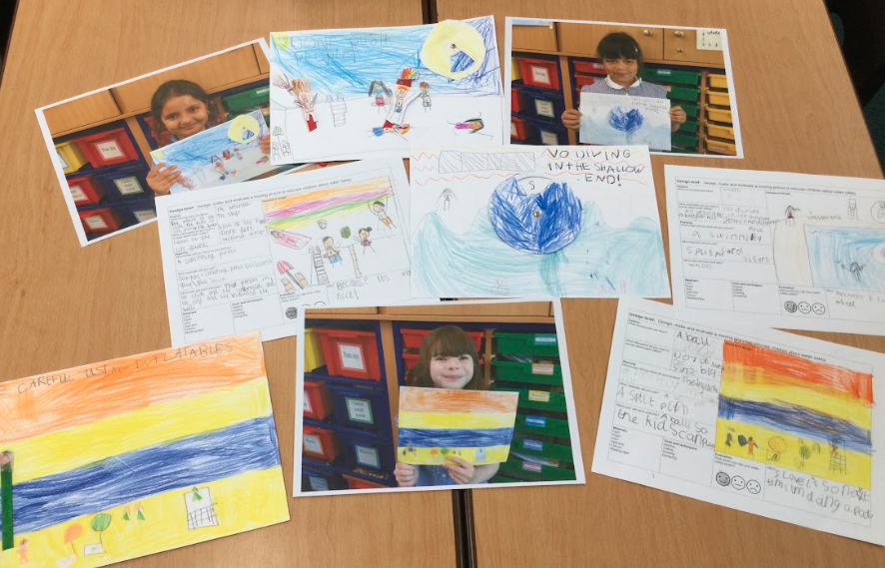
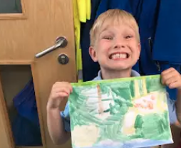
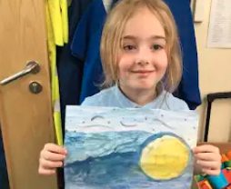
Cavalry Newsletter 20.05.2024
In Year 2:
We enjoyed learning about the creation story in RE and painting our own versions of each day.
We have also been making water safety posters including moving parts as part of our design project for summer.

Slide 2
In Year 3:
Year 3 ended the first half of the Summer Term with a very special event. After spending time with the amazing artist Rose Feather, the children were gifted with their very own book! This included all of the children’s original illustrations, written concepts, creative and imaginative ideas. They are incredible proud of this book as are we all!

Slide 3
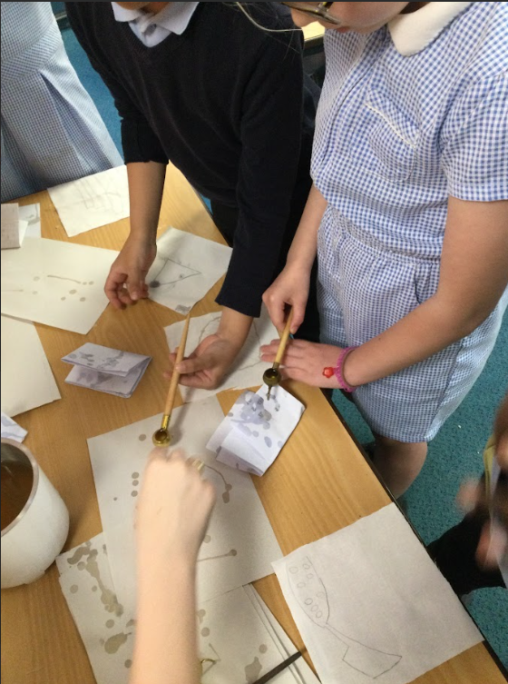
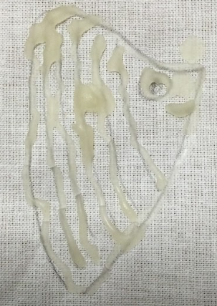
In Year 4 :
Last half-term in Art, year 4 had the opportunity to create their own fishy themed art using a technique called batik. Using melted wax and a tjanting tool, the children were able to create their own drawing.

Slide 4
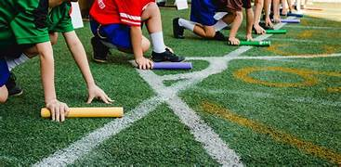
Our two sports days that have taken place so far have been a great success.
EYFS children thoroughly enjoyed their first experience of sports day and competed in all their events with great enthusiasm.
KS2 children competed in a very competitive event where children showed great athleticism and determination. After counting the scores, the trophy went to Clydesdales - a big congratulations to them.
We thank all of the adults that attended the two events as it created such a lovely atmosphere for all of us to be a part of.
Join us Tuesday 4th June for the KS1 sports day.

Slide 5
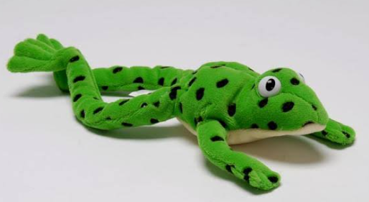
Have you read….?
Class 9 have really enjoyed…
Reading news:
Brilliant Books:
Class 6 have loved reading
Word Wizards:
This week the classes with the most ‘accurate quizzes’ in Y4/5/6 were:
Class -
Class -
Class -
Fred says ‘fantastic work!’ to all the children in Mrs Mann’s phonics group. The children are writing more and more independently. We couldn’t be more proud of their work!

Slide 6
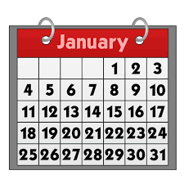
Dates for your calendar:
Monday 3rd June- BACK TO SCHOOL
Year 6 to visit Fire Station- Thursday 6th June
Phonics Screening Check- Wk beg. 14th June
Year 4 Legend of the Fens- Tuesday 18th June
Year 4 Author Visit- Friday 21st June
Summer Fair- Saturday 29th June
Year 6 Create Day with the Royal Opera House- Tuesday 2nd July
Summer Music Concert- Thursday 4th July
Year 6 Leavers Event- Friday 5th July
Reports Home- Tuesday 9th July
Year 3 Residential to Burwell- Wednesday 10th-12th July
Meet your new Teacher- Monday 15th July
Community Council- Monday 15th July
Last day of term- Friday 19 July 2024
All term dates for 2024 and 2025 are available on the school website. Please remember that holidays in term time are not authorised unless there are very exceptional circumstances and you may receive a penalty notice if your child misses school.

