Slide 1



5th June 2026
  Growing minibeasts
  Travelling by train
  Duxford trip

Slide 2

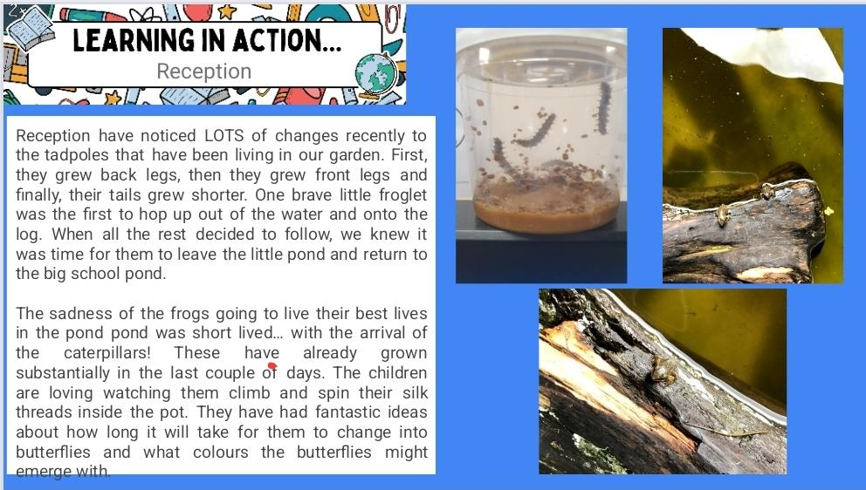
Reception

Slide 3
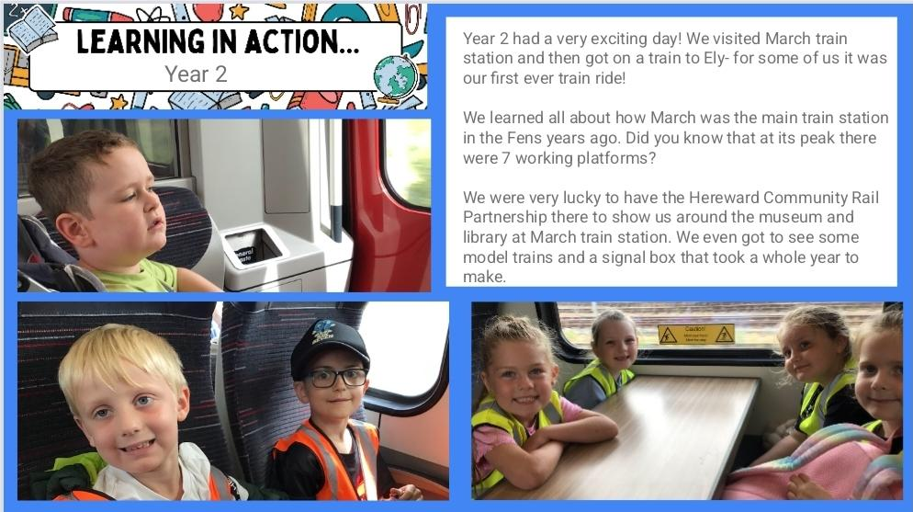
Year 2

Slide 4
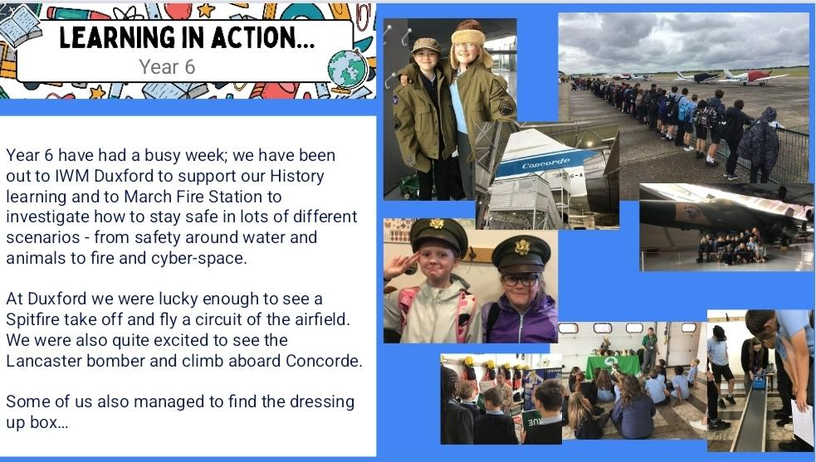
Year 6

Slide 5







Word Wizard Winners:
Year 3 - Class 8
Year 4 - Class 10
Year 5 - Class 11
Year 6 - Class 13
Mrs Wilson recommends The Boy Who Loved Maps by Kari Allen.
The Mapmaker loves maps. But when a girl asks for a map of a perfect place, the Mapmaker is perplexed. She wants a map to a toes-in-the-sand-warm, X-marks-the-spot-place filled with treasures, where it smells like her birthday and she can zip around like a dragonfly. Surely, a place that is all of these things can't exist...can it? Well, after a fun-filled day of exploring the neighborhood, the Mapmaker will discover that the perfect place--home--has been right in front of him all along.
Fred says ‘Well done’ to Mrs Banks’ group who are working hard to learn their special friends and read them in words!
Mr Brown recommends…

Slide 6

We are aiming for 97% attendance.
This week, our classes with the highest attendance are…
KS1 - Class 6 100%
KS2 - Class 7 95.91 %
WELL DONE

Slide 7



KS2 Sports Day Weds 10th June 1.45-3pm
Nursery/ Rec Sports Day Thurs 11th June
2.15-3pm
KS1 Sports Day Friday 12th June 2.15-3pm
Cavalry Food Festival 22nd -26th June
Nursery Summer Festival Weds 24th June
1-2.30pm
Summer Fair Friday 26th June 3.30 - 5pm
Rec Vision Screening Tuesday 30th June
Swimming Gala Thursday 2nd July

Slide 8



Cavalry Website
Contact us:
Cavalry Primary School
Cavalry Drive
March
Cambridgeshire
PE15 9EQ
office@cavalryprimary.org
Tel: 01354 652814

