Slide 1



8th May 2026
  A magic bed
  Vikings and archaeologists
`

Slide 2

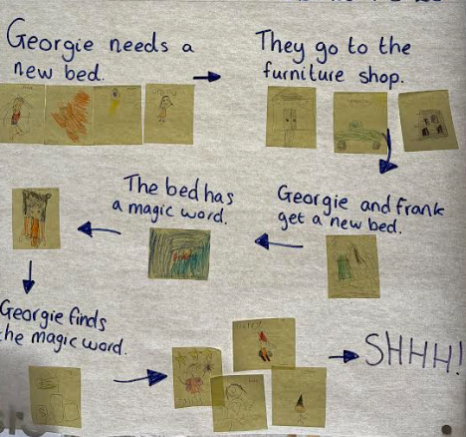
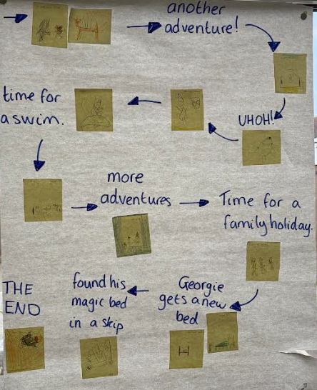
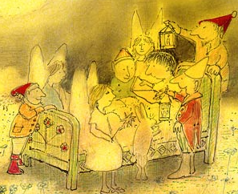
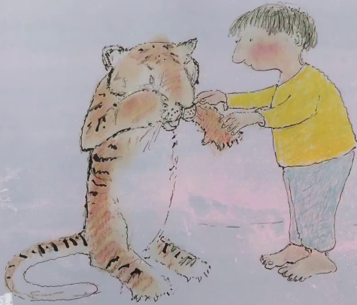
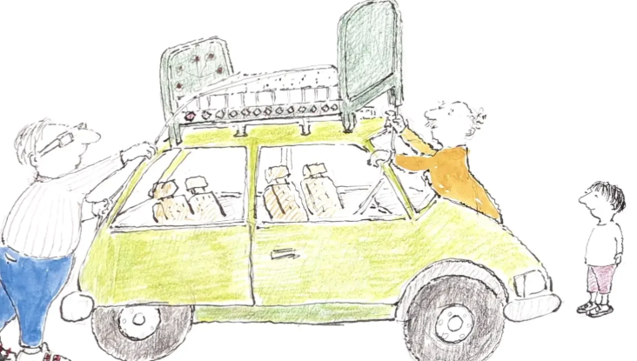
Year 1
The story The Magic bed has really captured the children of year 1s imagination. They have been thinking creatively about where a magic journey couldn take them. The class have enjoyed exploring the different adventures in the story and have been talking about their favourite part. During our lessons this week the children re told the story and drew their own pictures to go along with it.
Over the next few weeks the children will be writing their own magical story!

Slide 3
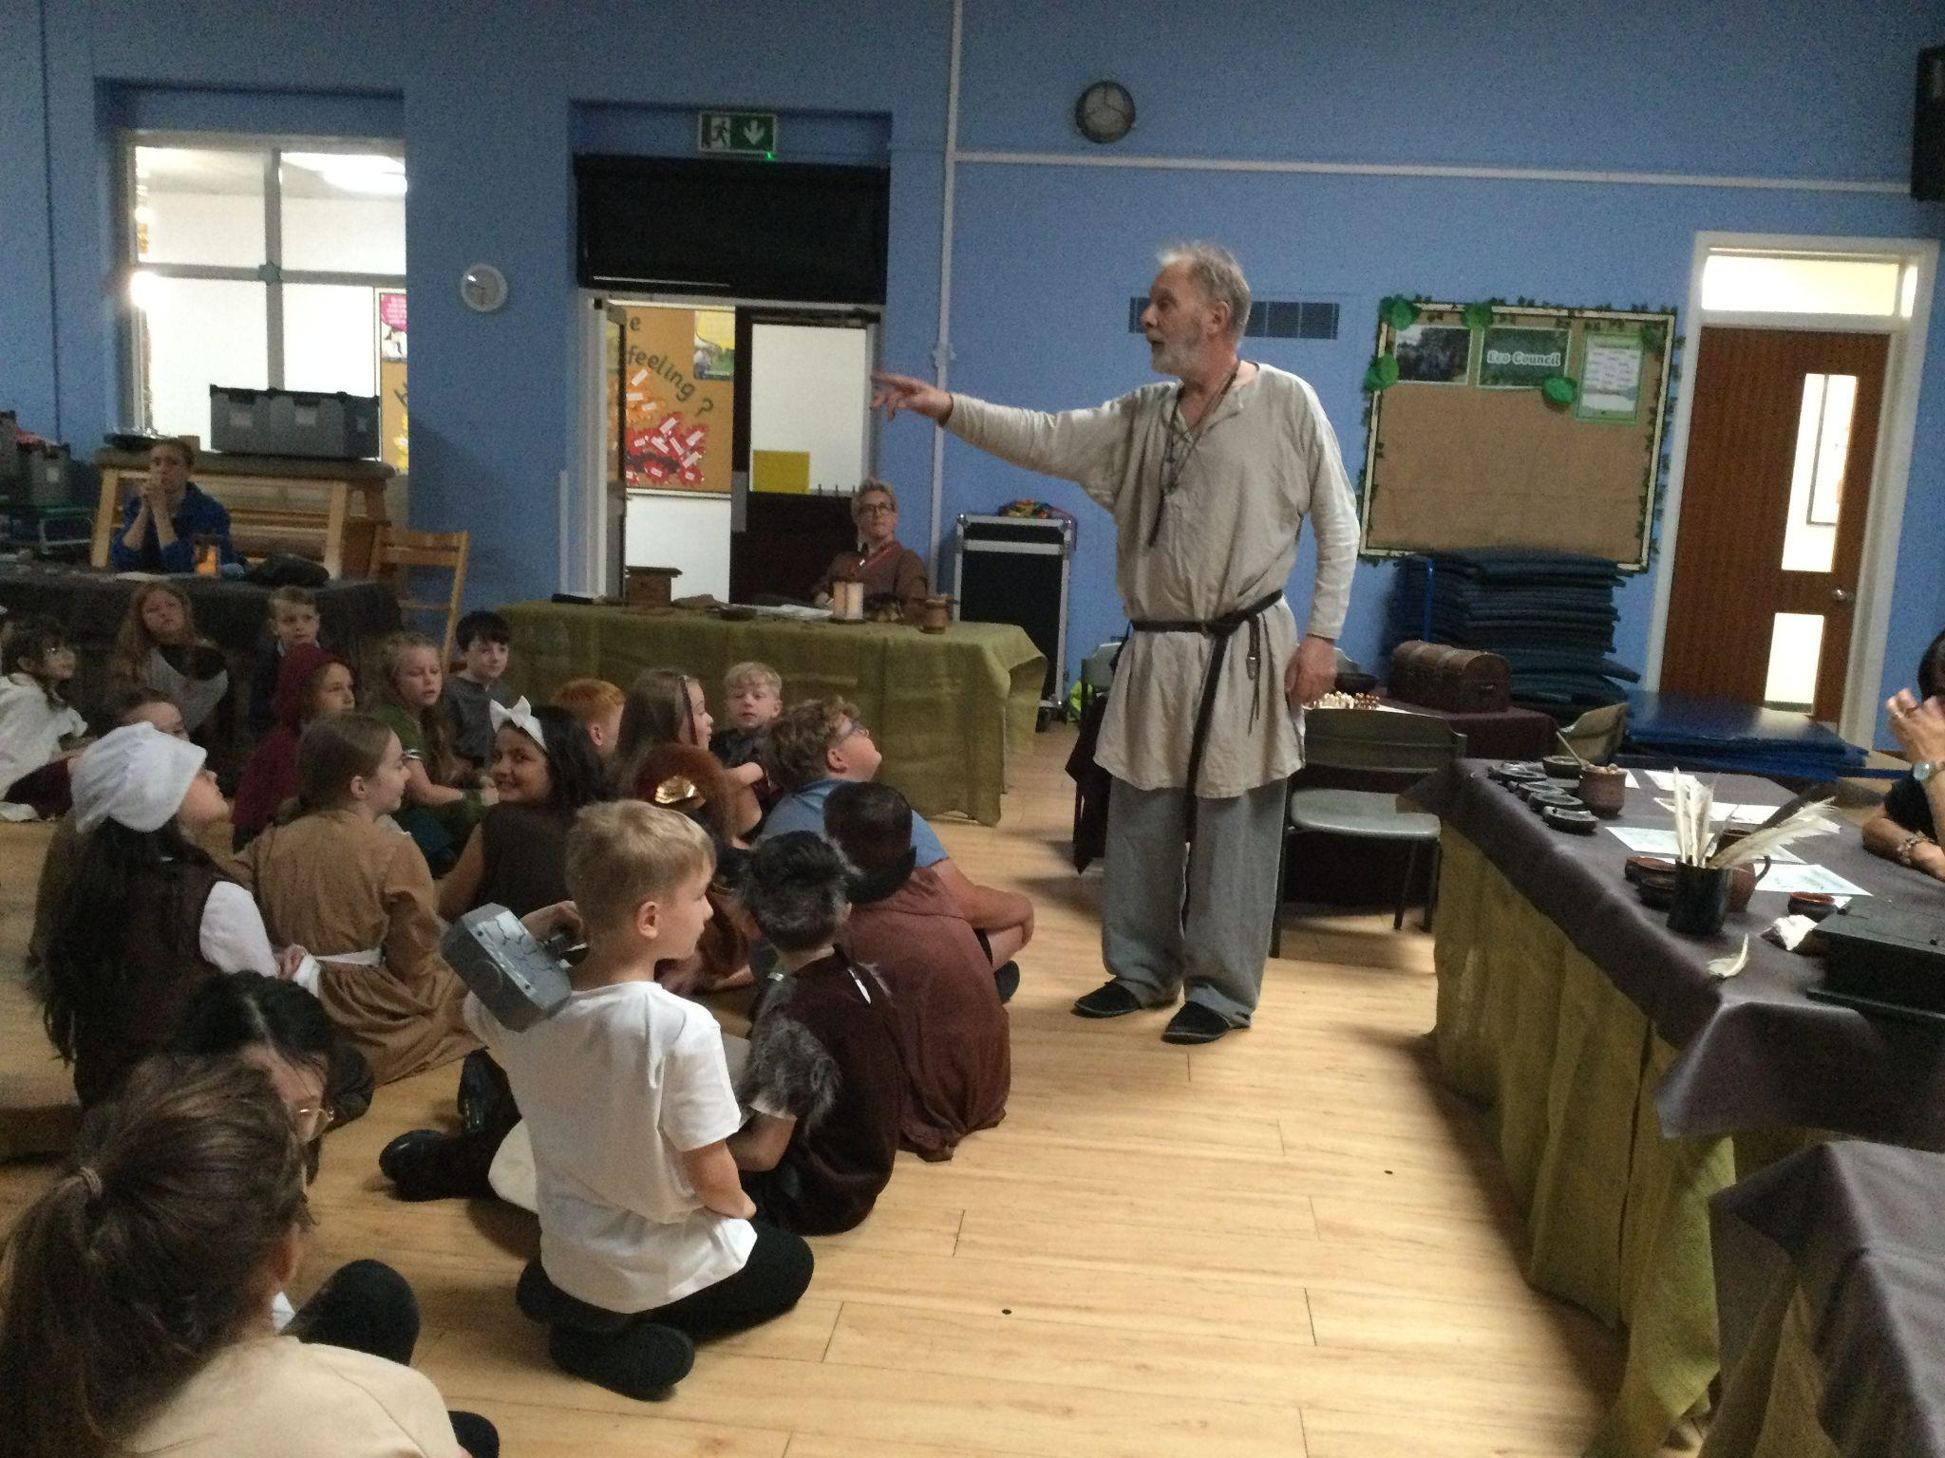
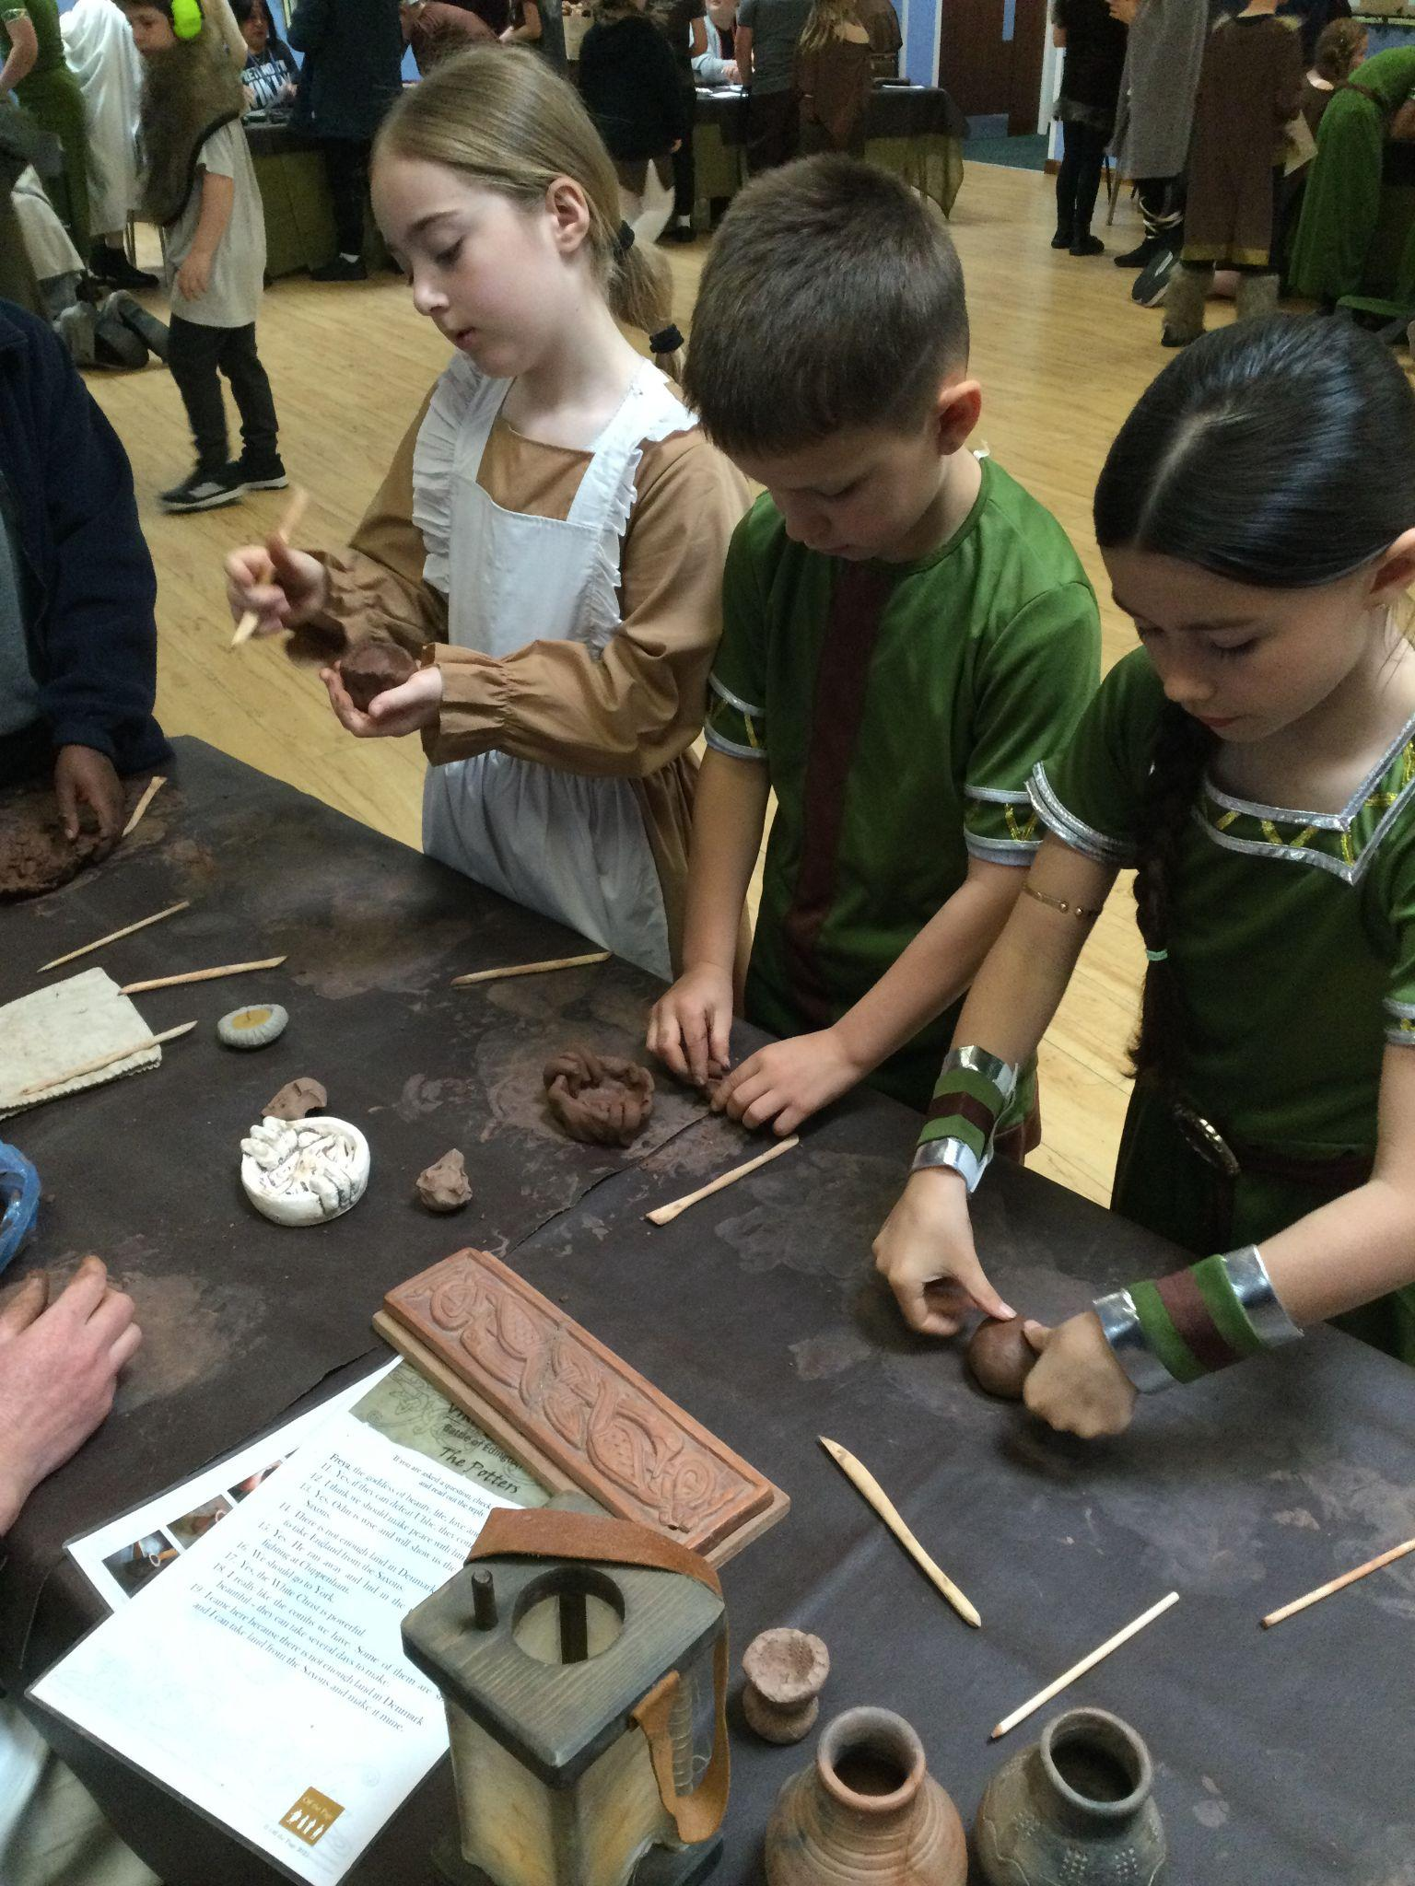
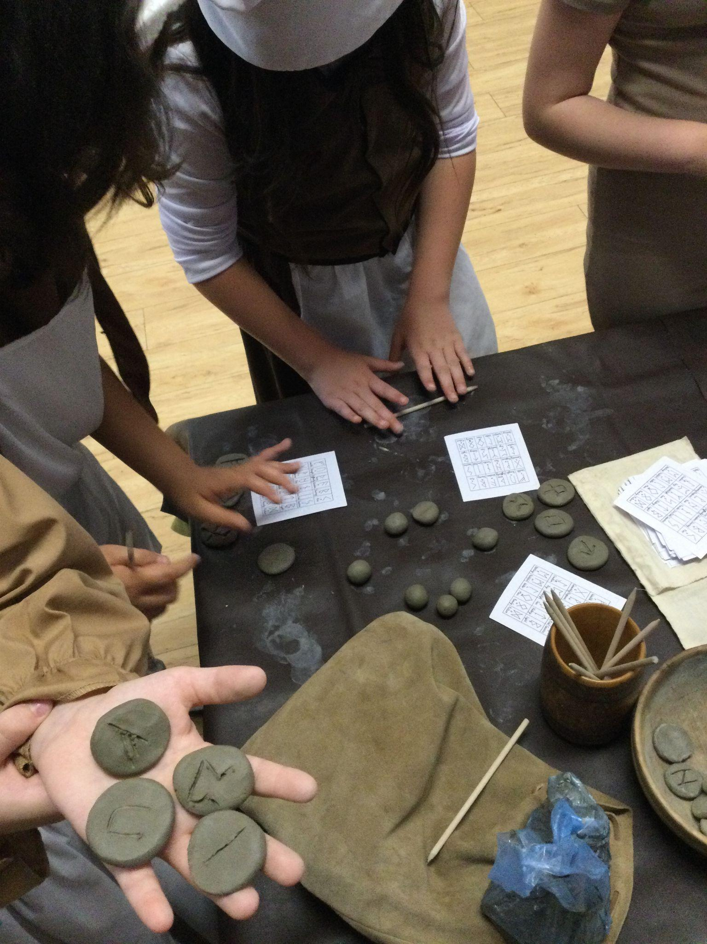
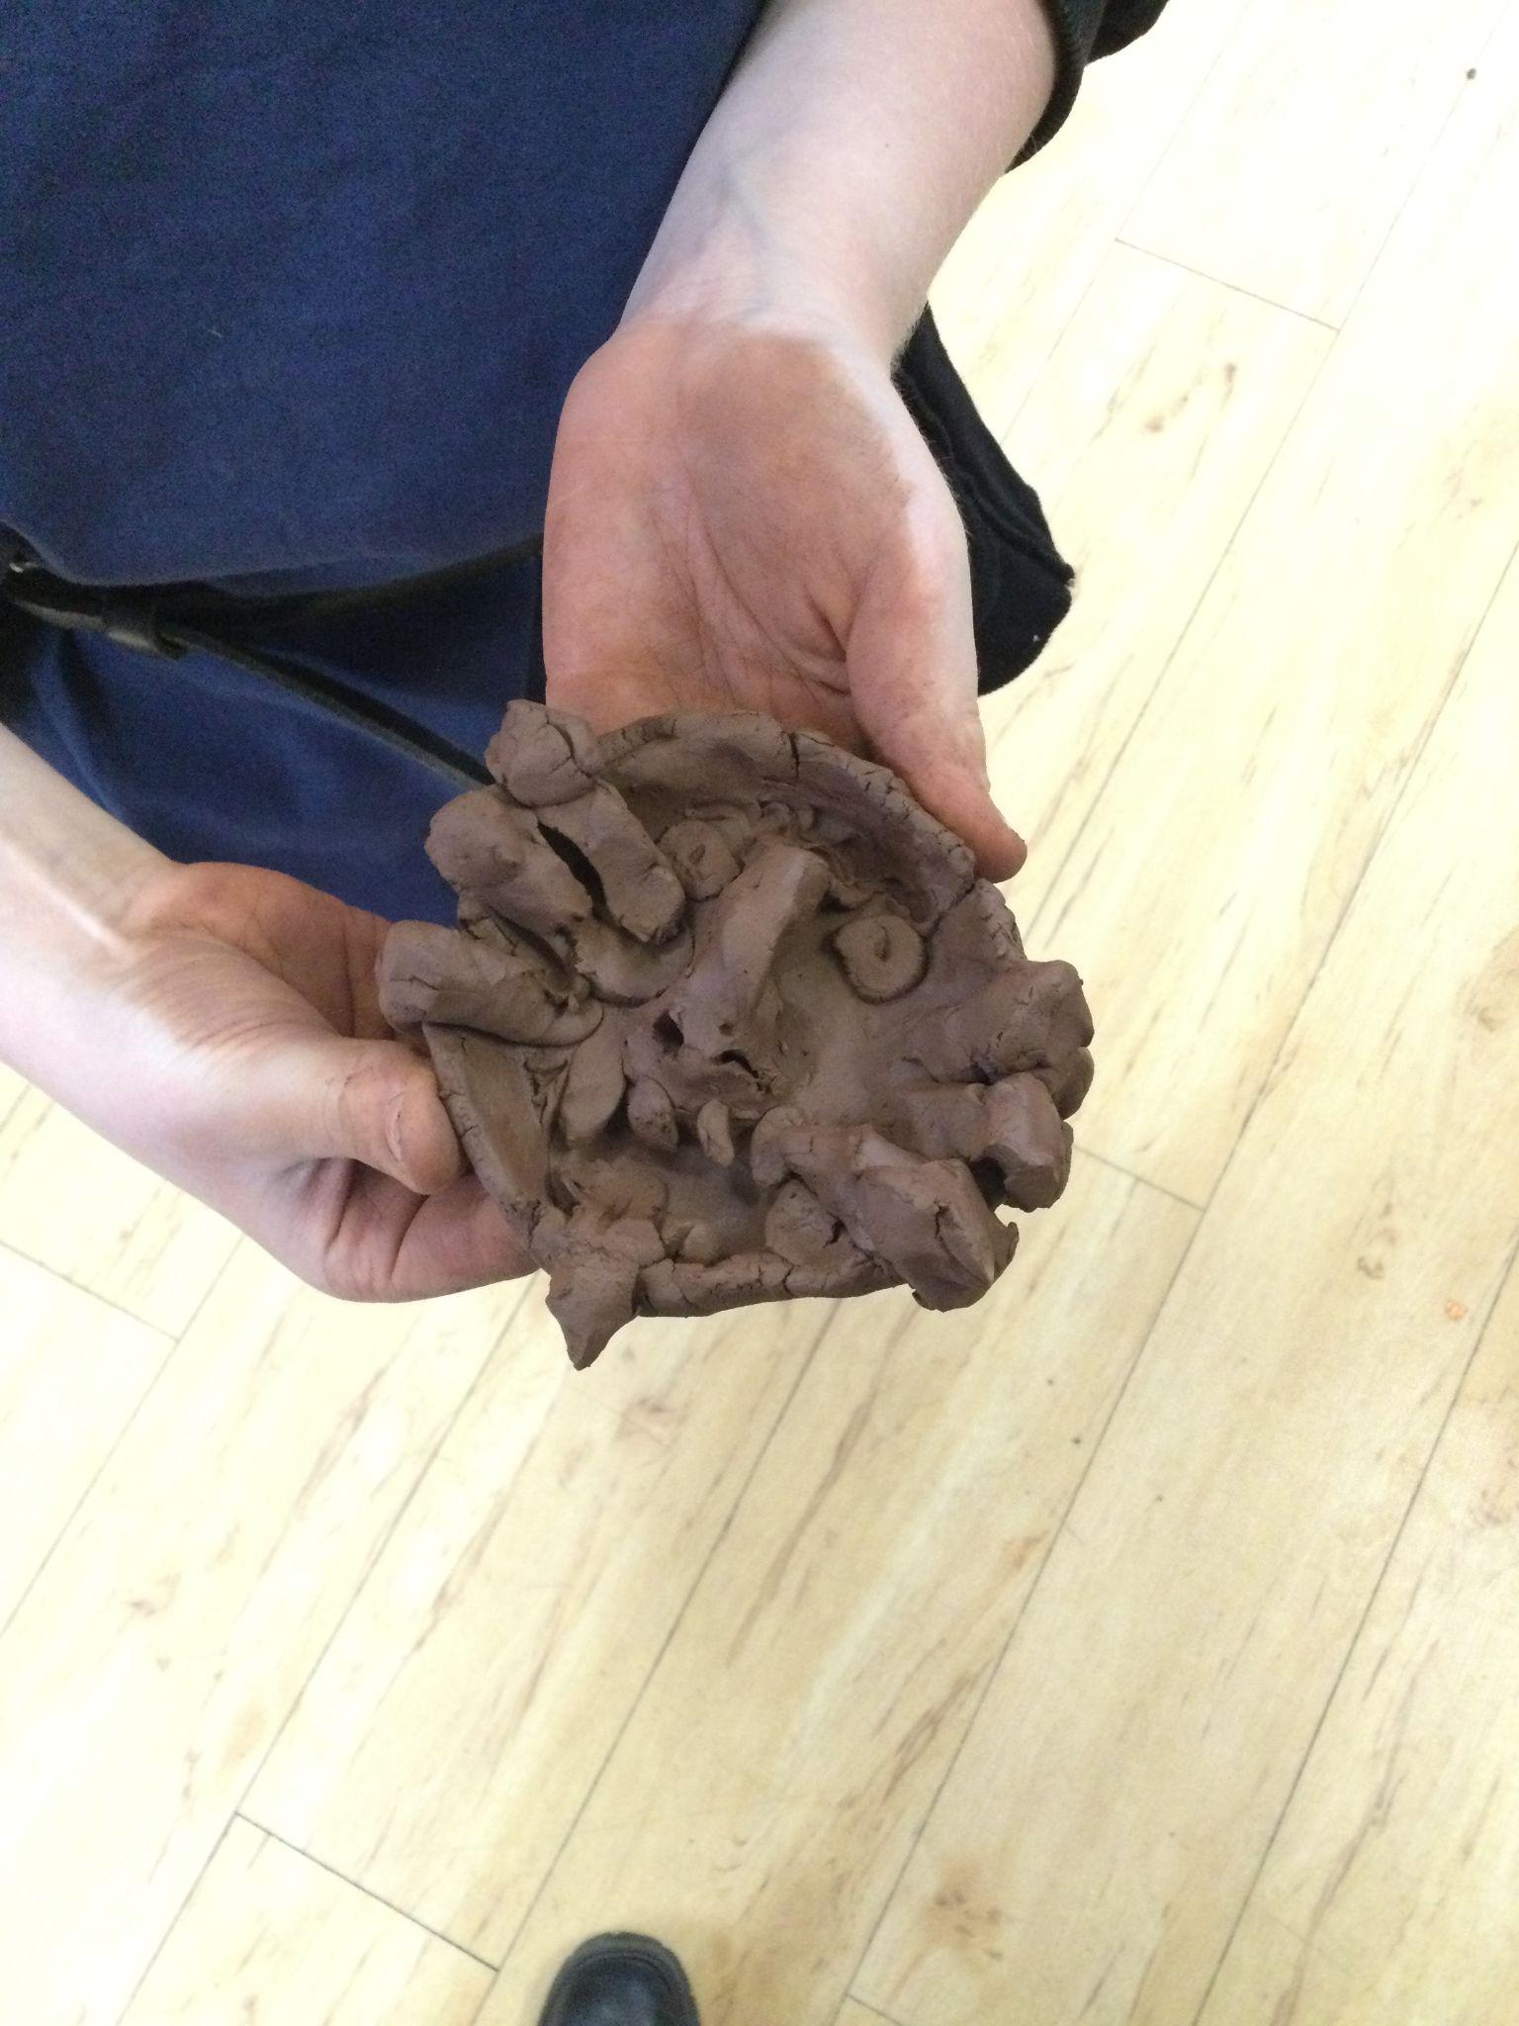
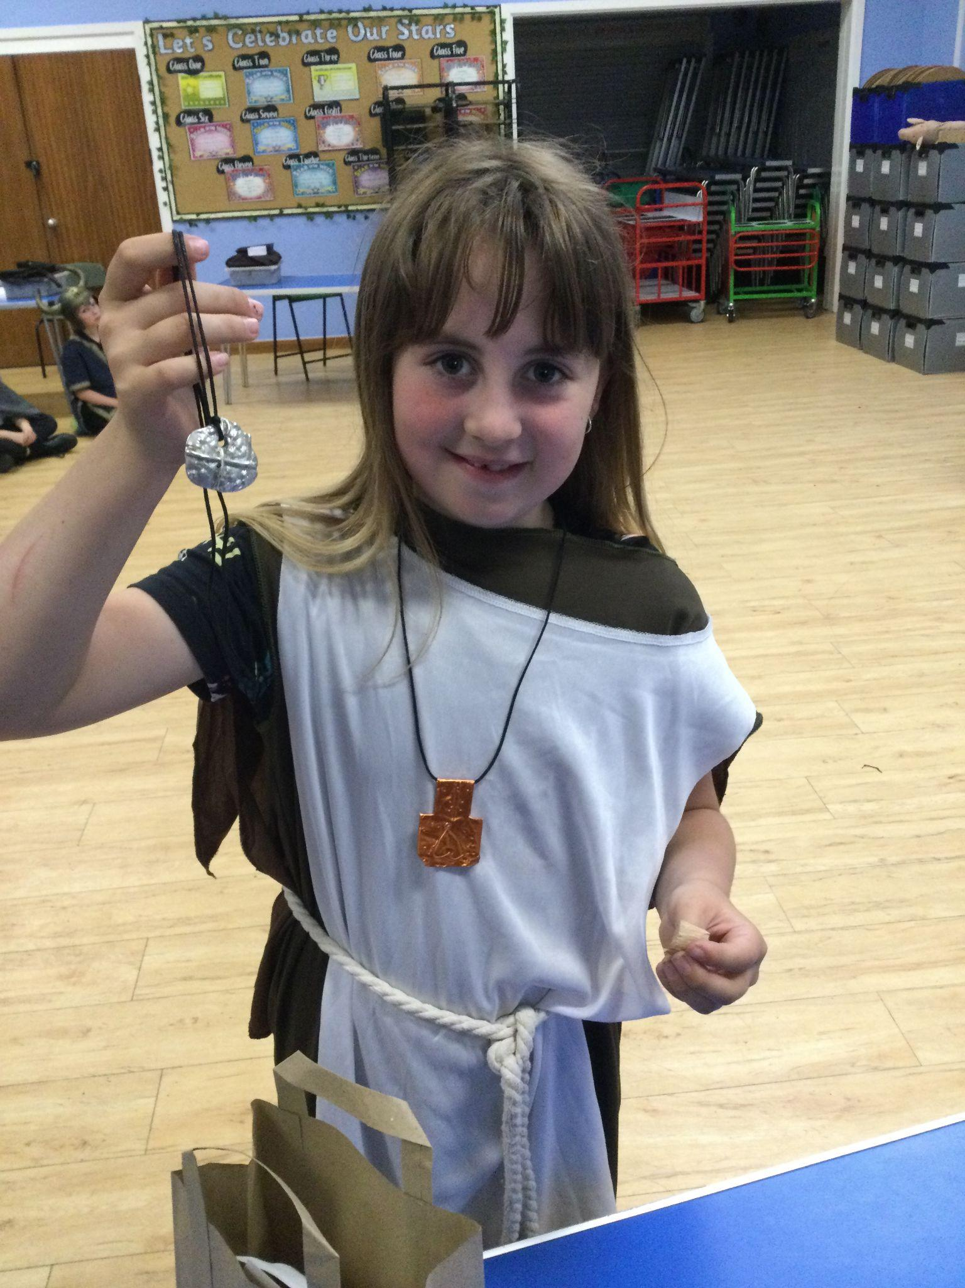
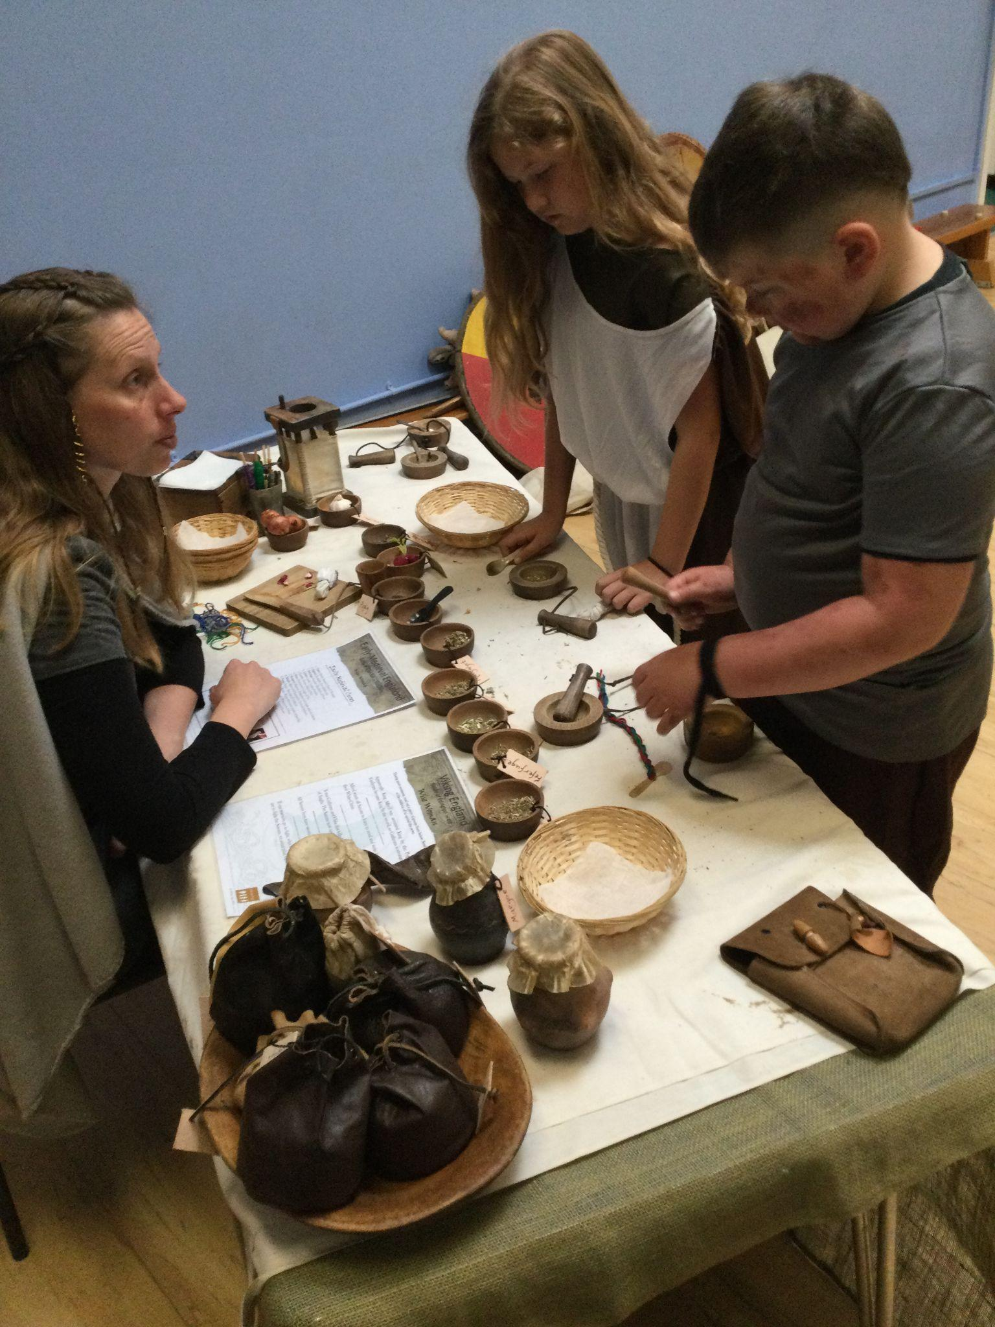
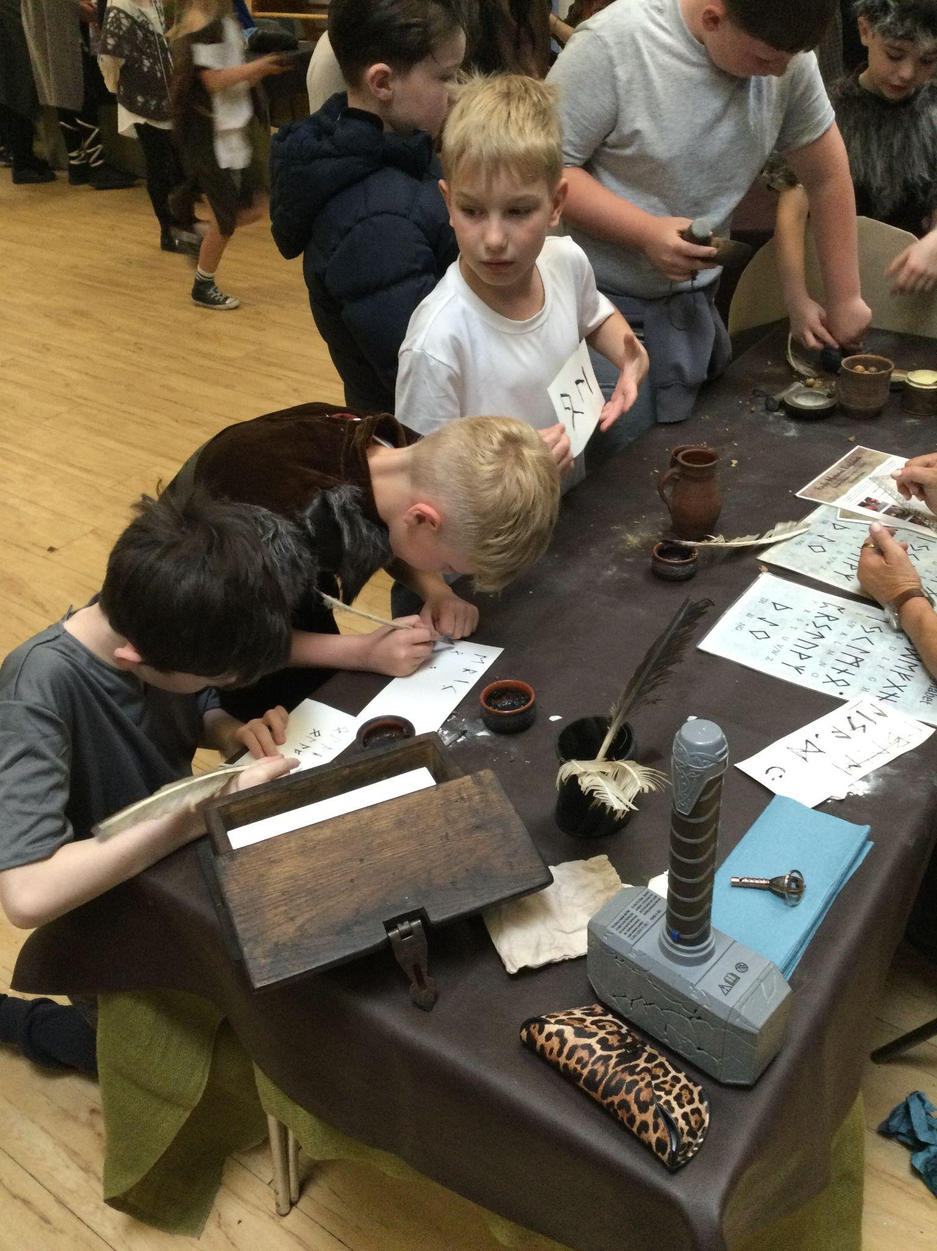
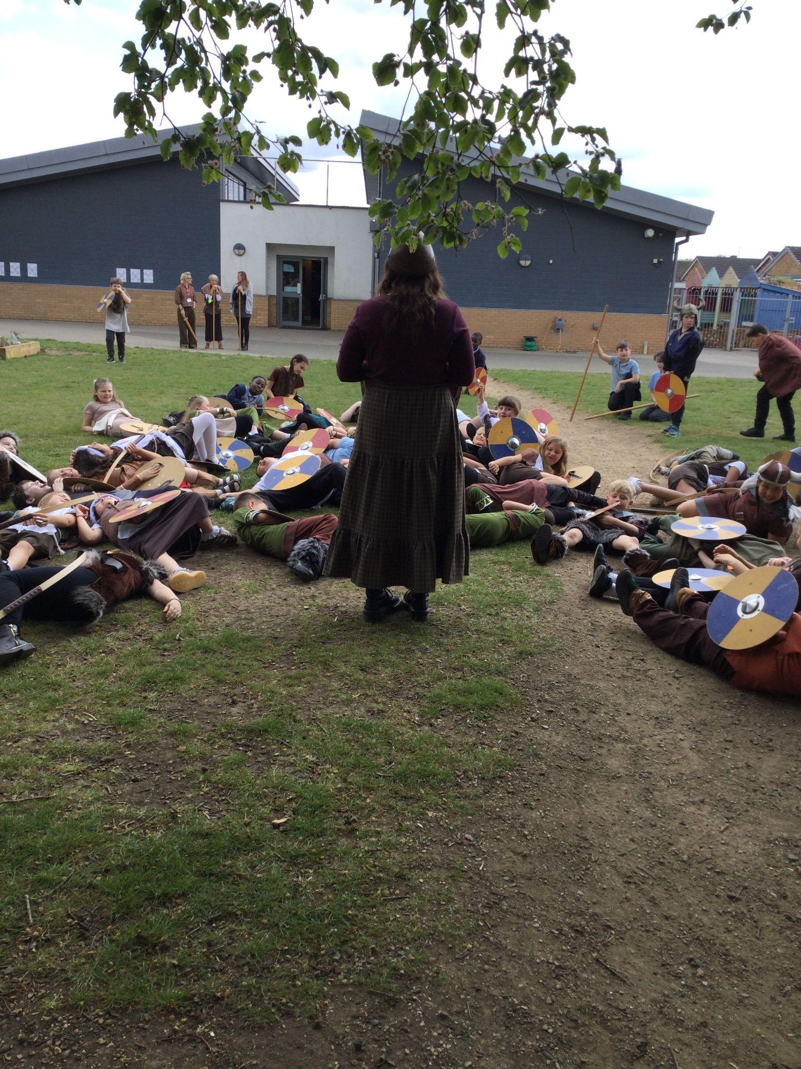
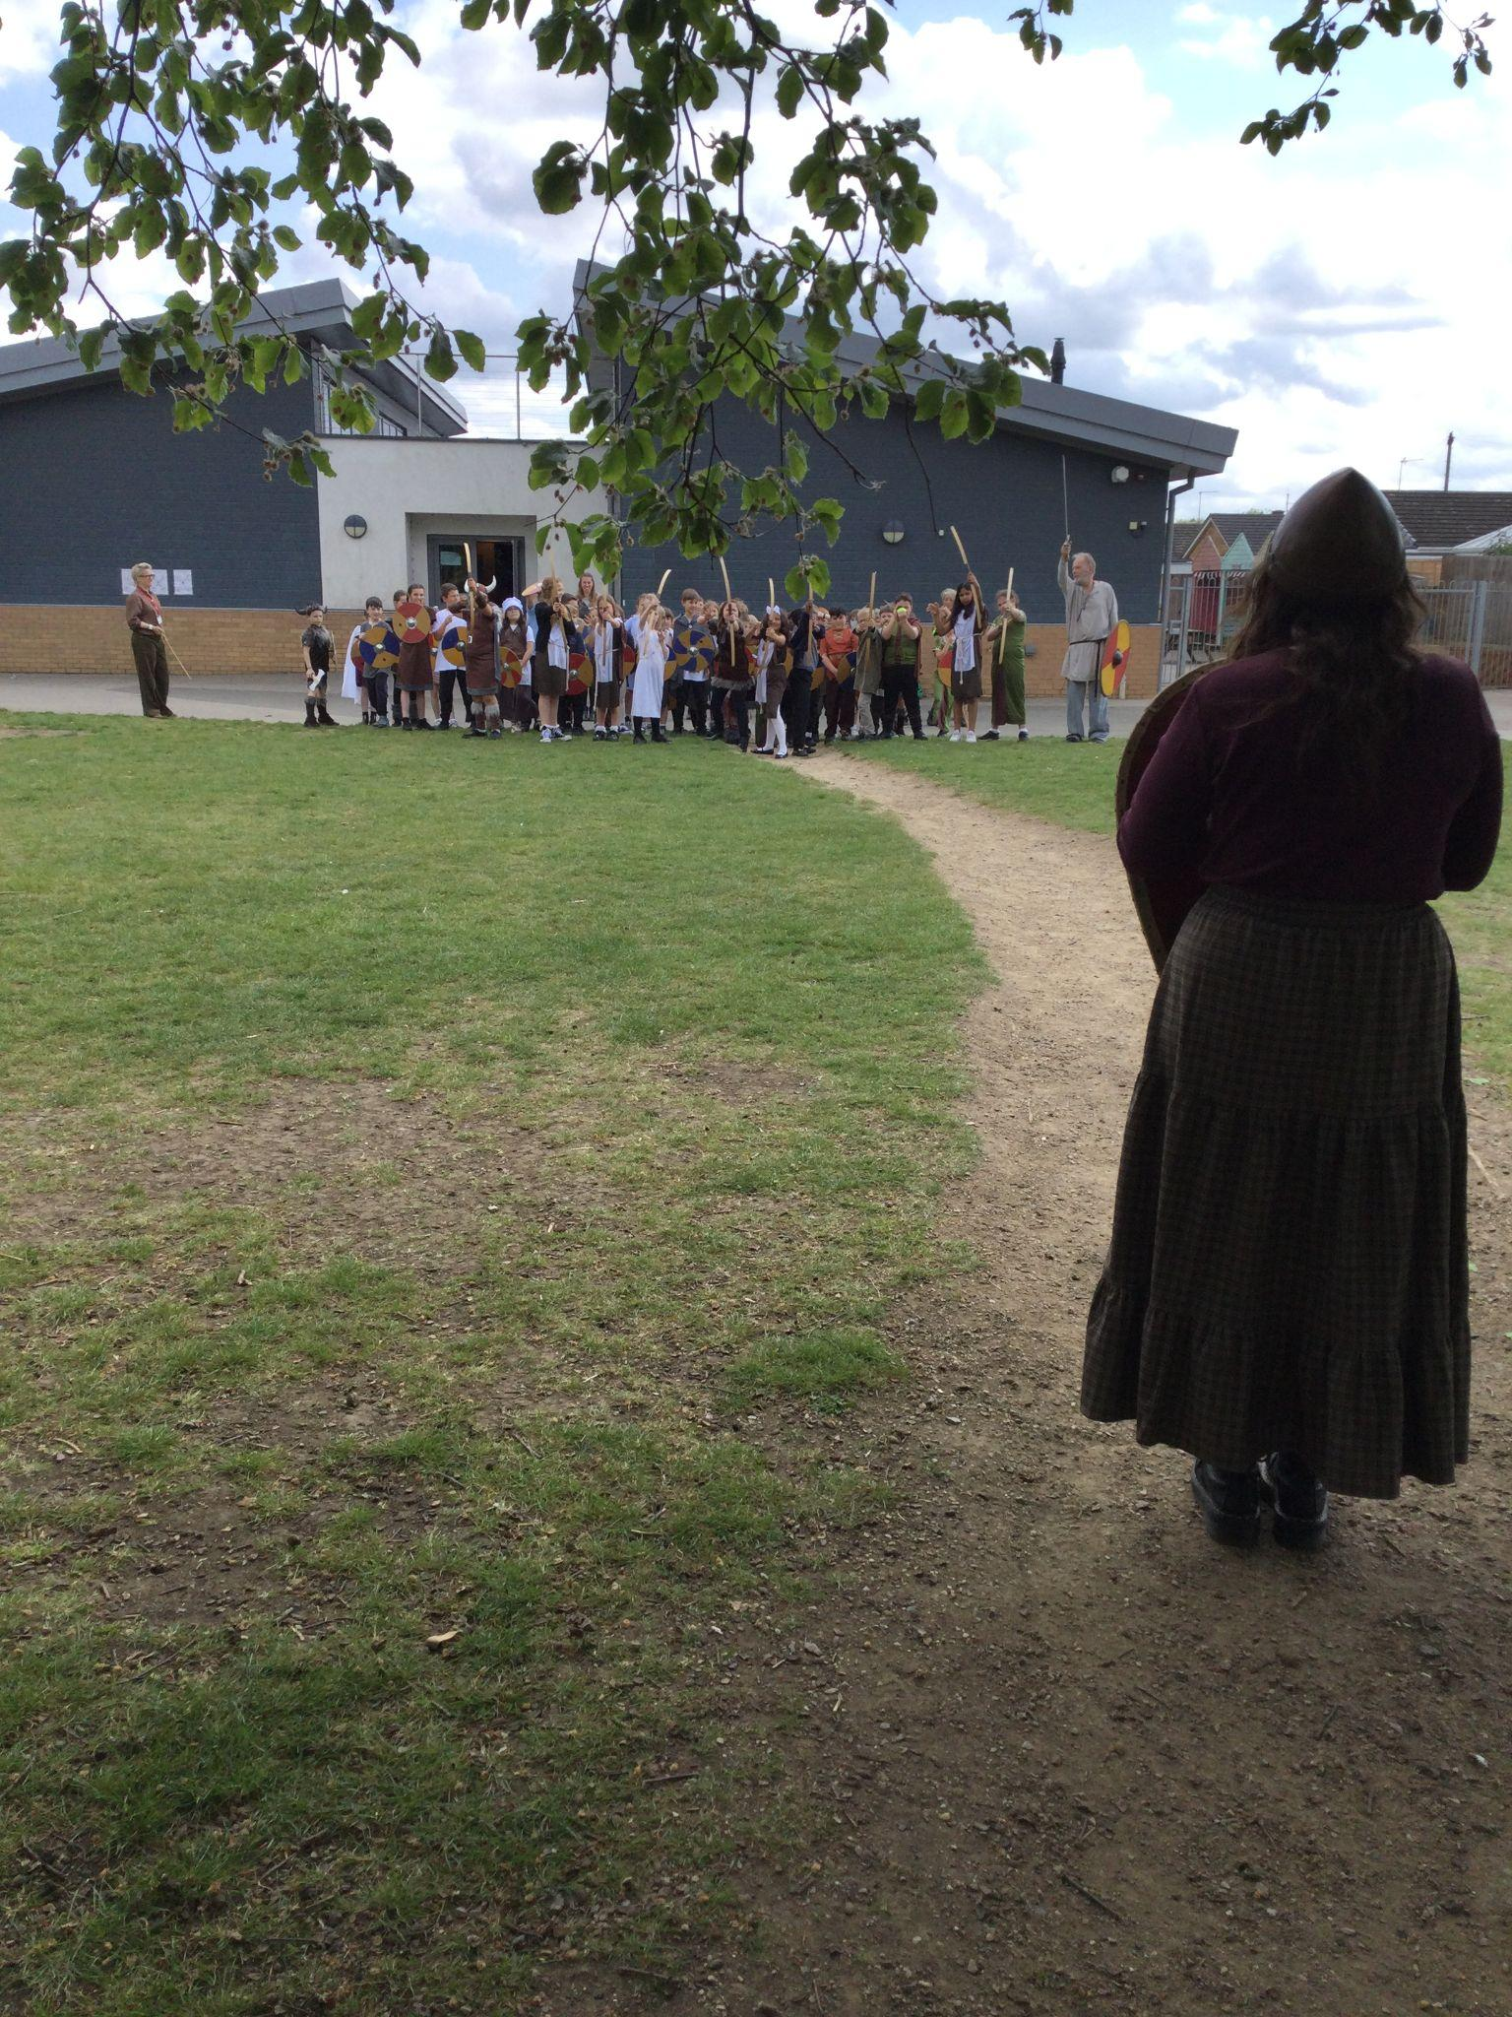
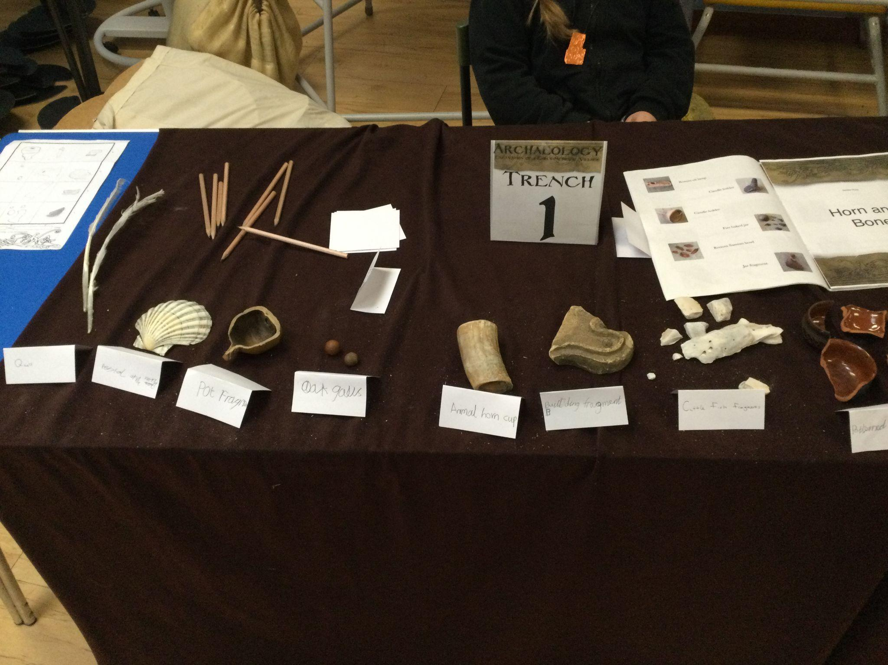
Year 4
Year 4 had a fantastic day on Thursday for Viking Day. History off the Page provided an immersive experience of a Viking market where the children had to work at tasks including making wax candles, writing their name in runes, creating their own amulets and making medicines with the wise woman. We then reenacted a battle between the Vikings and Anglo Saxons using our best battle cries! During the afternoon, they took on the role of archaeologists and excavated artefacts from Viking times. We discussed what we though each artefact was, what it was made from, who might have used it and where we think they might have been found. It was an engaging, exciting experience which the children all really enjoyed.

Slide 4







Word Wizard Winners:
Year 3 - Class 7 (55,010)
Year 4 - Class 10 (105,390)
Year 5 - Class 11 (292,468)
Year 6 - Class 13 (344,531)
Miss Turner recommends
The Last Journey by Stacy Gregg.
Pusskin lives a charmed life with his loving owner, Lottie. The bond between them is unbreakable, or so they both thought. But when birds start to disappear, cats are blamed. Pusskin and his feline friends have to band together and embark on an epic journey. Lottie wants to bring her beloved pet home. But for Pusskin to have any chance of survival, she may just have to let him go.
Fred says ‘Well done’ to Miss Blunt’s phonics group. You are working super hard to learn your set 2 sounds and read them in words! Keep it up.
Mrs Wilson recommends Susan Laughs. She swims with her father, works hard in school, plays with her friends -- and even rides a horse. Lively, thoughtfully drawn illustrations show a busy, happy little girl with whom many children will identify. Not until the end of the story is it revealed that Susan uses a wheelchair. A celebration of all that is possible and that ‘disability’ does not mean ‘disadvantage’.

Slide 5


Can you help us? Do you have links to food growing or production in our local area? We’re looking for local food heroes to inspire our pupils during our food festival week 22nd - 26th June.
We are aiming for 97% attendance.
This week, our classes with the highest attendance are…
KS1 - Class 2 98.61%
KS2 - Class 7 97.12%
WELL DONE

Slide 6


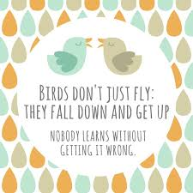
SATS Week (Year 6) Week Beg 11th May
PTFA Meeting Monday 18th May 5.15pm
PTFA Summer Disco Thursday 21st May
LAST DAY THURSDAY 21st May
TRAINING DAY - SCHOOL CLOSED 22nd May
HALF TERM Monday 25th - Friday 29th May
Year 6 to the Fire Station Wednesday 3rd June
New Reception Parents Sept 2026 meeting
Thursday 4th June 6pm
Non uniform day for summer fair donations Friday 5th June
Cavalry Food Festival Week 22-26th June
Summer Fair 26th June

Slide 7

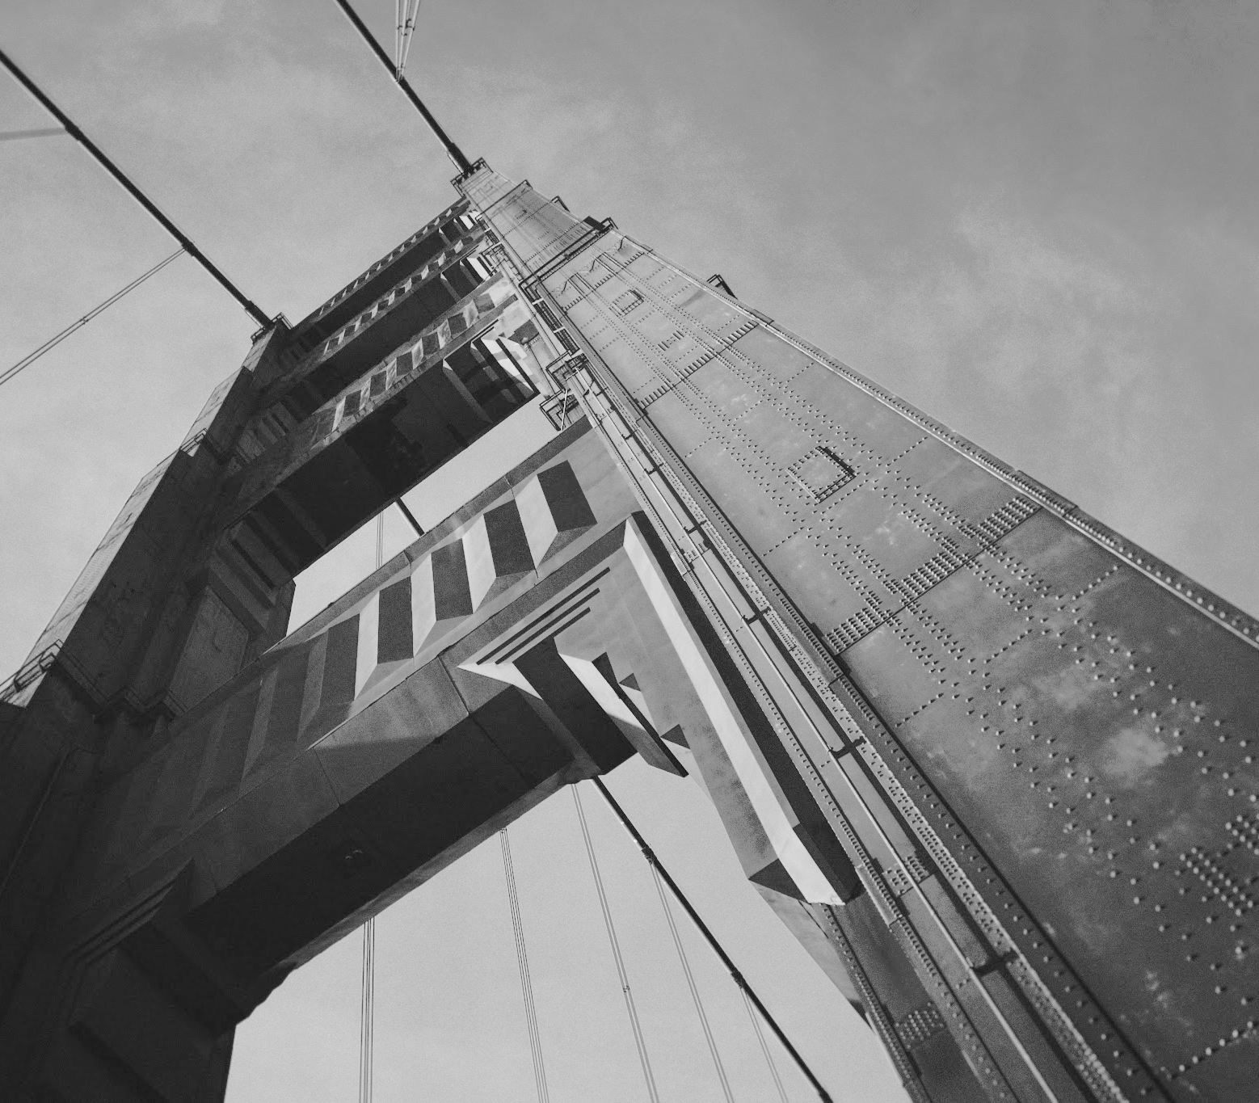
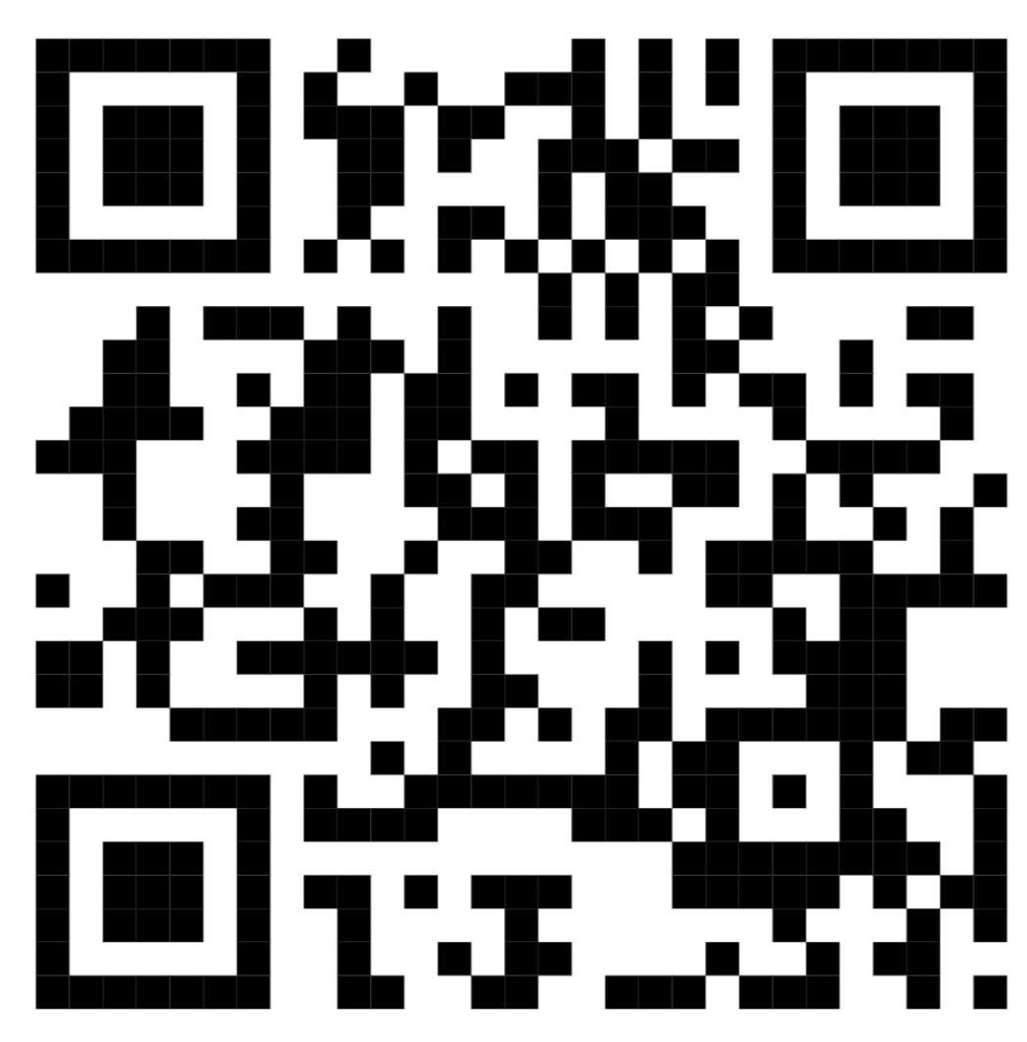
Cavalry Website
Contact us:
Cavalry Primary School
Cavalry Drive
March
Cambridgeshire
PE15 9EQ
office@cavalryprimary.org
Tel: 01354 652814

