Slide 1



3rd July 2026
  I will not never, ever eat a tomato!
  Happy Potters
  Experimenting

Slide 2

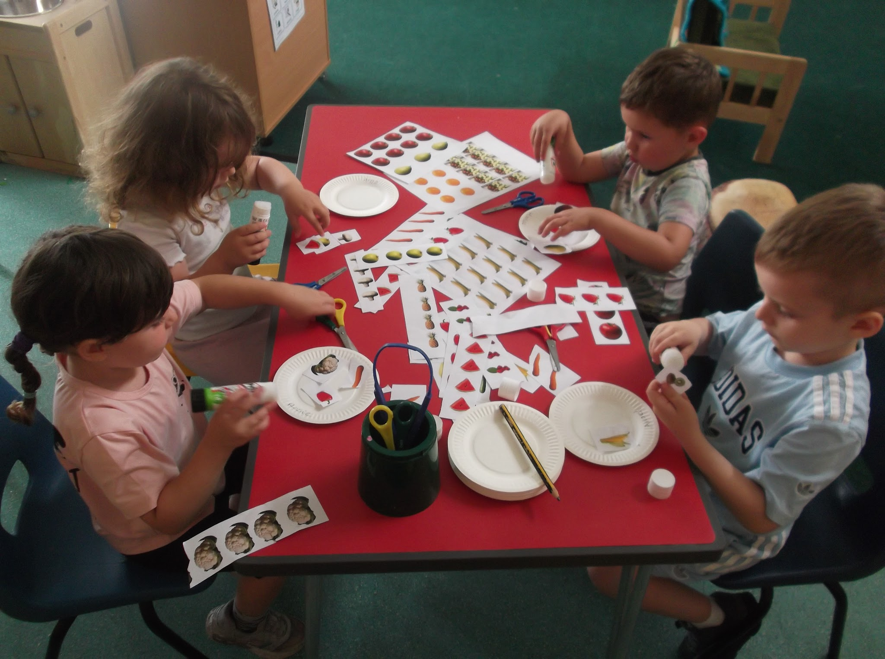
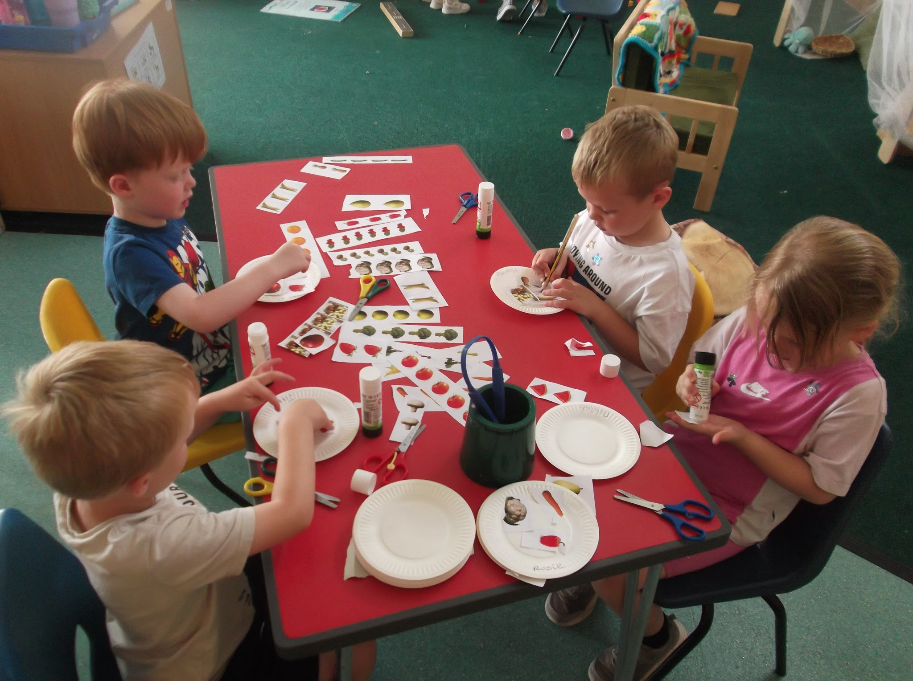
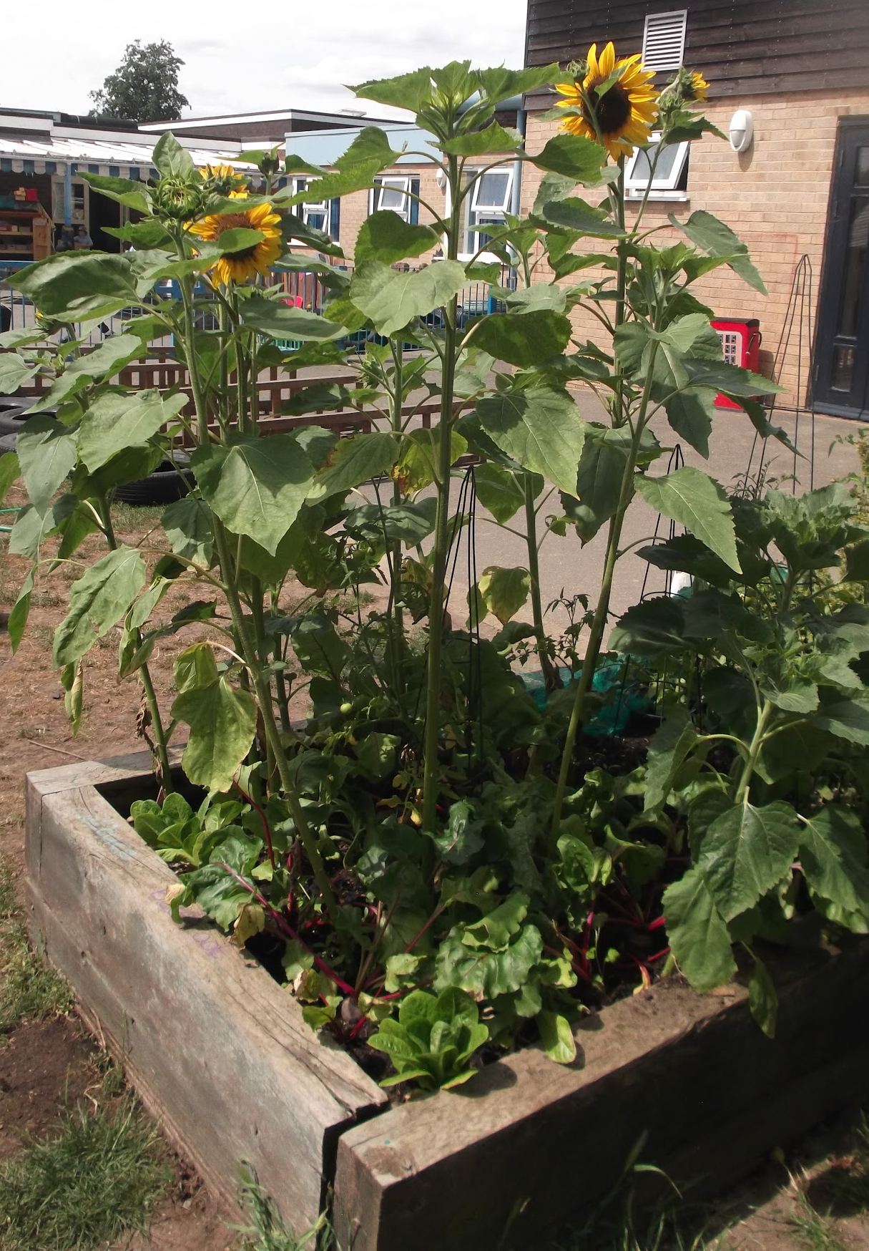
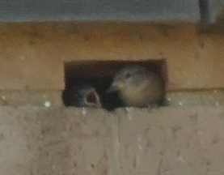
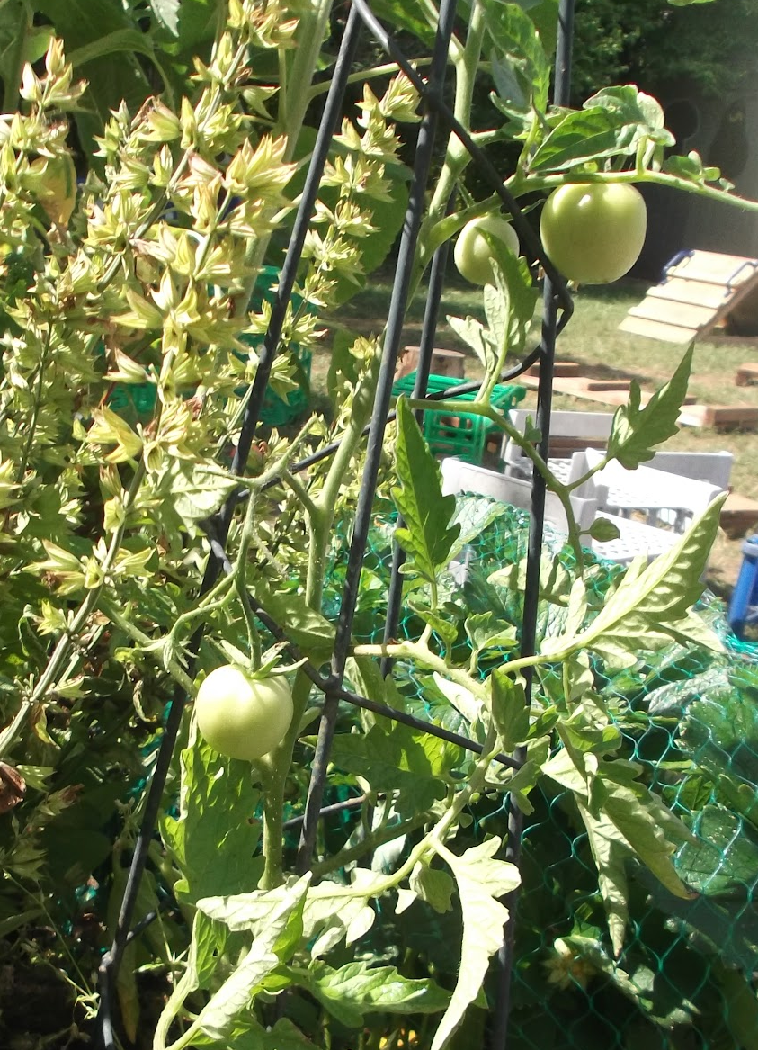
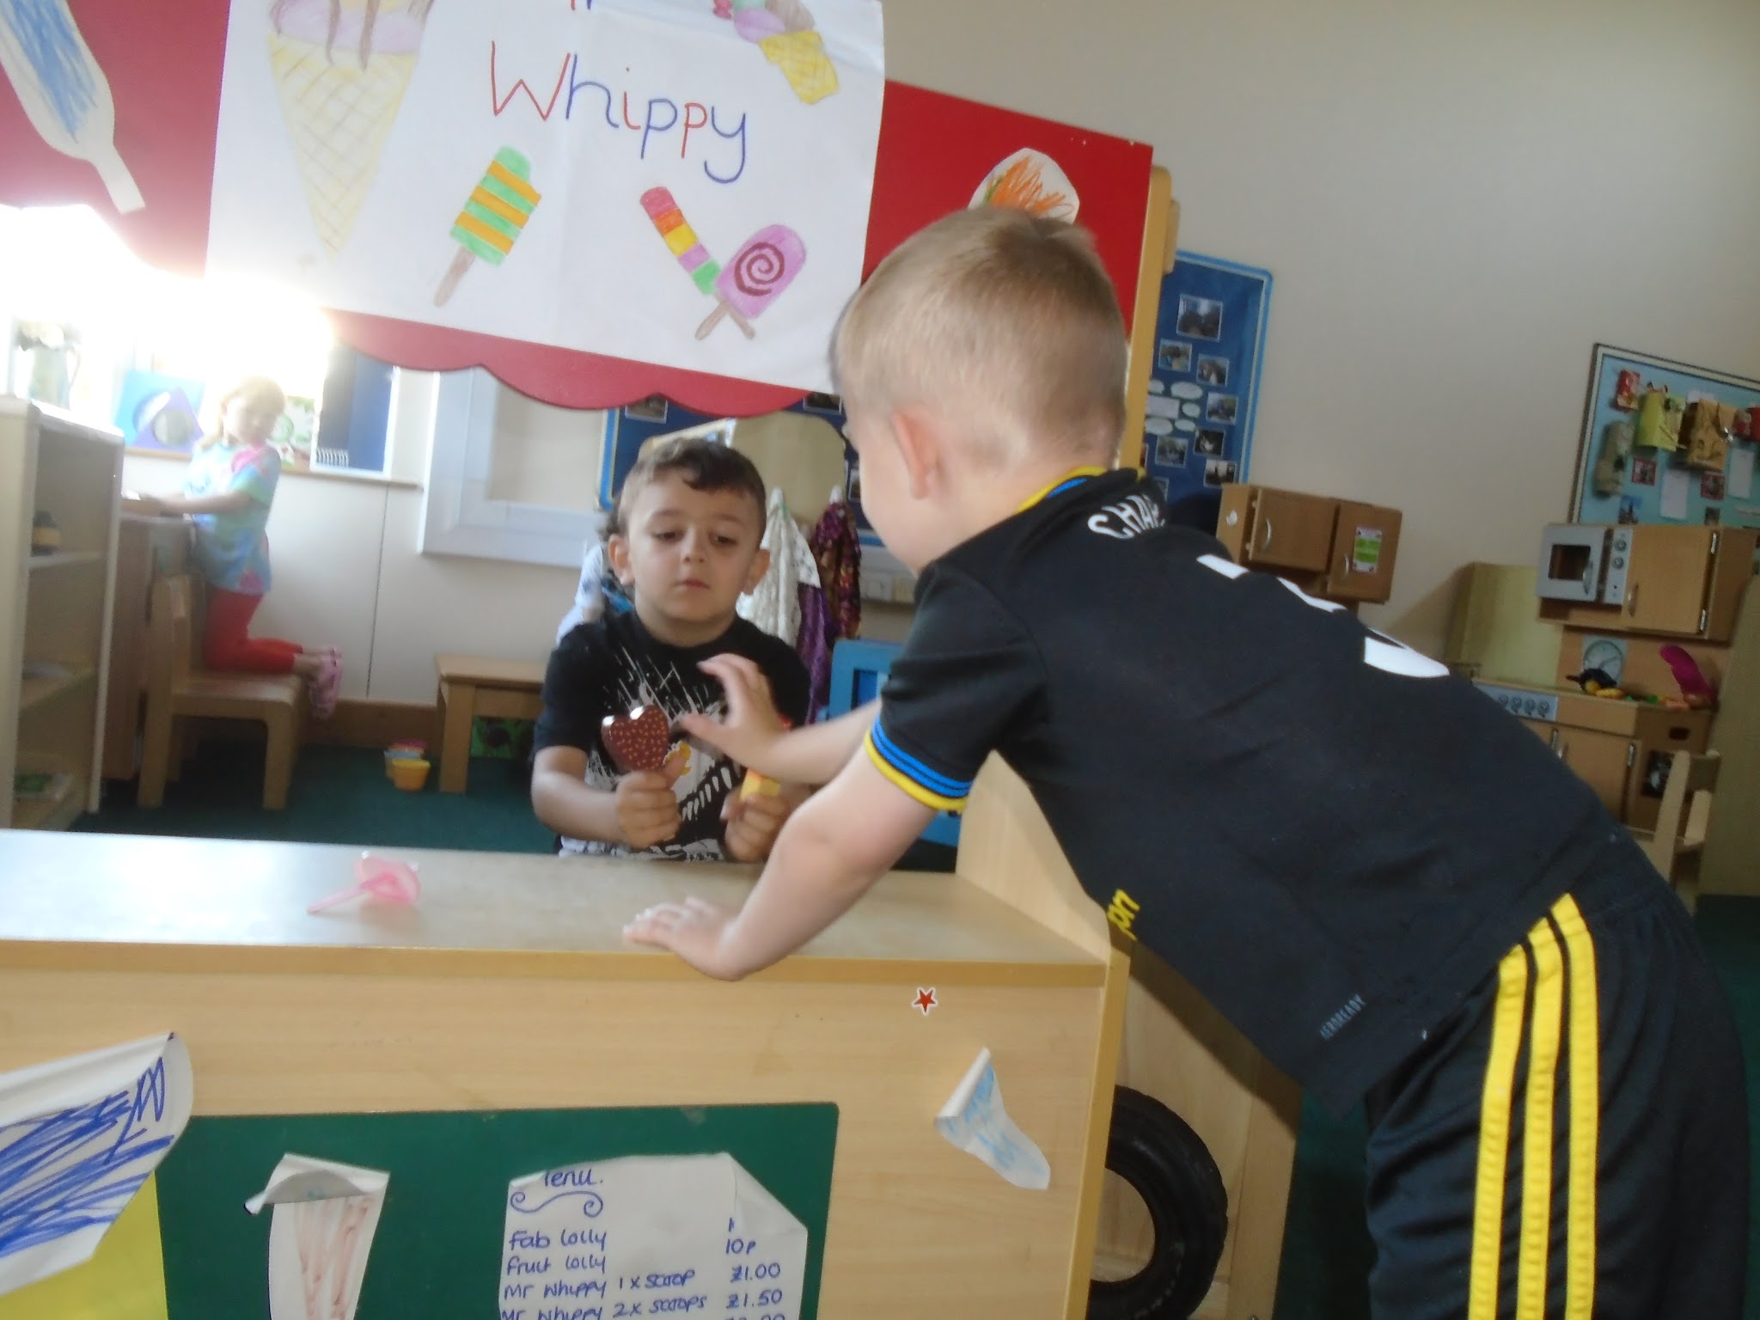
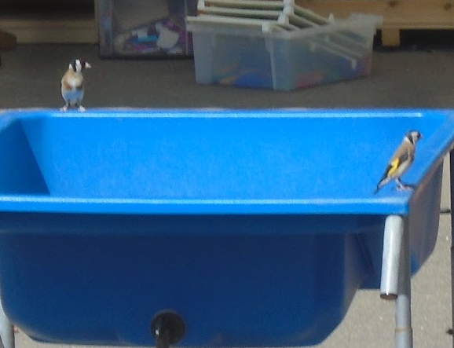
Nursery
We introduced the story of Lola, a very fussy eater in ‘I will not ever, never eat a tomato!’ We created paper plates of fruit and vegetables we like and the one thing we would not ever, never eat. We’ve been role playing in the greengrocers and sorting food into groups. We are eagerly awaiting the the ripening of the tomatoes we are growing in the vegetable bed so we can try them!
Outside the children have been fascinated by the wonders of nature. They have been observing the sparrows nesting in the wall above room 2 and watching a pair of goldfinch search for water in the reception playground. And look how tall our sunflowers are now!
Following the children’s interests we created a role play ice cream van and are enjoying making lollipops and ice creams at the dough table.

Slide 3
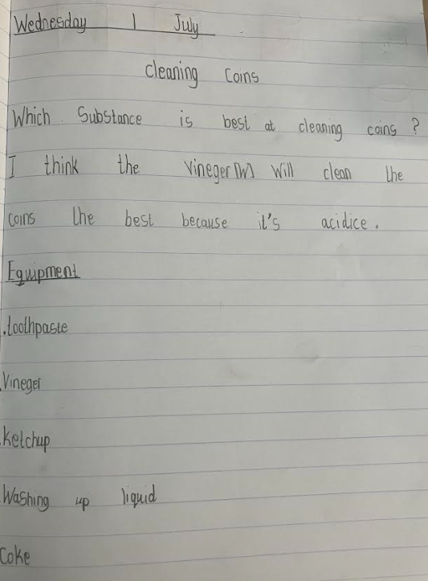
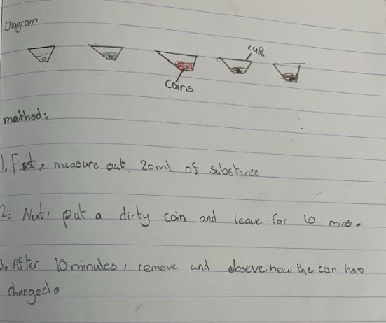
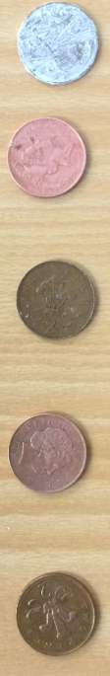
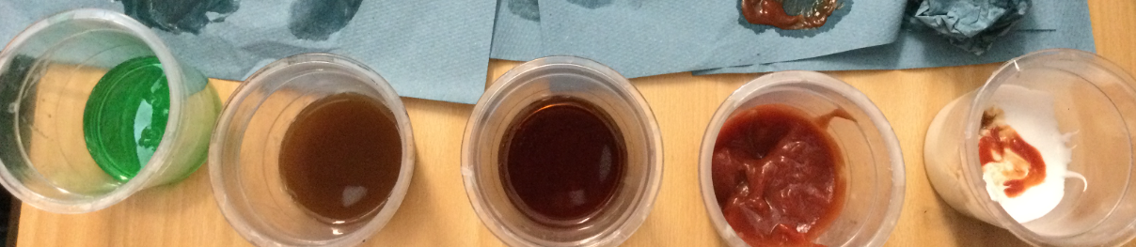
Year 3
This half term, children have been looking at how to conduct a science experiment. They have looked at posing a question, writing a hypothesis, listing the equipment, drawing a labelled diagram and writing the method.
This week, the children had the question:
‘Which substance is best at cleaning coins?’

Slide 4
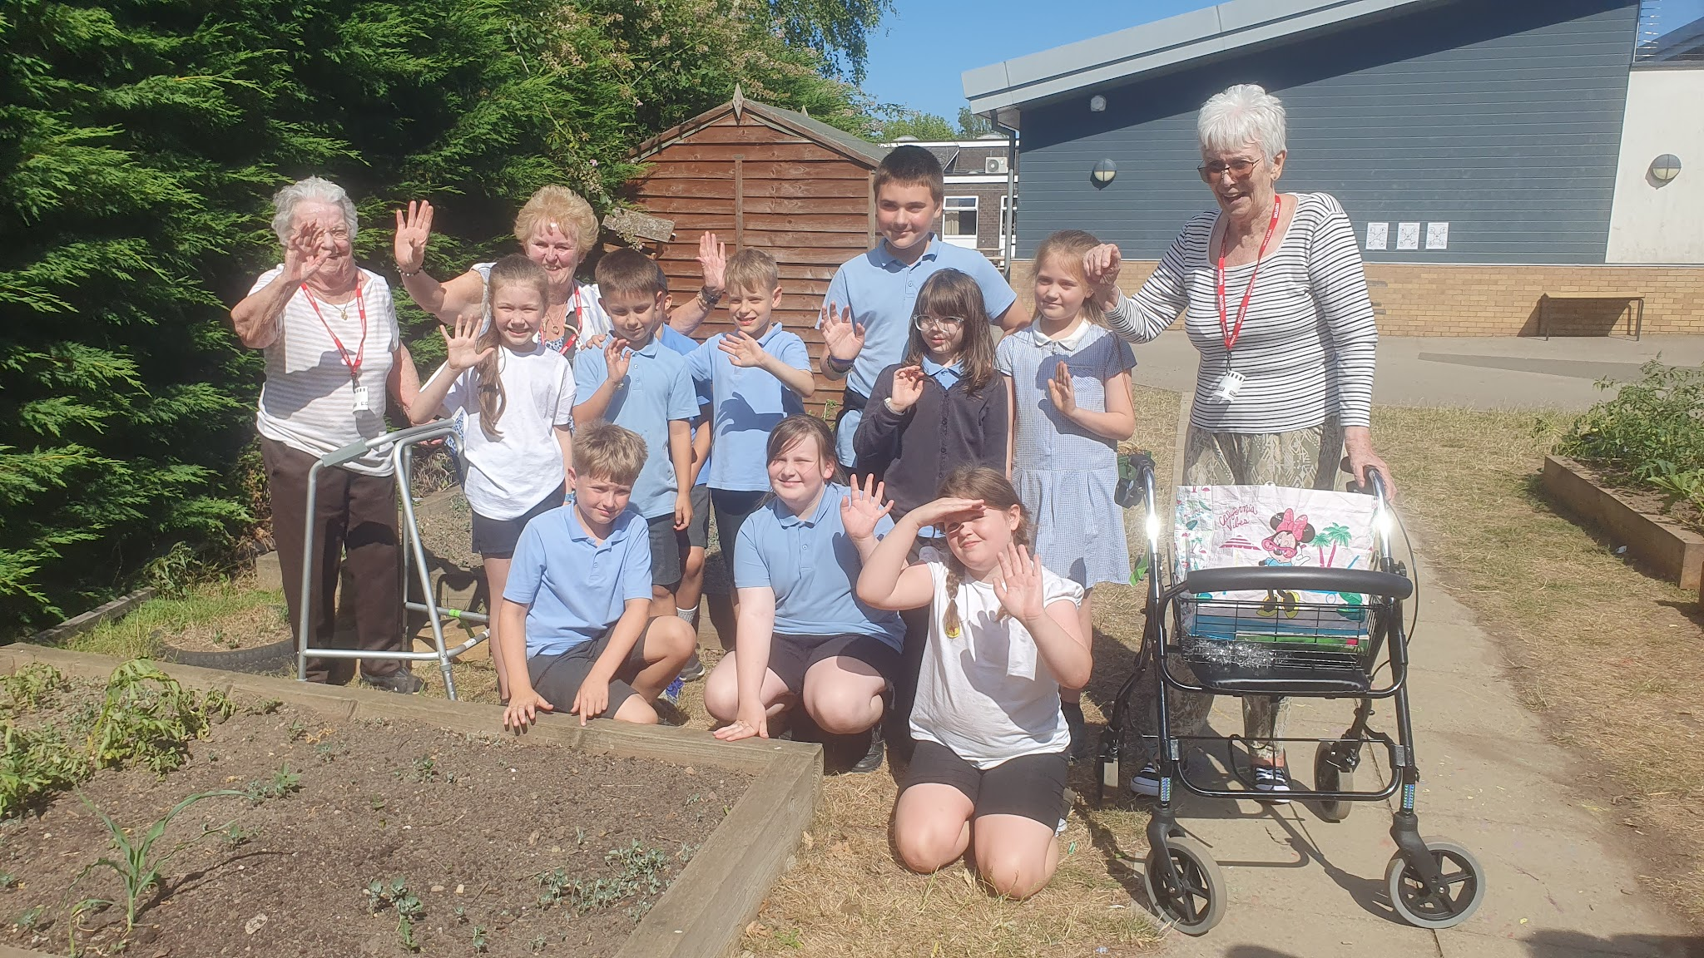
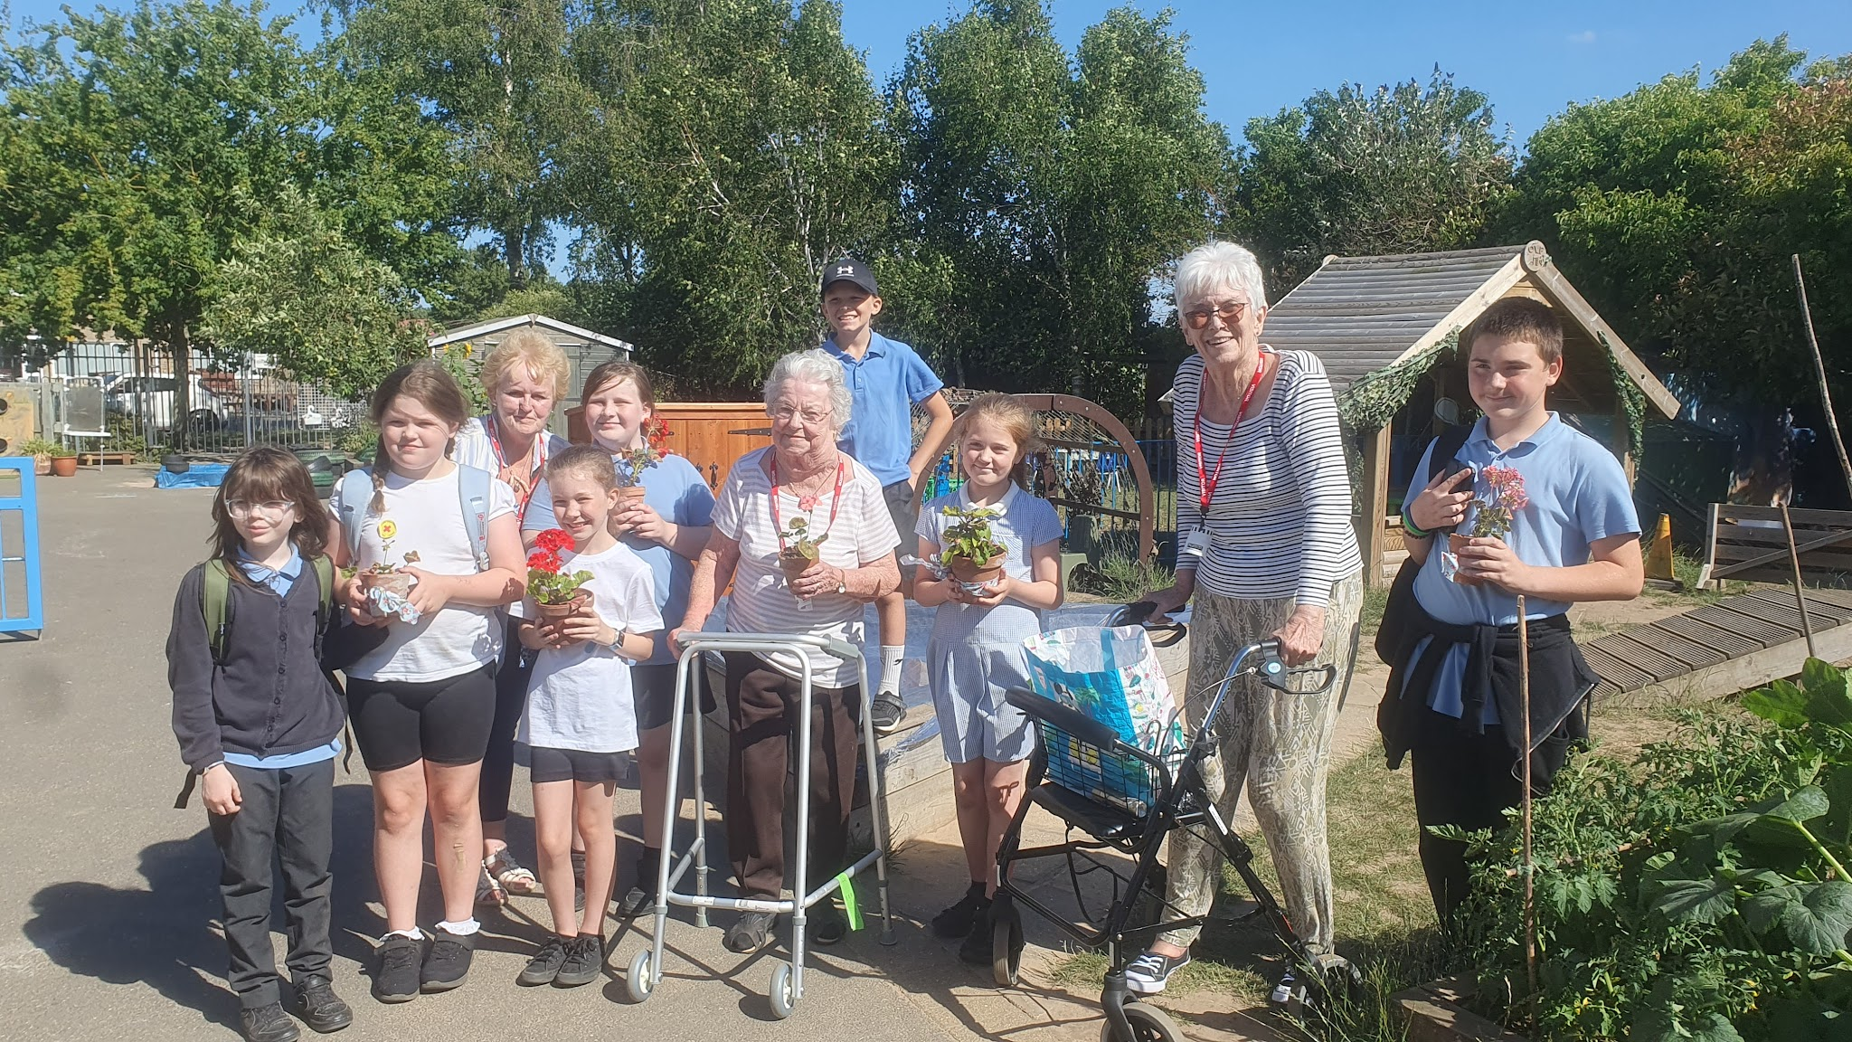
Happy Potters visit
On Thursday, members of Aria Court’s Happy Potters gardening club came to visit our Cavalry Happy Potter seedlings. We showed them around our growing beds and we were shown how to pinch out our tomatoes. We discussed how we will work closely in the future. There are so many benefits to this kind of intergenerational work and we got off to a great start, our pupils were a credit to the school and their families, showing respect and warmth to our wonderful visitors.
The Happy Potters kindly gifted Cavalry a lovely planter and we reciprocated by giving them some geraniums that we planted in pots.

Slide 5







Word Wizard Winners:
Year 3 - Class 8 (87,337)
Year 4 - Class 10 (250,676)
Year 5 - Class 11 (116,627)
Year 6 - Class 13 (269,170)
Mrs Brown recommends:
In this book you can discover how to find calm in overwhelming moments, it is a wonderful book where big feelings are gently explored.
Fred says ‘Well done’ to Mrs Darnell’s phonics group - you are getting super speedy with your fred in your head!
Miss Boyd recommends…
As part of our Ancient Greek topic, Class 7 have been enjoying 'Icarus was Ridiculous’ by Pamela Butchart, which is a hilarious retelling of one of our favourite Greek myths!

Slide 6



We are aiming for 97% attendance.
This week, our classes with the highest attendance are…
KS1 - Class 2 96.67%
KS2 - Class 7 89.64%
WELL DONE

Slide 7

UPDATED SUMMER FAIR INFO
Date: WEDNESDAY 15th July
Time: 2-4pm
You can collect your child early to attend the fair.
There will be hotdogs for sale, but no burgers.
All of the same stalls will be there as previously planned except the plant stall and the tractor. Look out for summer fair programme on our social media and website
Yr 3 Burwell House 8th - 10th July
Reception transition to Year 1 meeting 7th July 1.30-2pm
EYFS Sports Day 7th July 2.15 - 3.15pm
Jump up Day Tuesday 14th July 9.30-10.30
Summer Fair Wednesday 15th July 2-4pm
Reception trip to Sandringham 16th July
Last day of term Friday 17th July - whole school picnic
Training Day Monday 20th July - SCHOOL AND NURSERY CLOSED

Slide 8


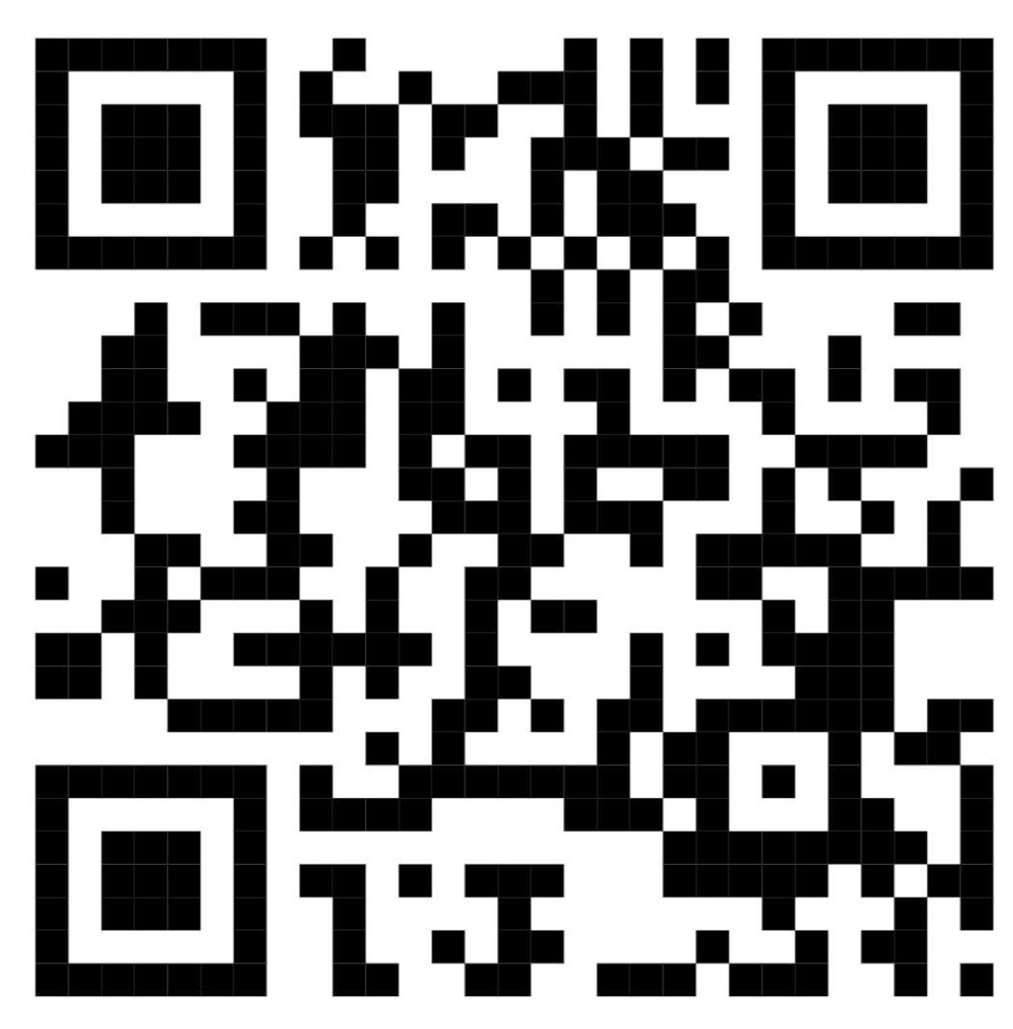
Cavalry Website
Contact us:
Cavalry Primary School
Cavalry Drive
March
Cambridgeshire
PE15 9EQ
office@cavalryprimary.org
Tel: 01354 652814

