Slide 1



17th July 2026
  Platinum Sport Standard
  Church Farm visit
  Ice cream sundaes

Slide 2

We are PLATINUM!
Achieving Platinum status in the School Games Mark, a Government-led scheme facilitated by the Youth Sport Trust, is the highest national accolade a school can receive for its dedication to physical education, school sport, and physical literacy.
Attaining Platinum means a school has already achieved the Gold Award for four consecutive years and has continued to prove exceptional, long-term commitment to keeping young people active. It recognises:
Inclusive Participation: Offering equal sporting opportunities and engaging a wide range of students—including targeted groups.
Extensive Competition: Providing a robust extra-curricular program and participating in a high number of inter-school fixtures and events.
Leadership and Volunteering: Giving students the chance to officiate, coach, and run sports clubs.
Community Engagement: Demonstrating strong links to local clubs and the wider community
WELL DONE TEAM CAVALRY!

Slide 3

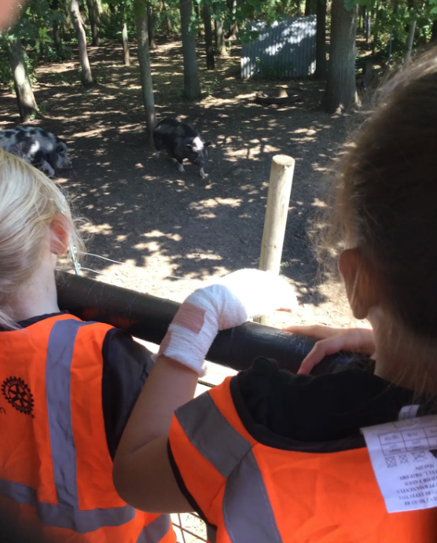
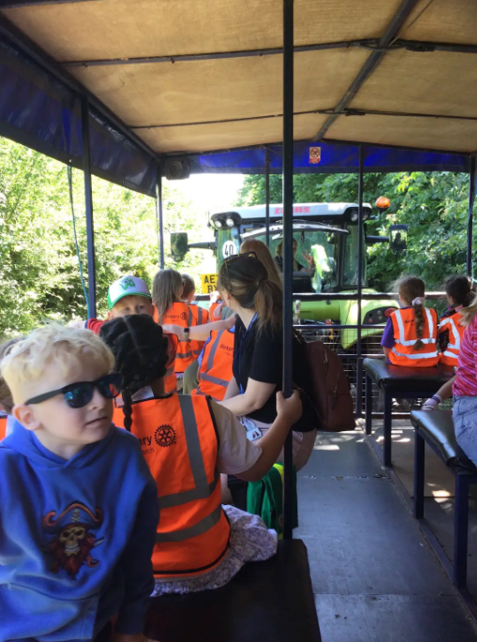
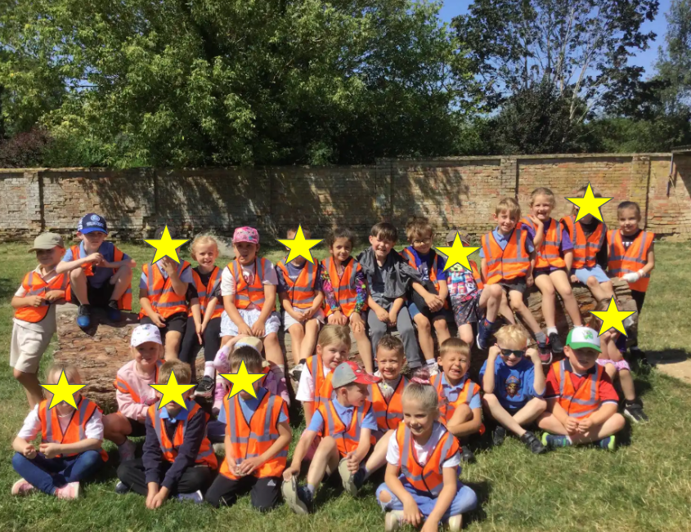
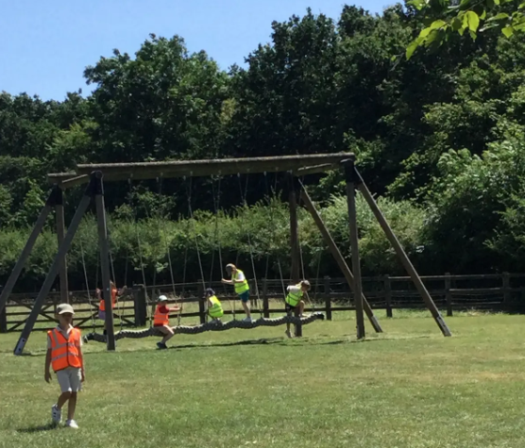
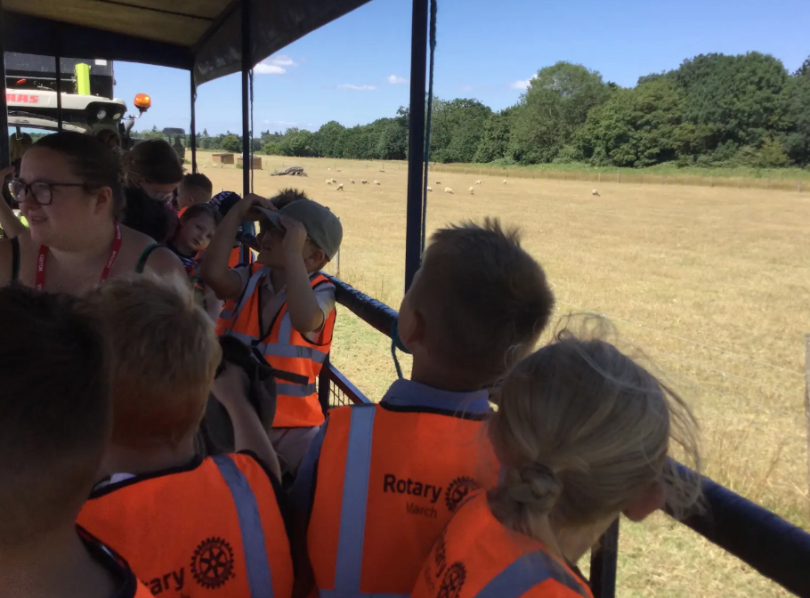
Year 1
We had the most amazing day meeting all of the farm animals and their adorable babies at church farm. The tractor ride gave us the chance to explore the farm and everyone loved meeting the sitting pigs!
It was wonderful to see the children confidently using all of the knowledge they have learned this term to talk about the farm, animals and their habitats. This was a fantastic way to end year 1 and bring our learning to life.

Slide 4
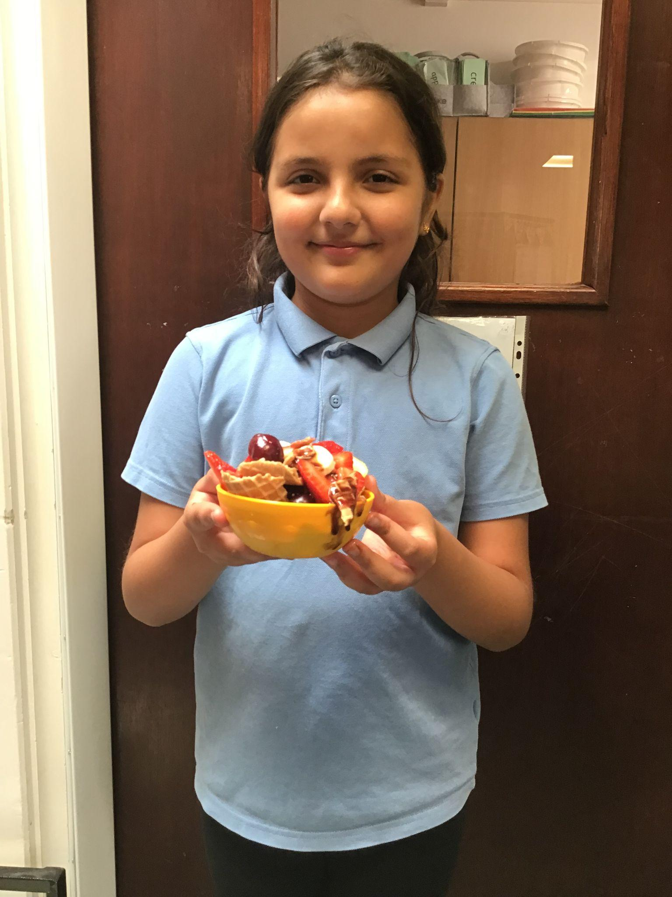
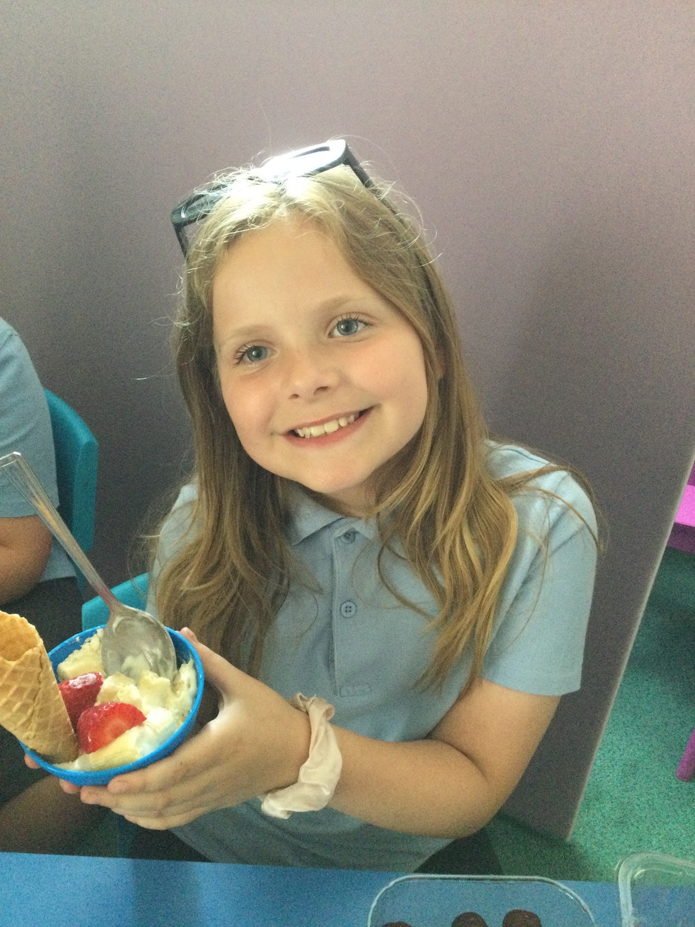
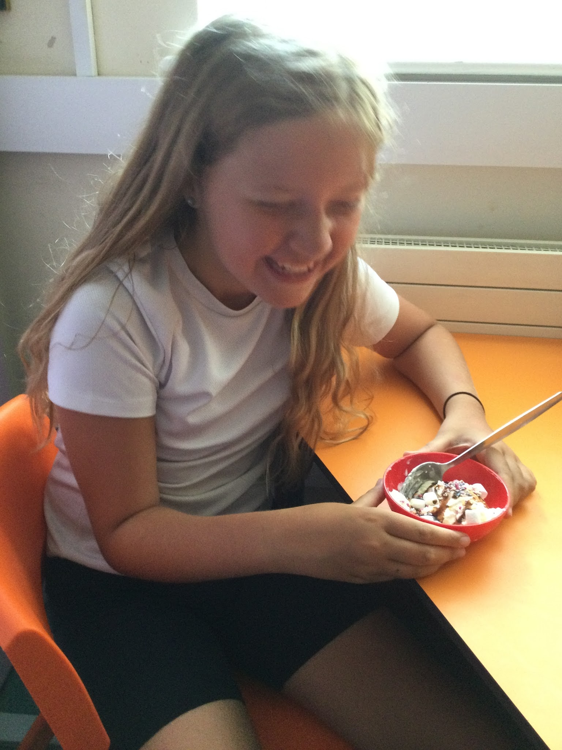
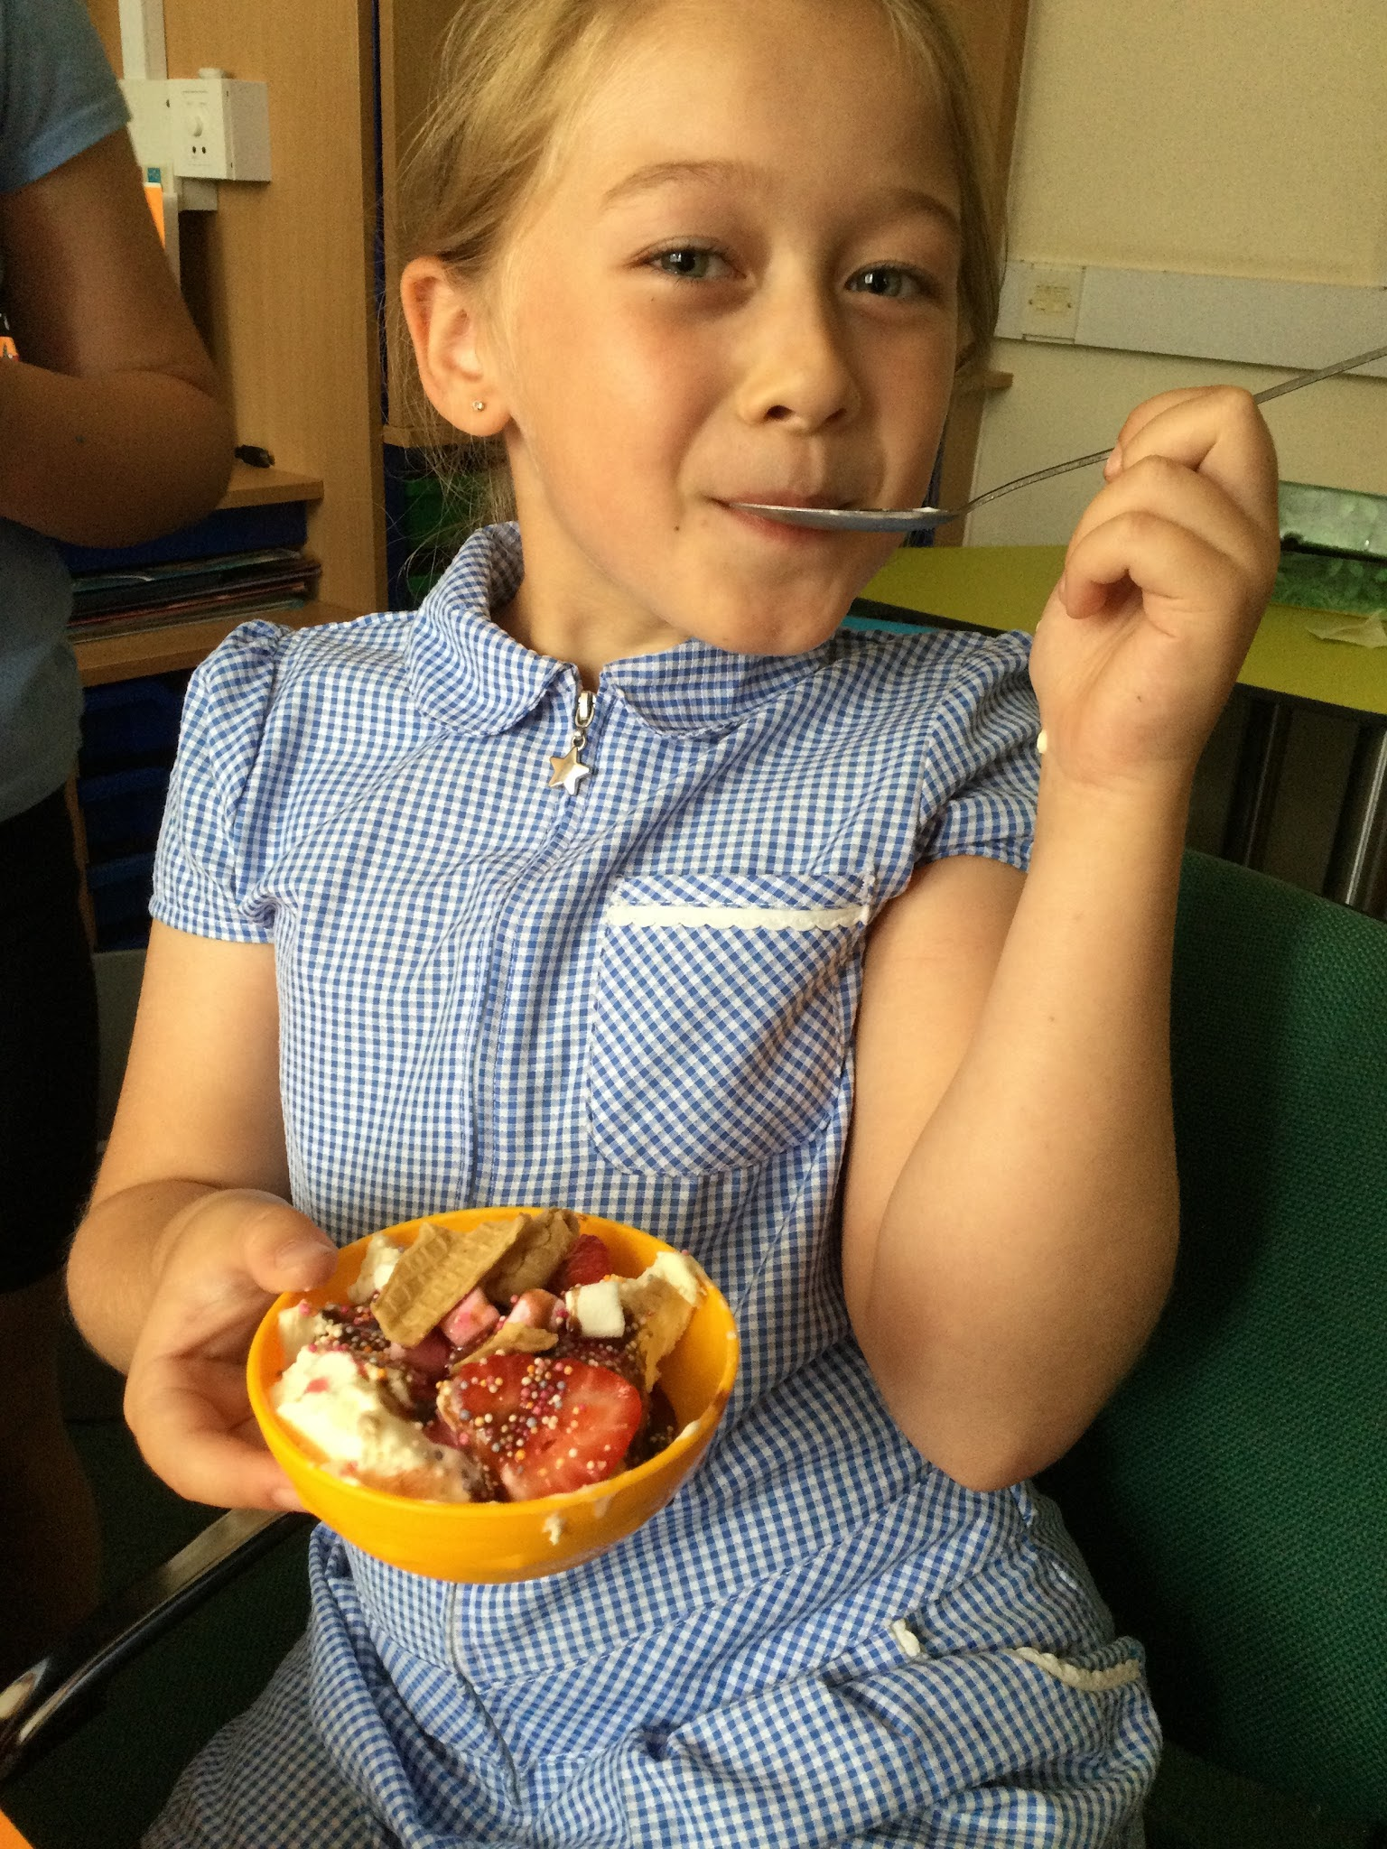
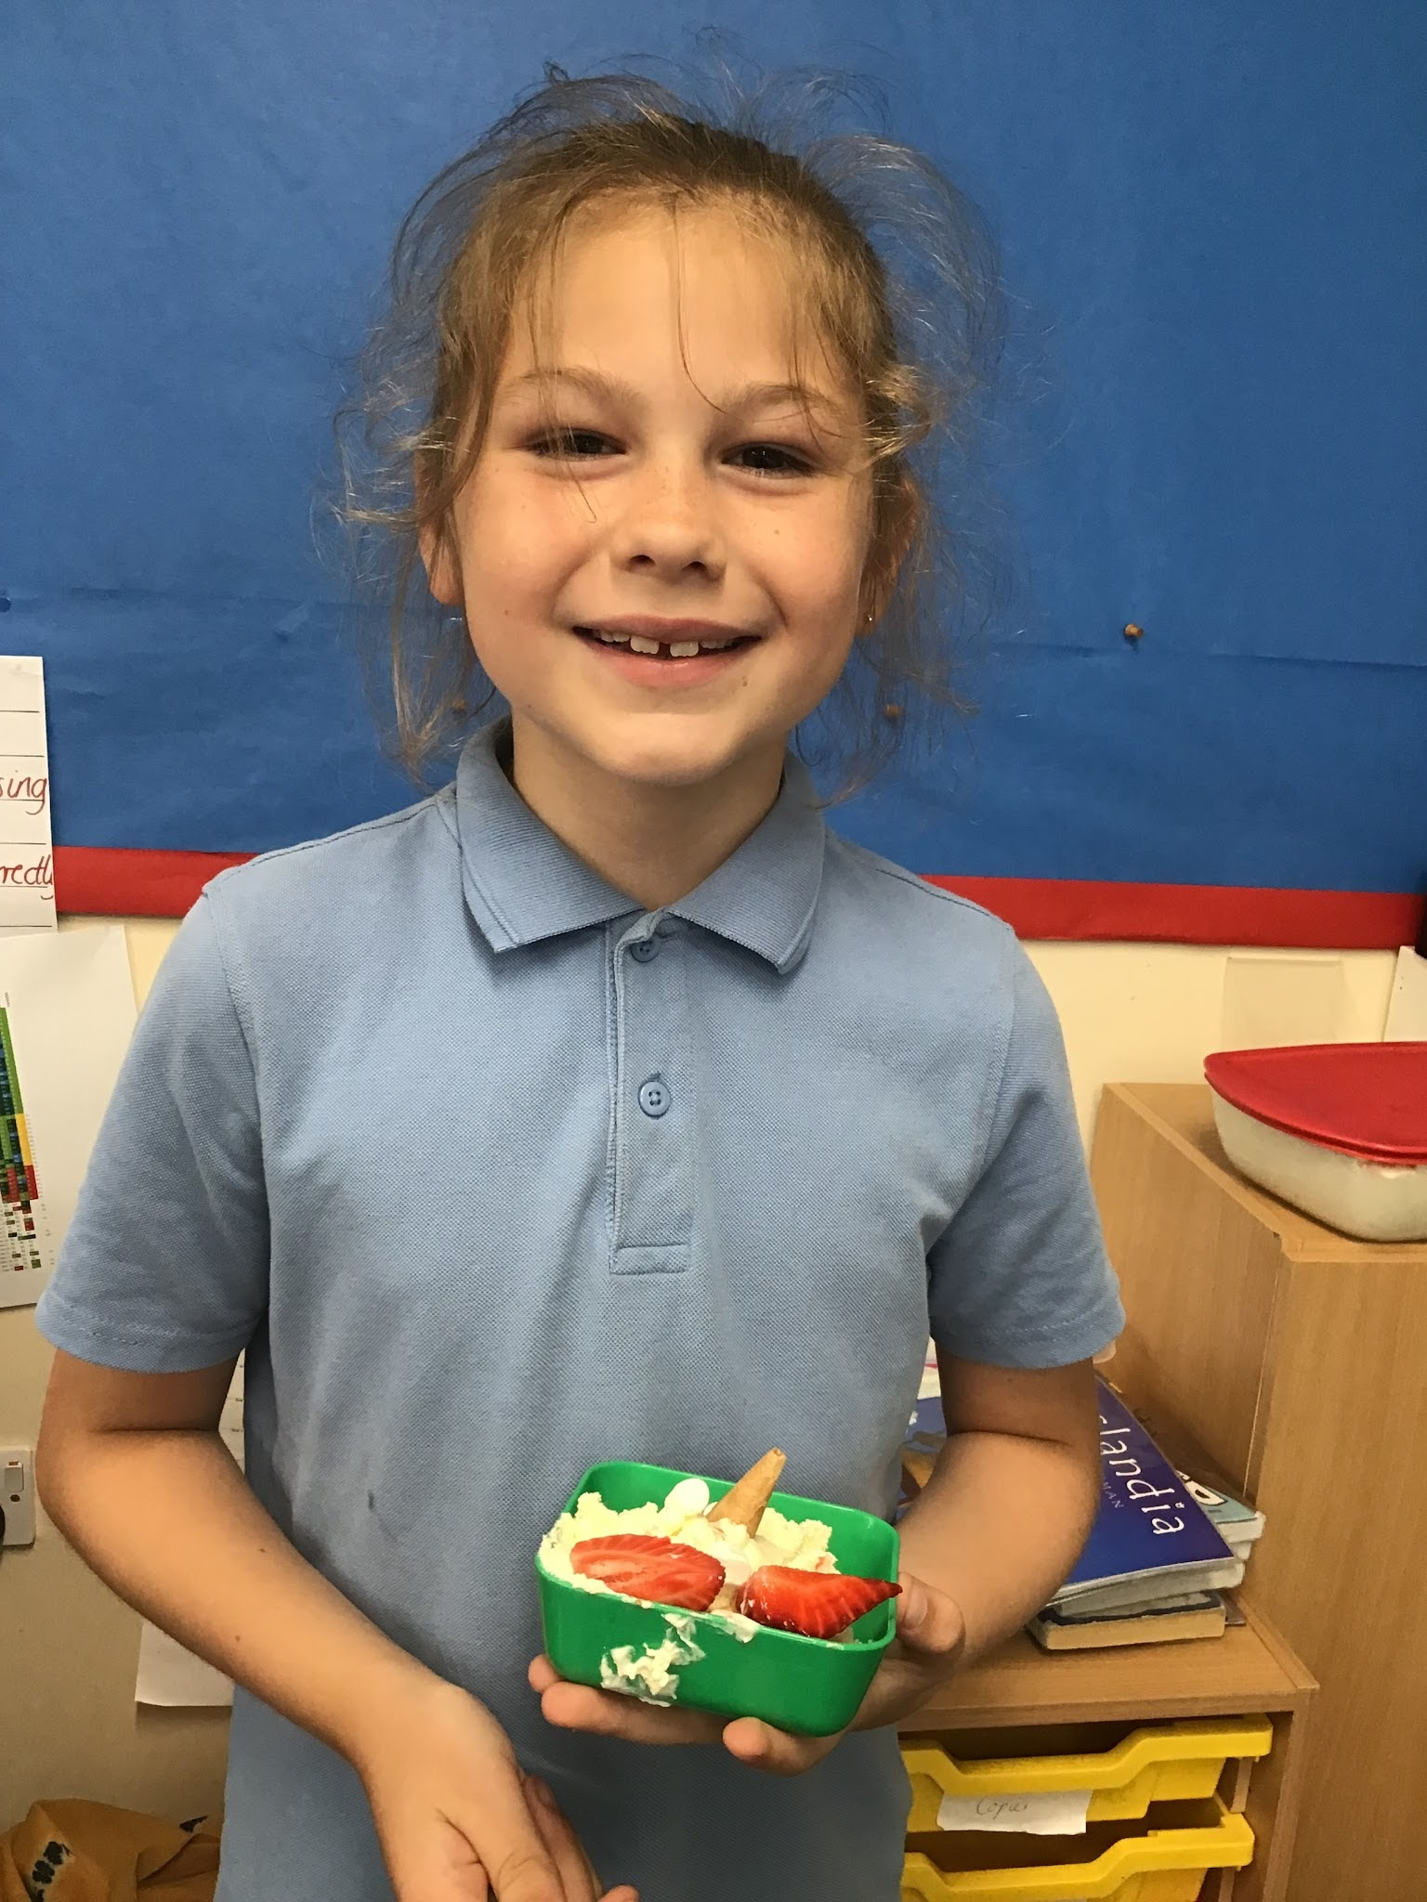
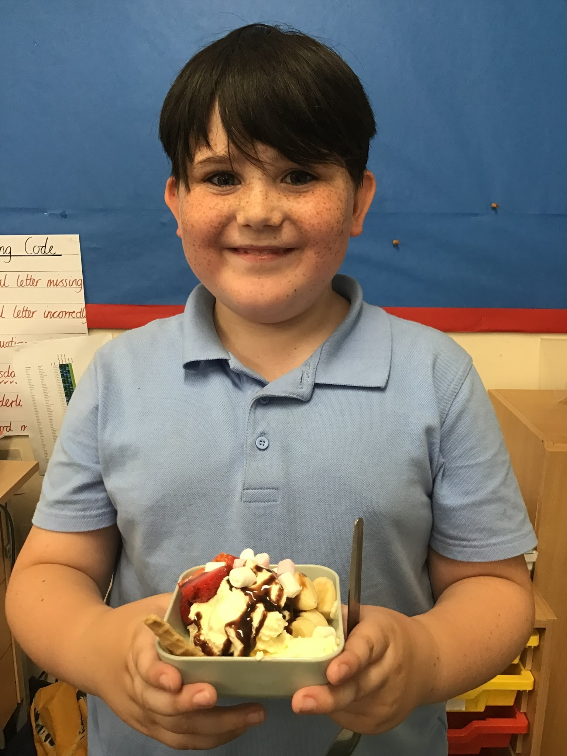
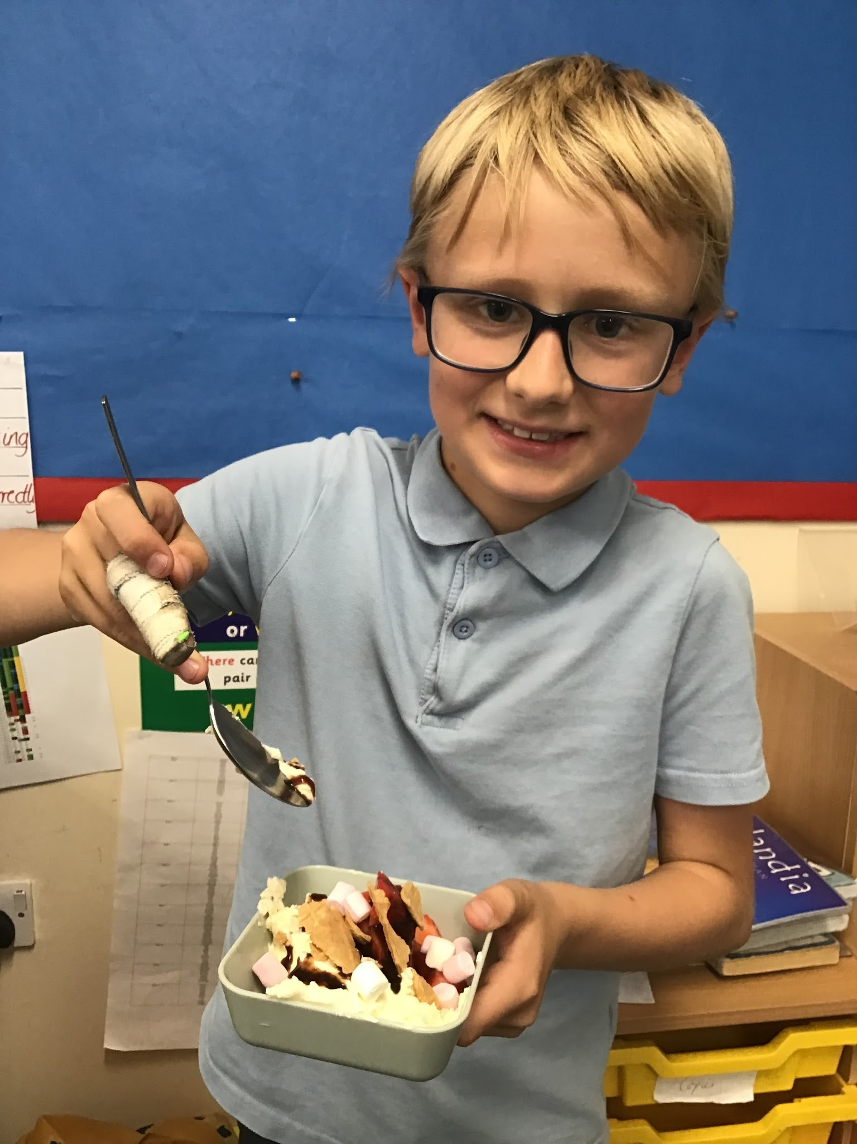
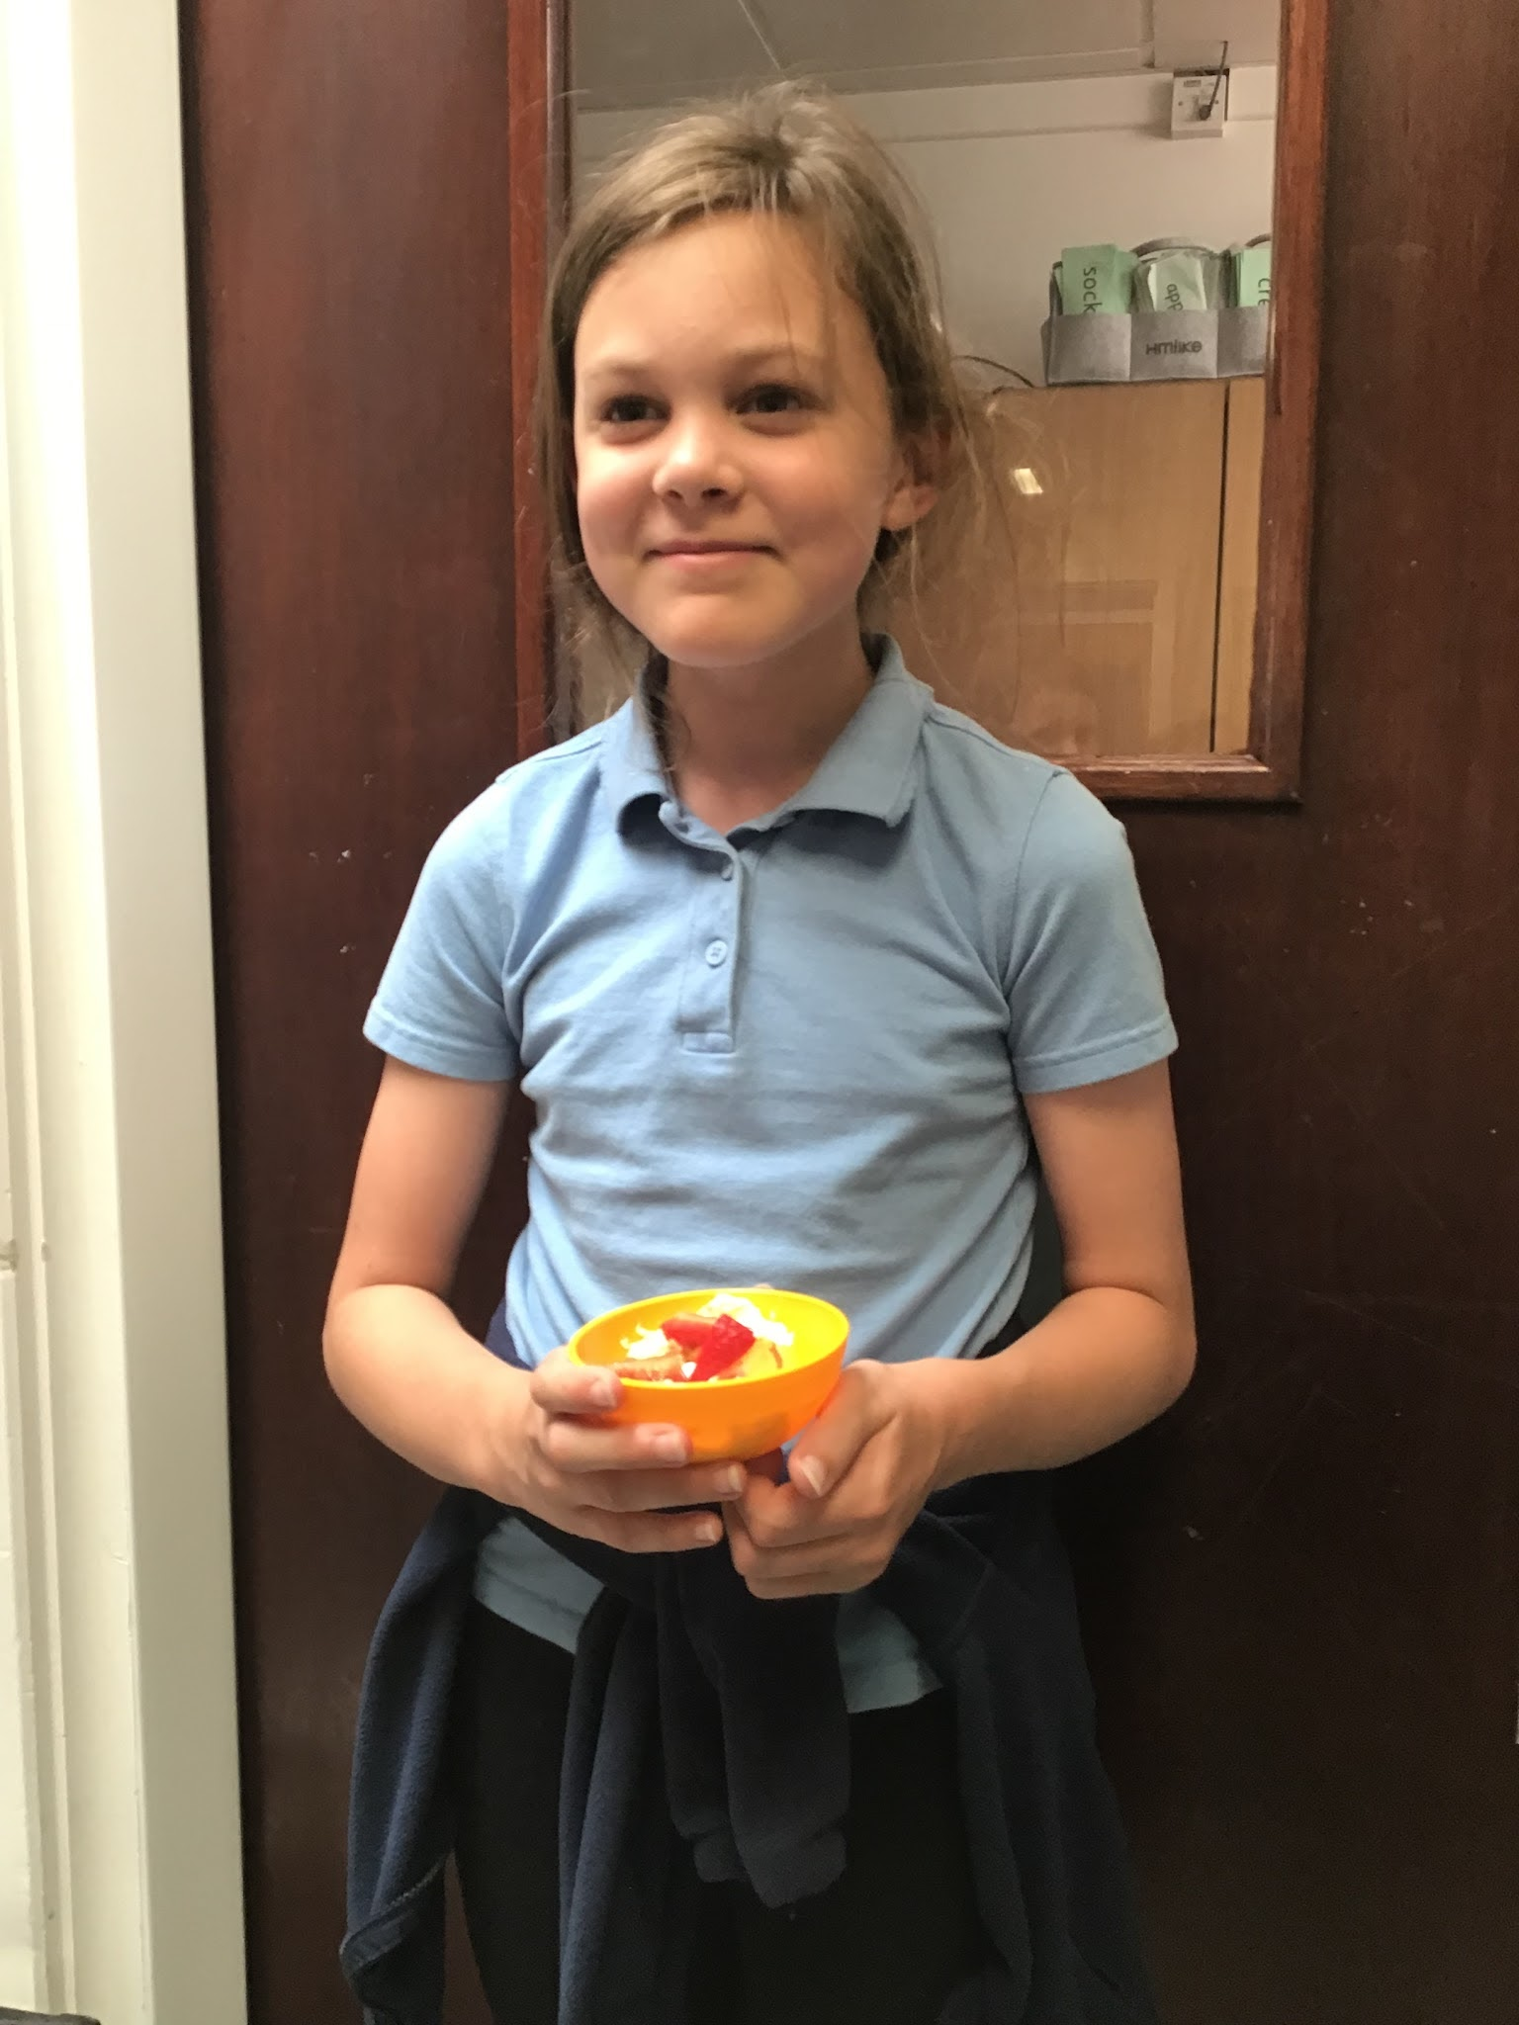
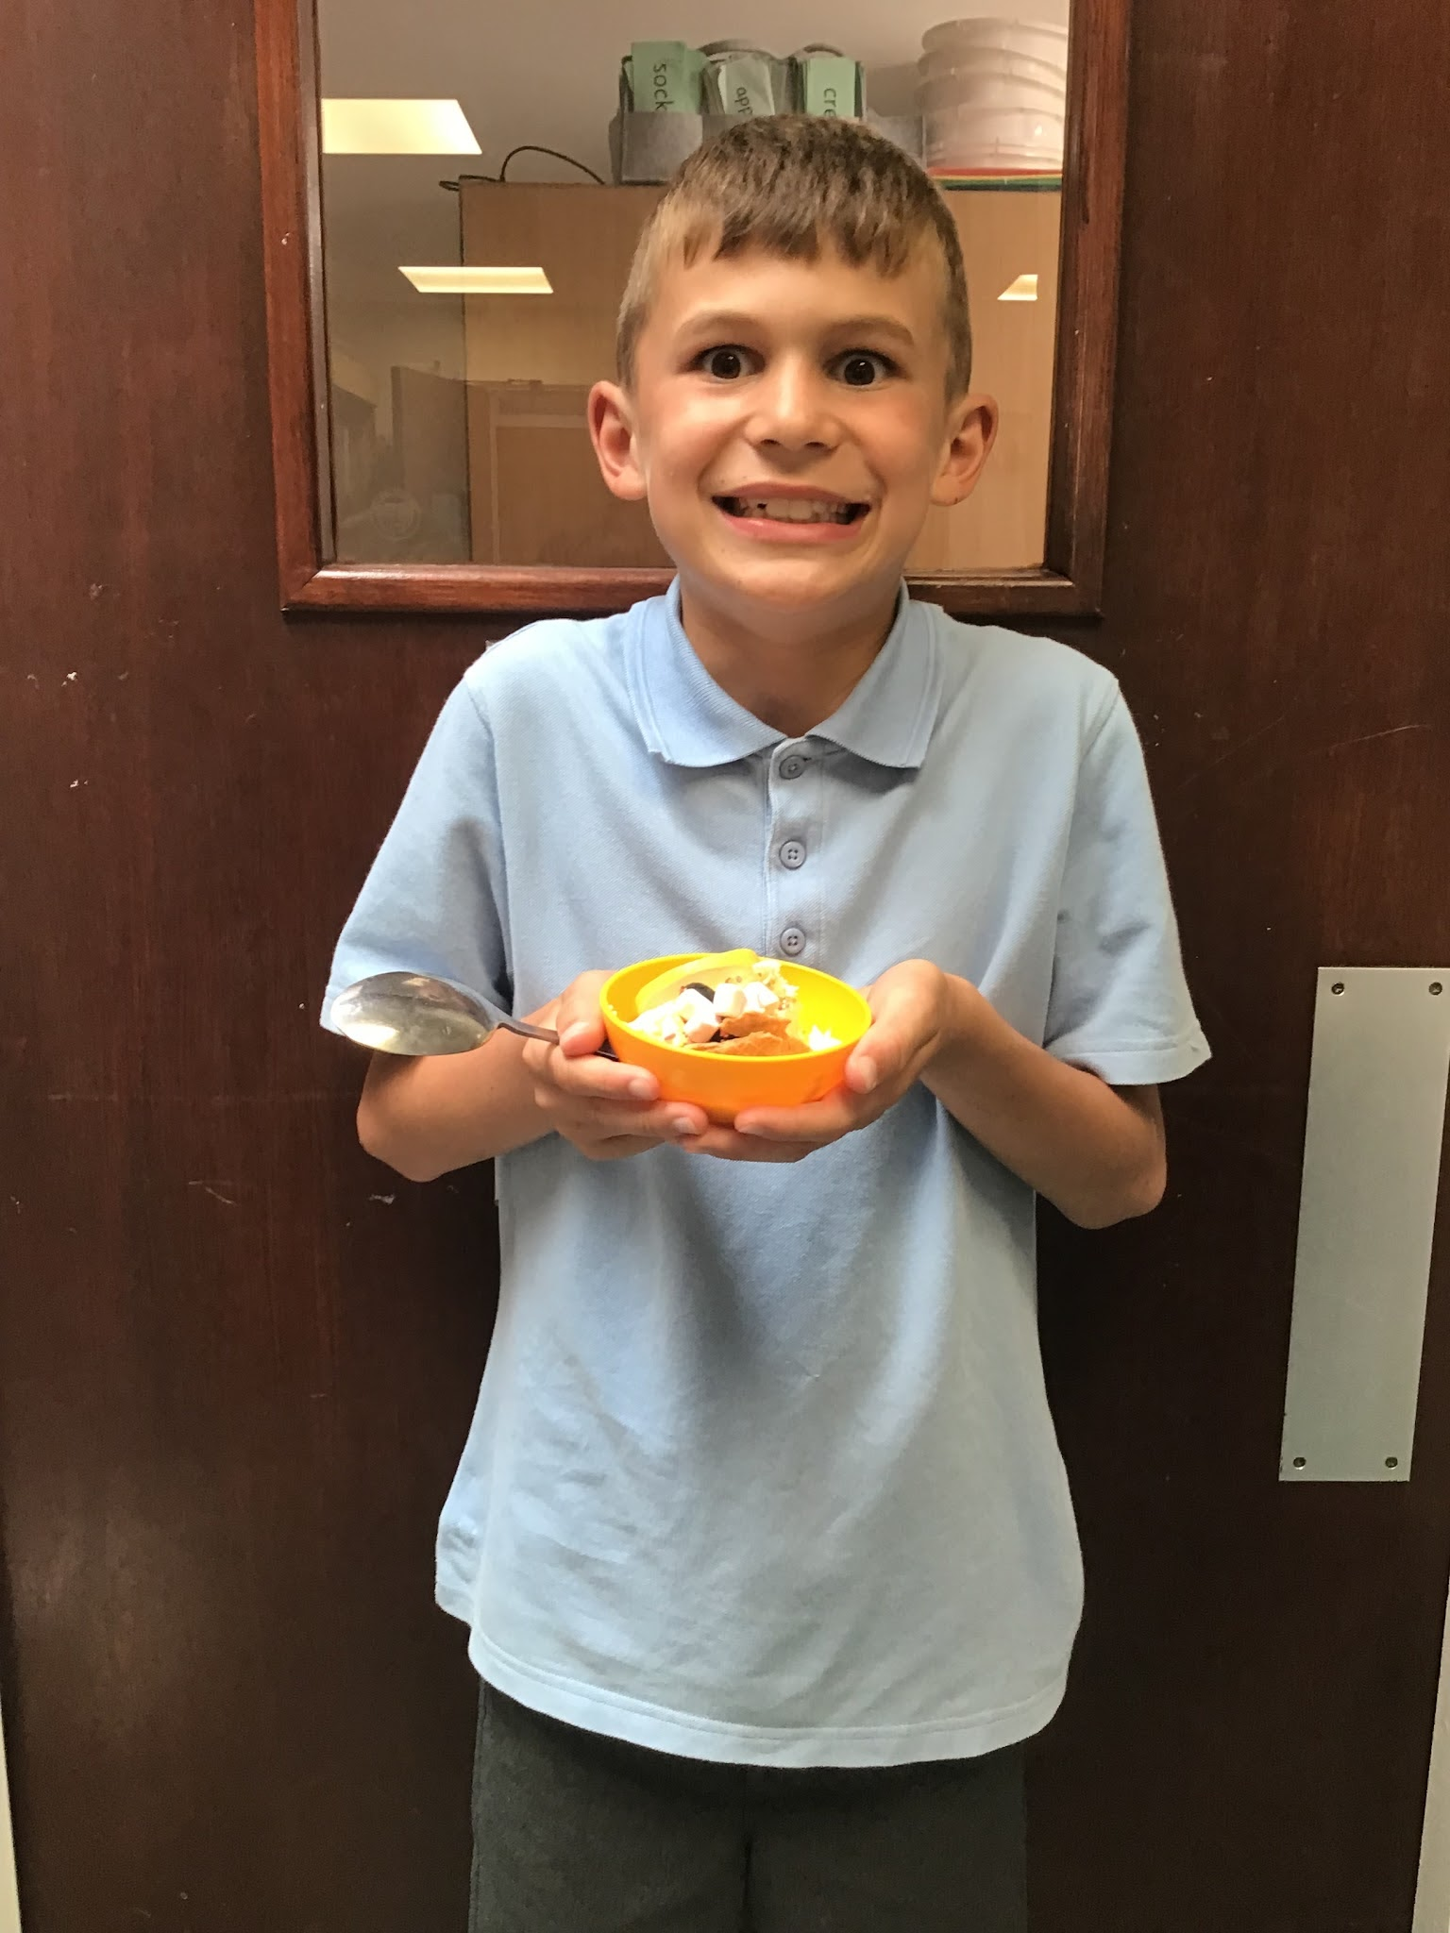
Year 4
We have enjoyed designing, making and eating our ice cream sundaes. The children made their own vanilla ice cream and thought about what toppings they could add to make a healthy ice cream sundae.

Slide 5






Word Wizard Winners:
Year 3 - Class
Year 4 - Class
Year 5 - Class
Year 6 - Class
Miss Deeks recommends:
The Green Planet. It is a factual book all about animals and plants.
Did you know that Grizzly bears front claws are 10cm long! Or that the tallest tree in the world is a Giant redwood.
It's full of great illustrations that are bright and colourful.
Fred says ‘Well done’ to ALL of our phonics groups! You have all worked hard to learn sounds, use Fred talk and read red words speedily! Keep on reading over the summer and see you in September!
Miss Turner recommends…
Brand New Boy by David Almond.
When a brand new boy called George starts at school, Daniel and his best friend Maxie are looking forward to getting a chance to enjoy the company of a new classmate. Daniel agrees to keep an eye on the new boy, although he has to admit there are a few unusual things about George.

Slide 6

Safeguarding at Cavalry School - during the holidays
Worried about a child?
If a child is in immediate danger or at risk of immediate harm, you should contact the Police on 999
If you are concerned about a child you should share your concern with our local Children’s Social Care Service by calling Cambridgeshire Children's Services on 01733 234724 or using https://cambridgeshire-self.achieveservice.com/service/Childrens_Services_online_referral_form
You can also contact the NSPCC for advice on 0808 800 5000 or email help@NSPCC.org.uk
If you have non urgent information about the safety or welfare of a child to share with the safeguarding team at Cavalry School then please email safeguarding1@cavalryprimary.org
Please note, this email is only monitored once daily during school holidays, it is not monitored during weekends.
If you need an immediate response or if you are concerned for a child’s immediate safety or welfare please contact the Police.
We are aiming for 97% attendance.
This week, our classes with the highest attendance are…
KS1 - Class
KS2 - Class
WELL DONE

Slide 7



Training Day Monday 20th July - SCHOOL AND NURSERY CLOSED
Training Day Tuesday 1st Sept
Back to School Wednesday 2nd September
Class 1 Parent workshops Wednesday 2nd 9.30-10.30 OR 1.30-2.30
Class 2 Parent workshops Thursday 3rd 9.30-10.30 OR 1.30-2.30
Reception start full time Friday 4th September
Clubs start wk beg 14th September
Training Day - Friday 24th October -
SCHOOL AND NURSERY CLOSED

Slide 8


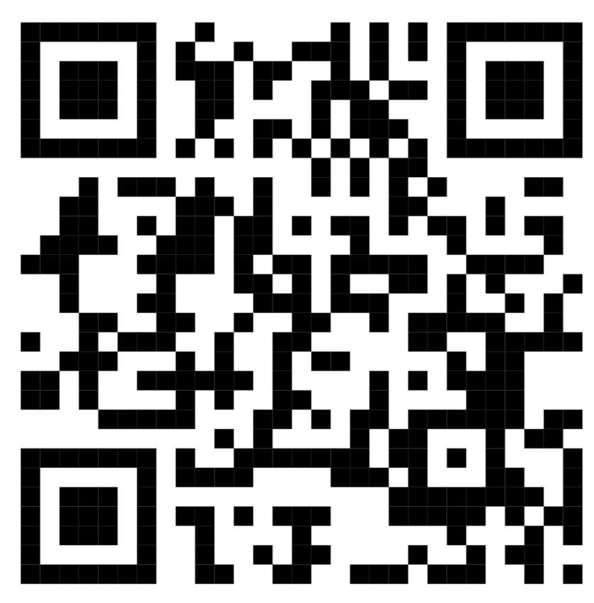
Cavalry Website
Contact us:
Cavalry Primary School
Cavalry Drive
March
Cambridgeshire
PE15 9EQ
office@cavalryprimary.org
Tel: 01354 652814

