Slide 1



19th September 2025
A Lowry Perspective
Seasons
Brilliant blending

Slide 2

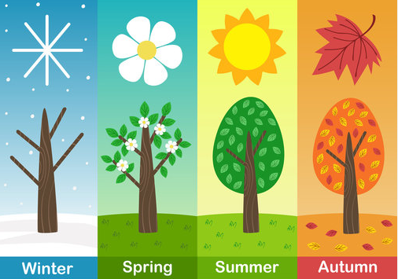
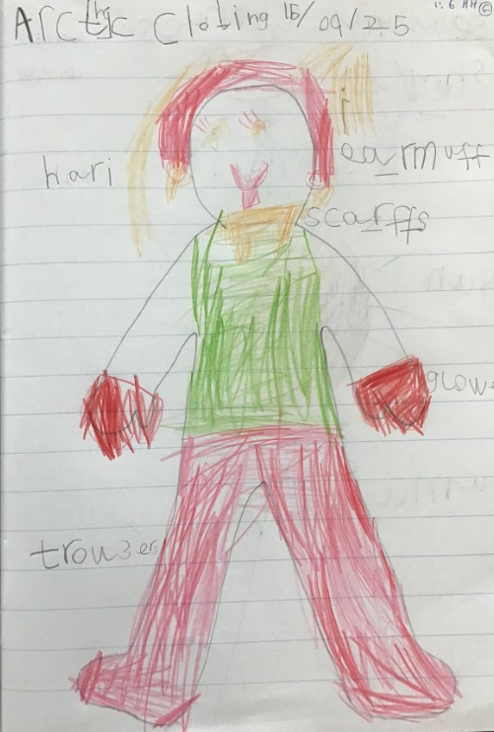
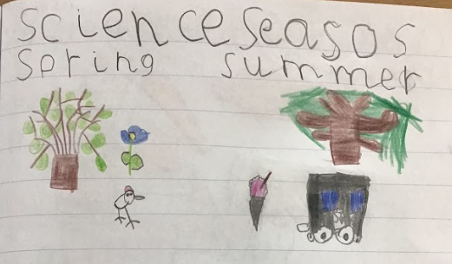
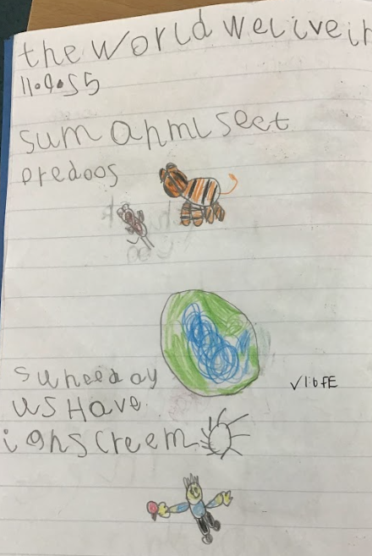

Year 1
Year 1 have been looking at seasons in science. The children have drawn beautiful pictures of what they feel represents the 4 seasons to them.
During year 1’s geography the children have been exploring everything ice! What clothes should you wear in the Arctic? What could you live in?
RE has brought lots of interesting conversations about the world we live in. They exchanged facts they knew about the world.

Slide 3
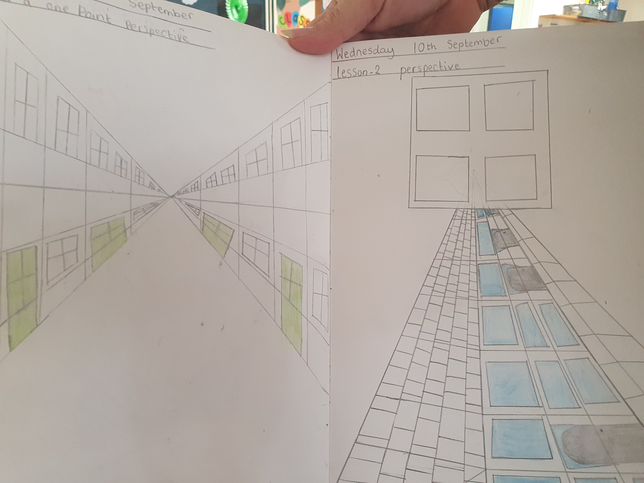
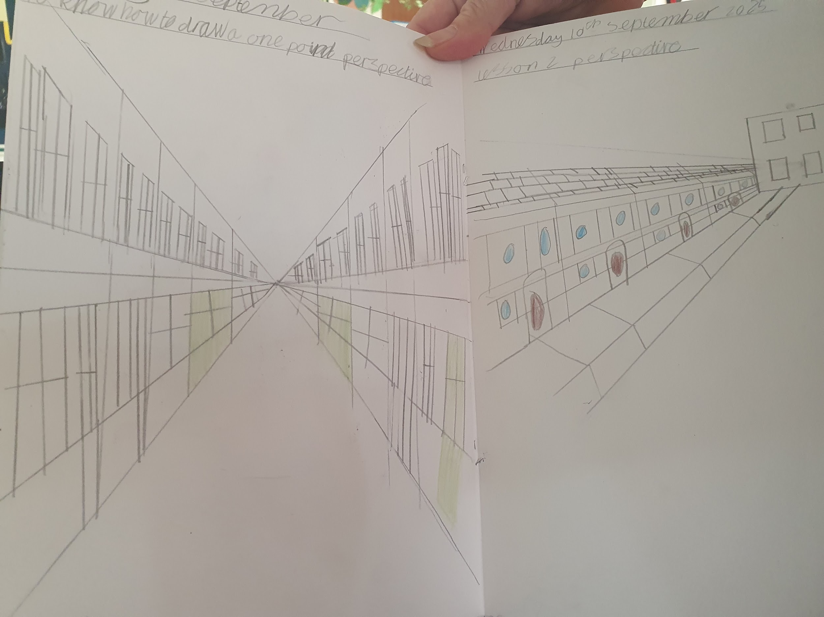
Year 5
Year 5 have been looking at the work of Lowry and drawing one point perspectives . We have been finding a vanishing point to start our art work.Here are some examples, i think you will agree they are amazing we are very proud of them in year 5.

Slide 4






Word Wizards:
Year 4 - Class 10
Year 5 - Class 12
Year 6 - Class 13
Well done to Mrs Elsey’s phonics group who have done brilliant blending and have worked really hard all week. Fabulous!
Miss Deeks recommends
I recommend
The suitcase kid by
Jacqueline Wilson.
It's an honest book and very moving, yet funny at the same time.
The illustrations by Nick Sharratt are
very artistic too.
Mrs Birt recommends…

Slide 5

We are aiming for 97% attendance.
This week, our classes with the highest attendance are…
KS1 - Class 3 97.67%
KS2 - Class 14 97.33%
WELL DONE

Slide 6



Harvest Festival (Foodbank Collection) Monday 6th October
School Photographs Tues 14th October
Parents’ Evening
Weds 15th October (3.30-6pm) Thurs 16th October (4.40-7pm)
‘Show Racism the Red Card’ Day Friday 17th October
Halloween Discos Thursday 23rd Oct (KS1 5-6pm) (KS2 6.15-7.15pm)
Last day of half term Thurs 23rd October
TRAINING DAY - Friday 24th October
Values are who you are … even when no one is watching.
Wk3- 15.09.25

Slide 7
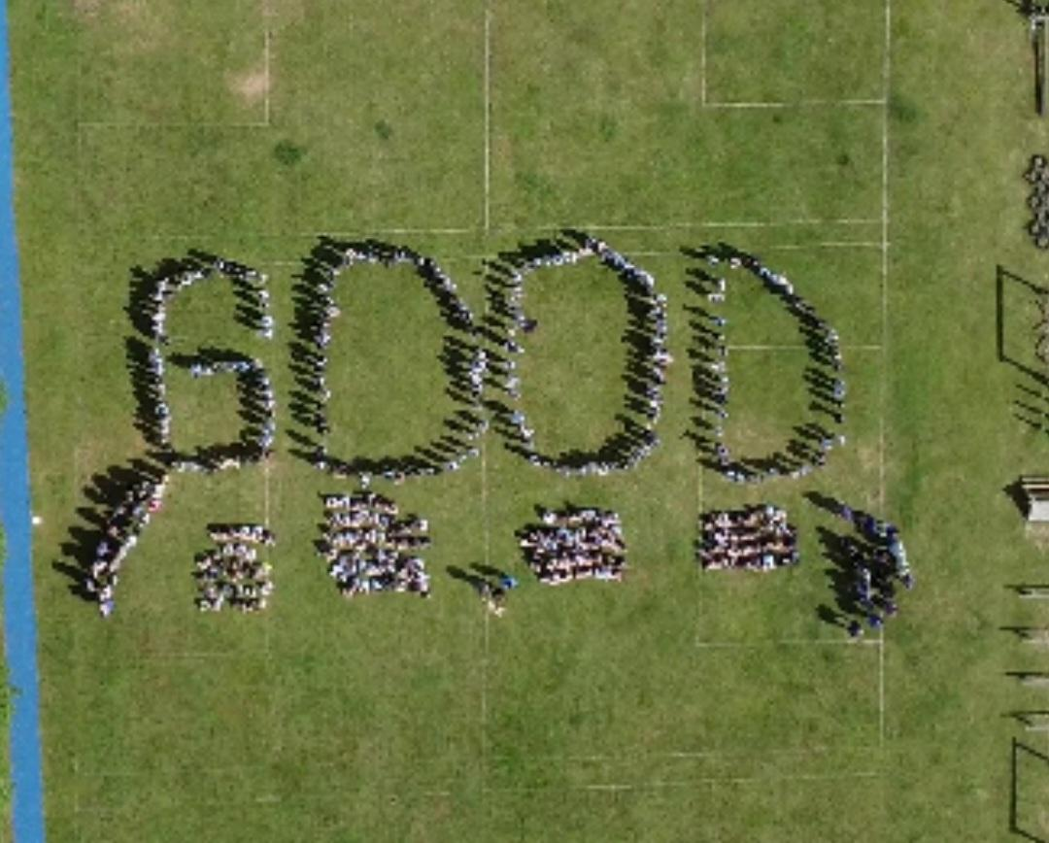


Cavalry Website
Contact us:
Cavalry Primary School
Cavalry Drive
March
Cambridgeshire
PE15 9EQ
office@cavalryprimary.org
Tel: 01354 652814

