Slide 1



15th May 2026
Well done, Year 6!
Railway roles

Slide 2

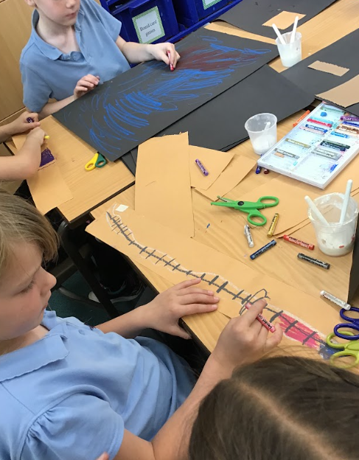
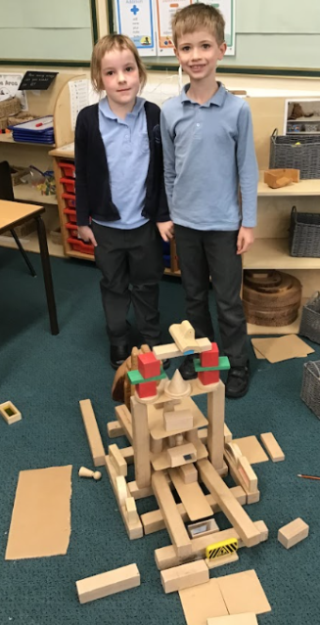
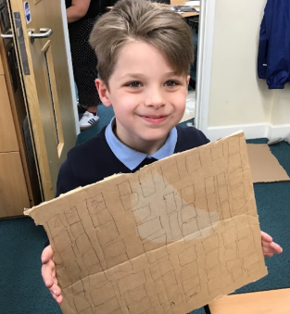
Year 2
Year 2 have been getting ready for our very exciting trip to the train station on Wednesday 3rd June!
We have been learning all about March train station and how the very first trains originated from.
We have also been learning about the different jobs that the railway provides behind the scenes. Ask us what we can remember…

Slide 3

Year 6
This week, Year 6 have been completing their SATs papers.
They have worked extremely hard throughout the year up to this point and we are very proud with the efforts they put into the papers.
Well done to all of Year 6!

Slide 4







Word Wizard Winners:
Year 3 - Class 7 (50,336)
Year 4 - Class 10 (225,935)
Year 5 - Class 12 (181,178)
Year 6 - Class 14 (480,232)
Miss Hickford recommends
Fred says ‘Well done’ to Miss Cawthorn’s phonics group. You are working hard to read alien words with Set 3 sounds and lots of you have been reading at home! Great work!
Mr Davies recommends…
“Bringing Down
The Moon” is a
great book for
bedtime with
one of my
favourite opening
lines.

Slide 5



KS2 Sports Day Wednesday 10th June 1.45-3pm
Nursery/ Rec Sports Day Thursday 11th June 2.15-3pm
KS1 Sports Day Friday 12th June 2.15-3pm
Gates open 15mins prior to the start.
Parents and carers are asked to find a seat
on the trim trail side of the running tracks.
Children are to be collected after from their
classroom doors only, not the field.
In the event of bad weather, if the sports day is
cancelled, we will notify you via Parentpay and
our school social media. A new date will be set
and shared also in this way.
We are aiming for 97% attendance.
This week, our classes with the highest attendance are…
KS1 - Class 6 94.14%
KS2 - Class 14 97.67%
WELL DONE

Slide 6



PTFA Meeting Monday 18th May
PTFA Summer Disco Thursday 21st May
LAST DAY THURSDAY 21st May
TRAINING DAY - SCHOOL CLOSED 22nd May
HALF TERM Monday 25th - Friday 29th May
Year 6 to the fire station 3rd June
Year 2 March-Ely train journey 3rd June
New Reception Parents Sept 2026 meeting
Thursday 4th June 6pm
Non uniform day for donations for summer fair
Friday 5th June

Slide 7



Cavalry Website
Contact us:
Cavalry Primary School
Cavalry Drive
March
Cambridgeshire
PE15 9EQ
office@cavalryprimary.org
Tel: 01354 652814

