Slide 1



10th July 2026
  Celebrating Reception
  Blue Planet River Systems

Slide 2

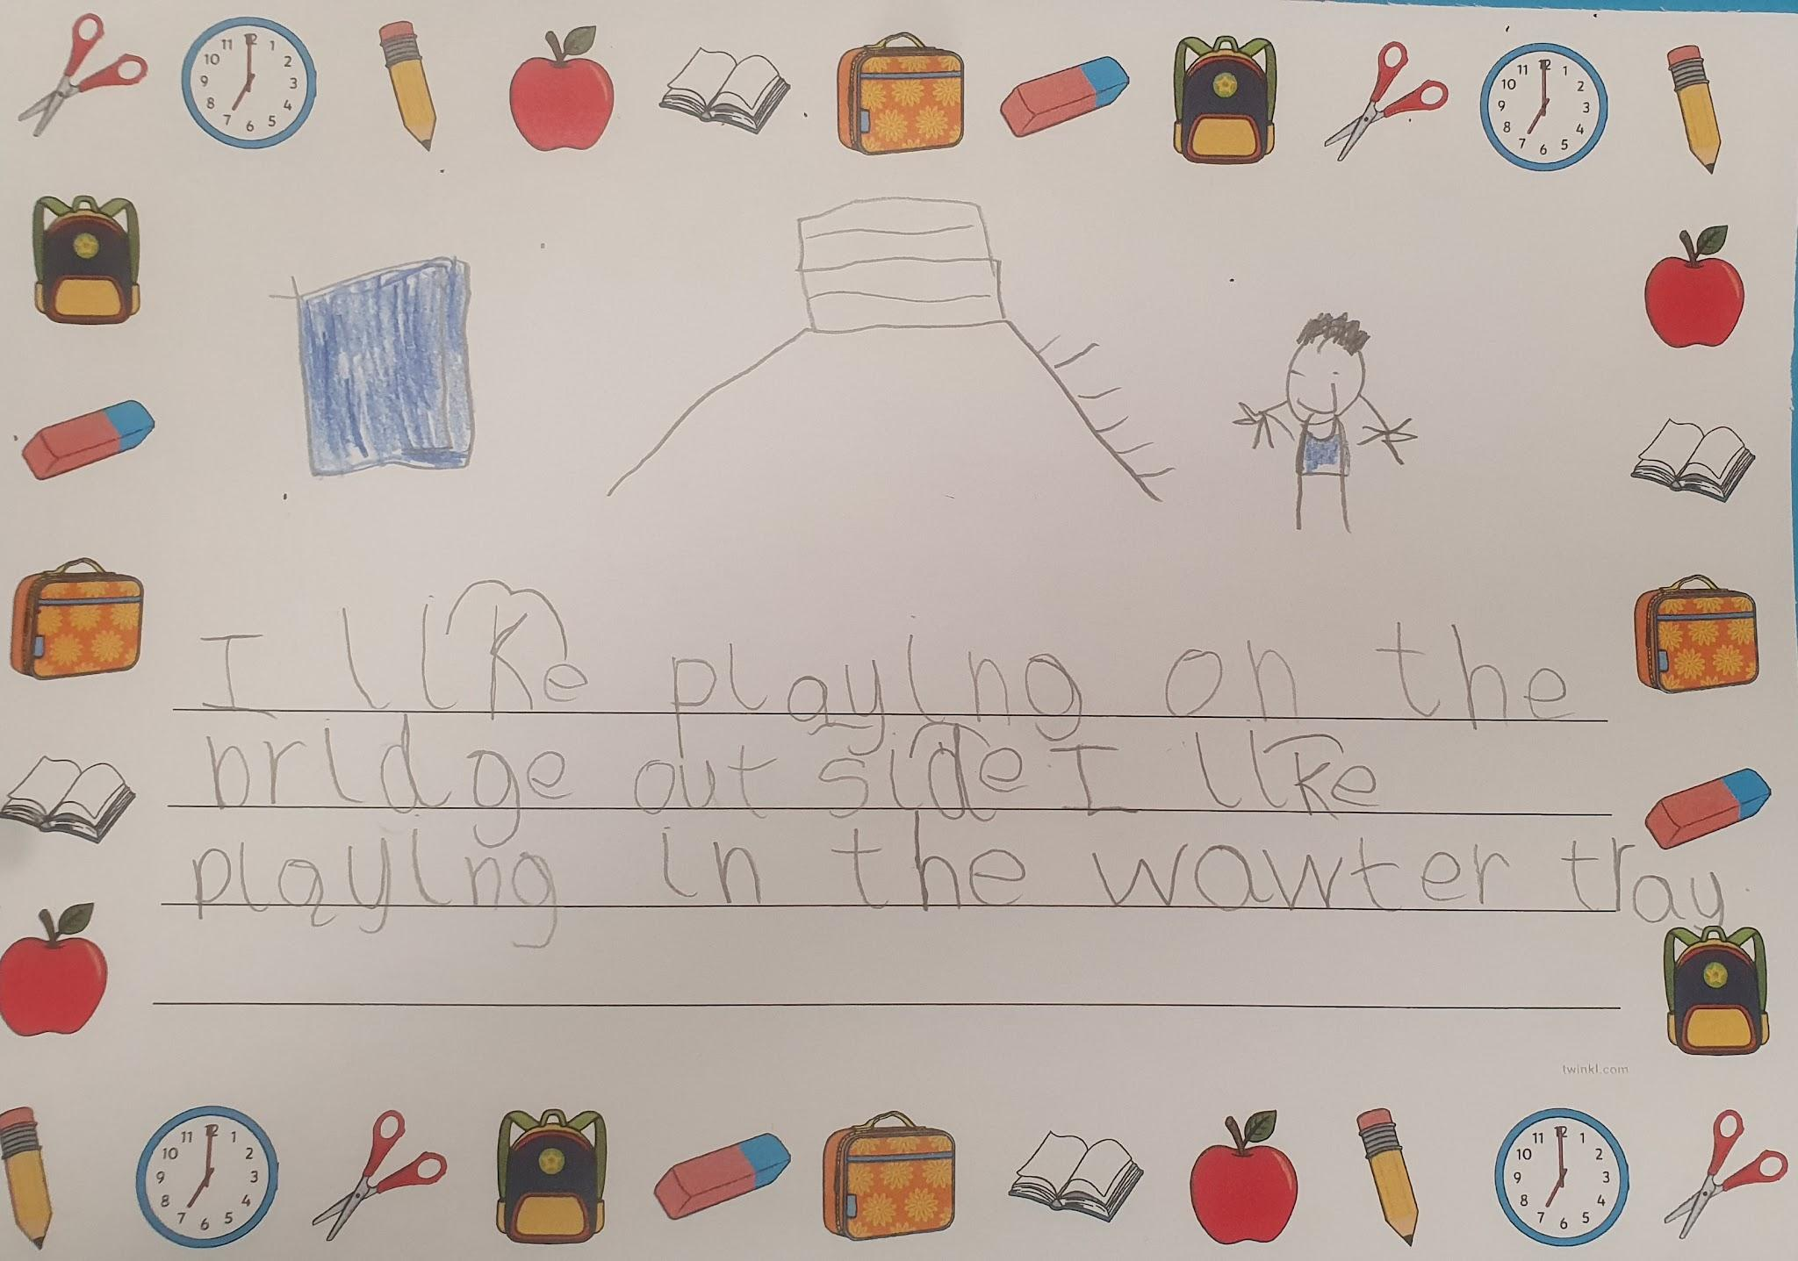
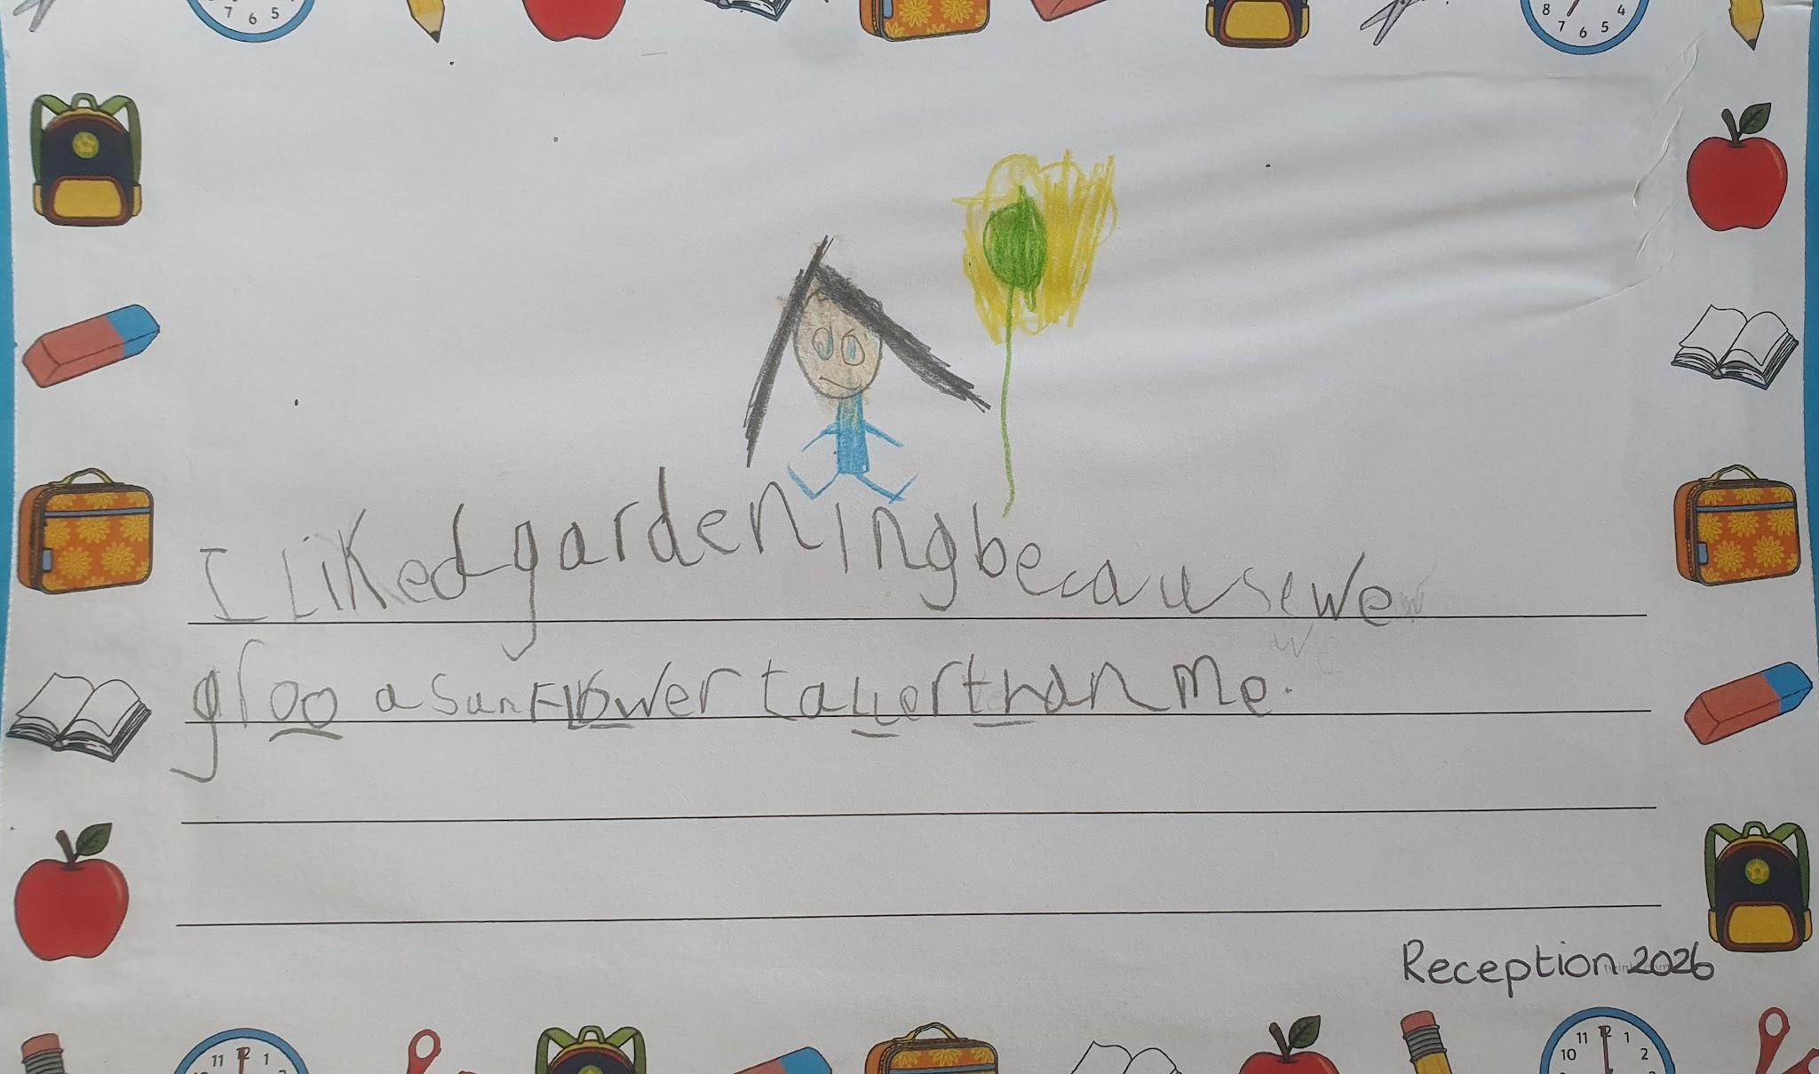
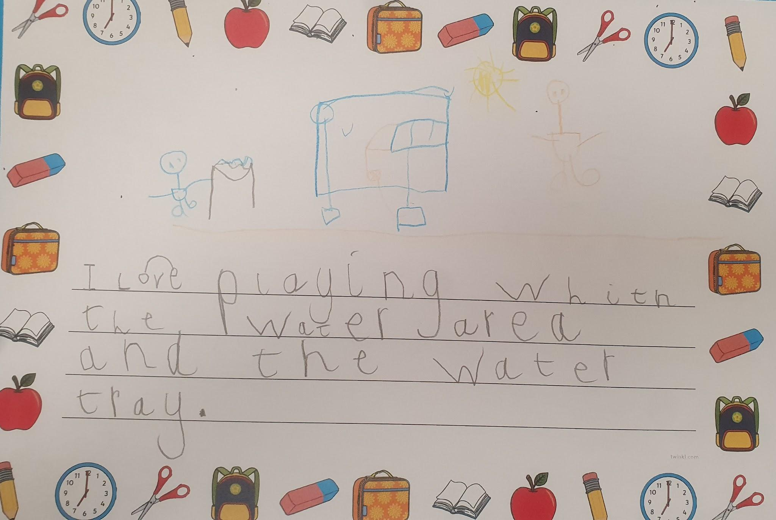
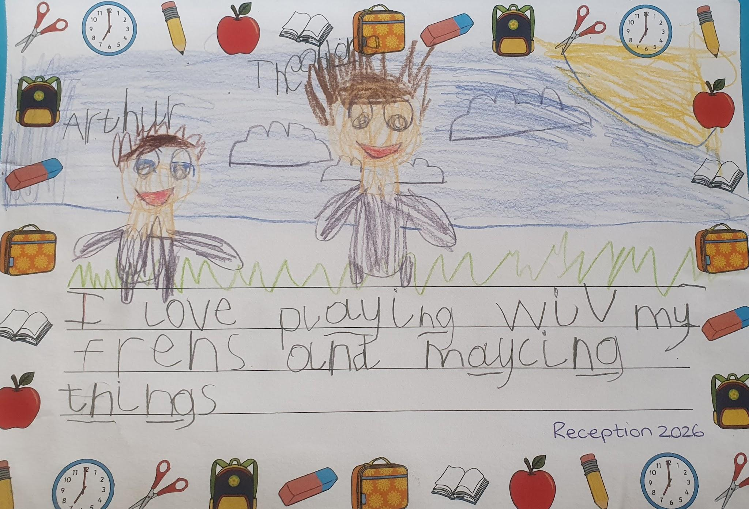
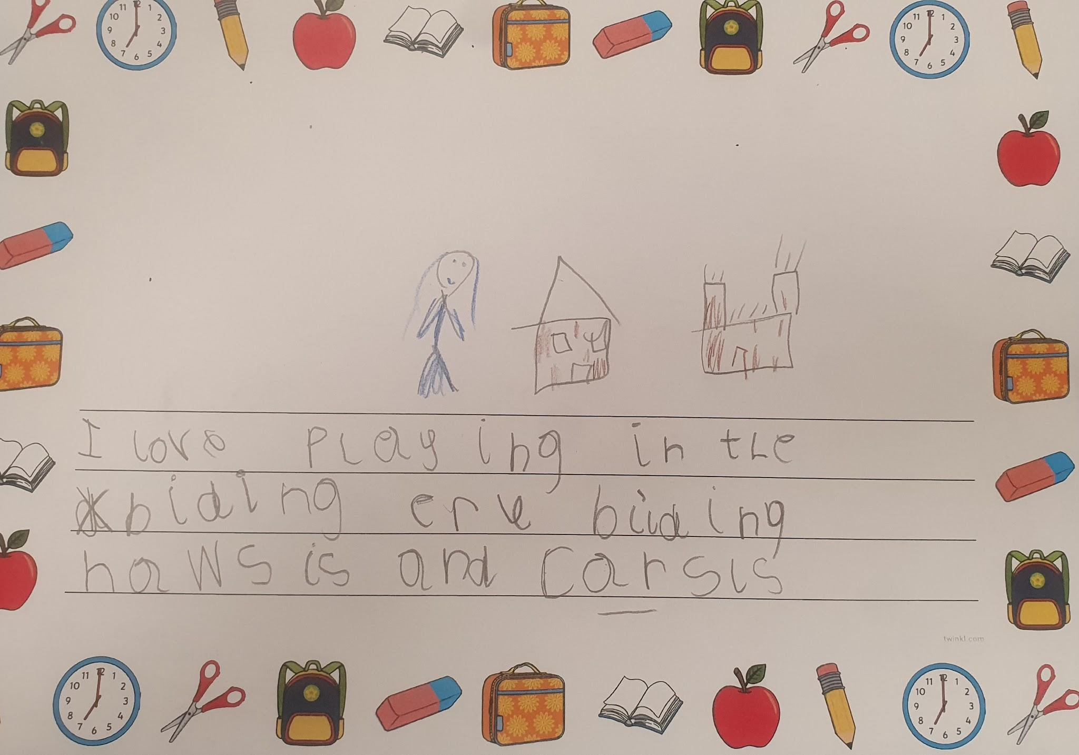
Our Reception pupils have been busy reflecting on a fantastic first year at school. They thought about what they have liked the most about being in Reception and wrote about it as their final piece of special writing. We are so proud of every child in Reception and the incredible journey they have been on since September. What a year!
Reception

Slide 3
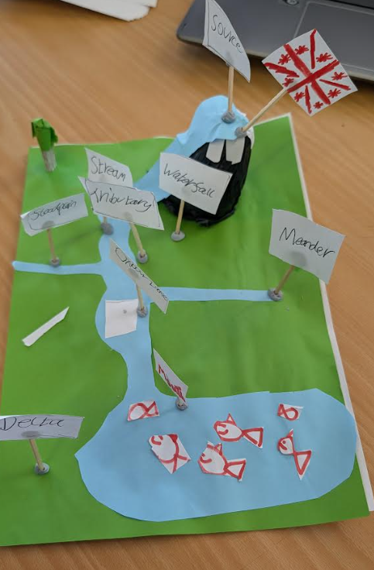
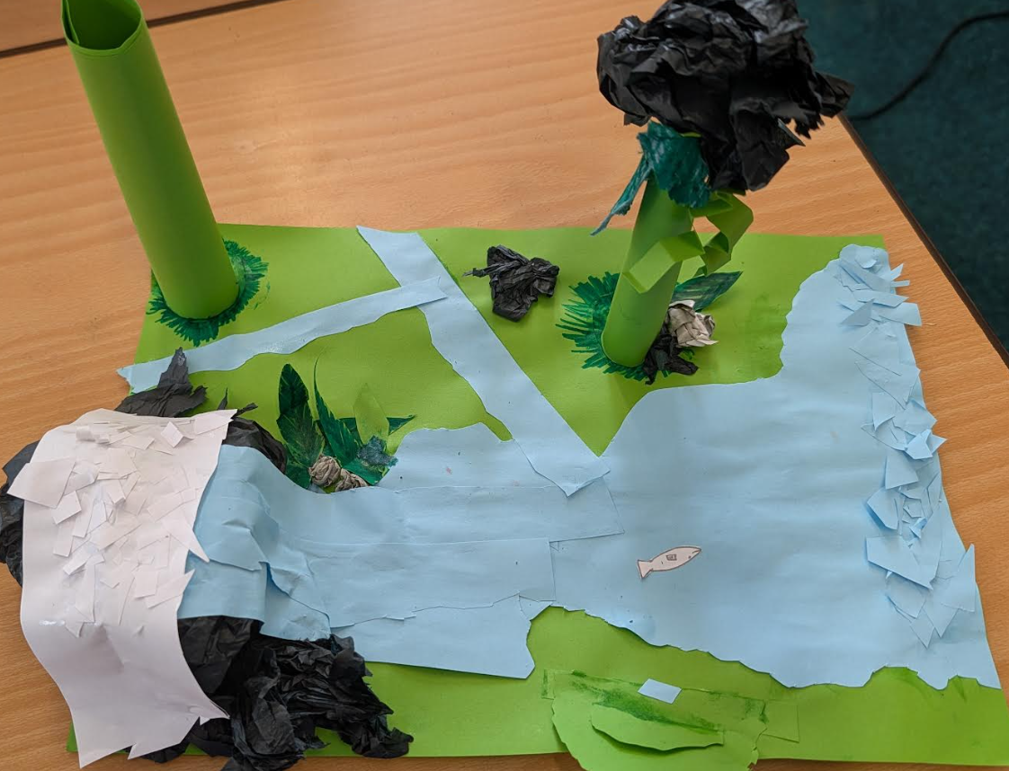
Year 5
As part of our Science topic on Our Blue Planet, Year 5 made wonderfully creative models of rivers, labelling key parts such as the source, stream and tributaries!

Slide 4







Word Wizard Winners:
Year 3 - Class 7
Year 4 - Class 10
Year 5 - Class 11
Year 6 - Class 13
Mrs Banks recommends
We have enjoyed this wonderful story set in Kenya. We even used instruments in reception to add sound effects for the weather!
Fred says ‘Well done’ to Mrs Wilson’s group, you are working so hard to form your letters correctly!
Mr Harris recommends…
The Family Quiz
Written in the form of a rhyming series of questions, The Family Quiz depicts all kinds of families, whether that’s a boy and his dad, a family with lots of dogs, a family of friends, a musical troupe, a family that does yoga or a family that’s a girl and her grandparents. A great book about all different types of families.

Slide 5


We are aiming for 97% attendance.
This week, our classes with the highest attendance are…
KS1 - Class 2 95.93%
KS2 - Class 14 95%
WELL DONE

Slide 6



Year 6 trip Monday 13th July
Jump up Day Tuesday 14th July 9.30-10.30
Summer Fair Wednesday 15th July 2-4pm
Reception trip to Sandringham 16th July
Greek day for Year 3 16th July
Last day of term Friday 17th July - whole school picnic
Training Day Monday 20th July - SCHOOL AND NURSERY CLOSED

Slide 7


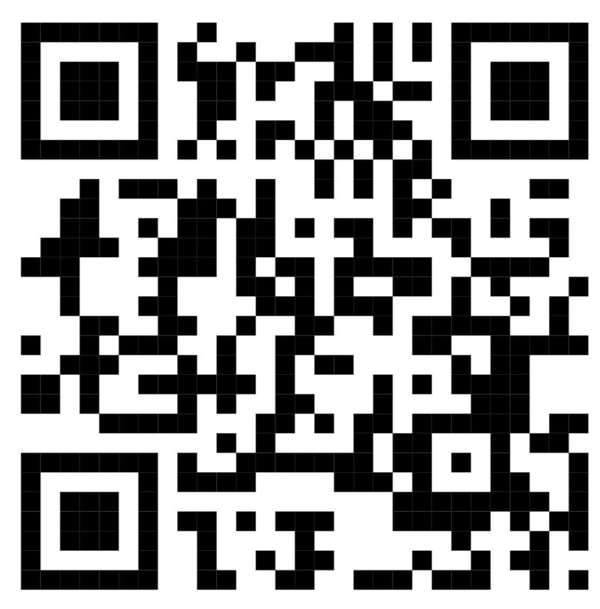
Cavalry Website
Contact us:
Cavalry Primary School
Cavalry Drive
March
Cambridgeshire
PE15 9EQ
office@cavalryprimary.org
Tel: 01354 652814

