Slide 1



26th June 2026

Slide 2

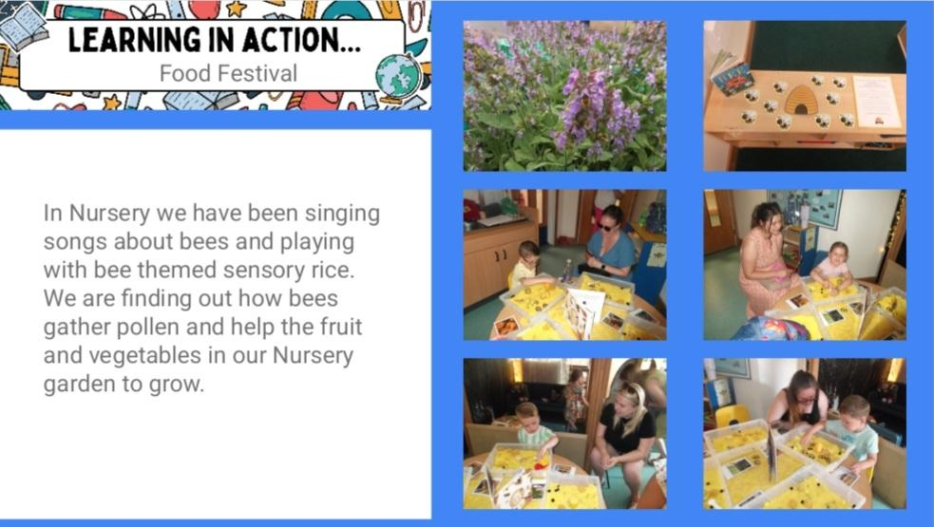
Food Festival

Slide 3
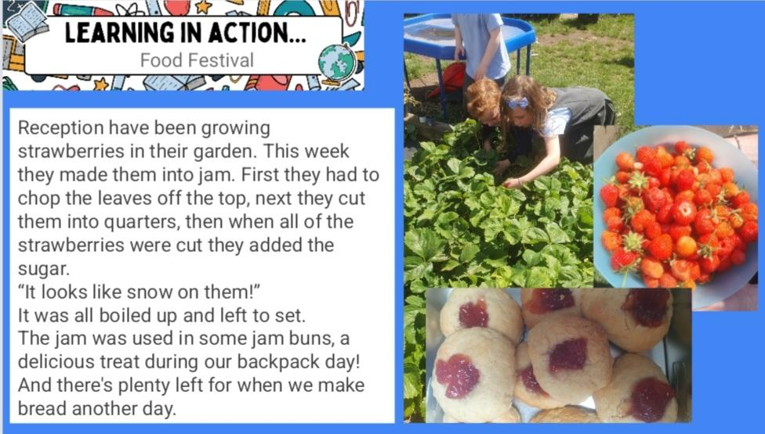
Food Festival

Slide 4
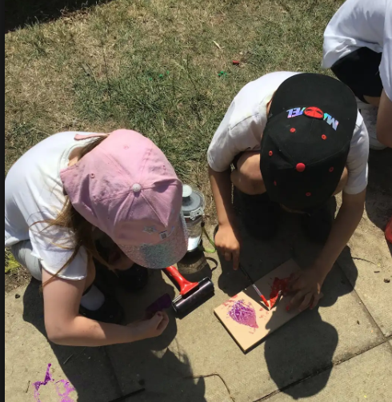
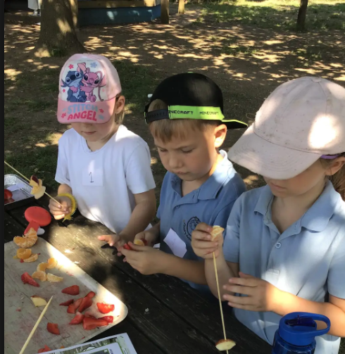
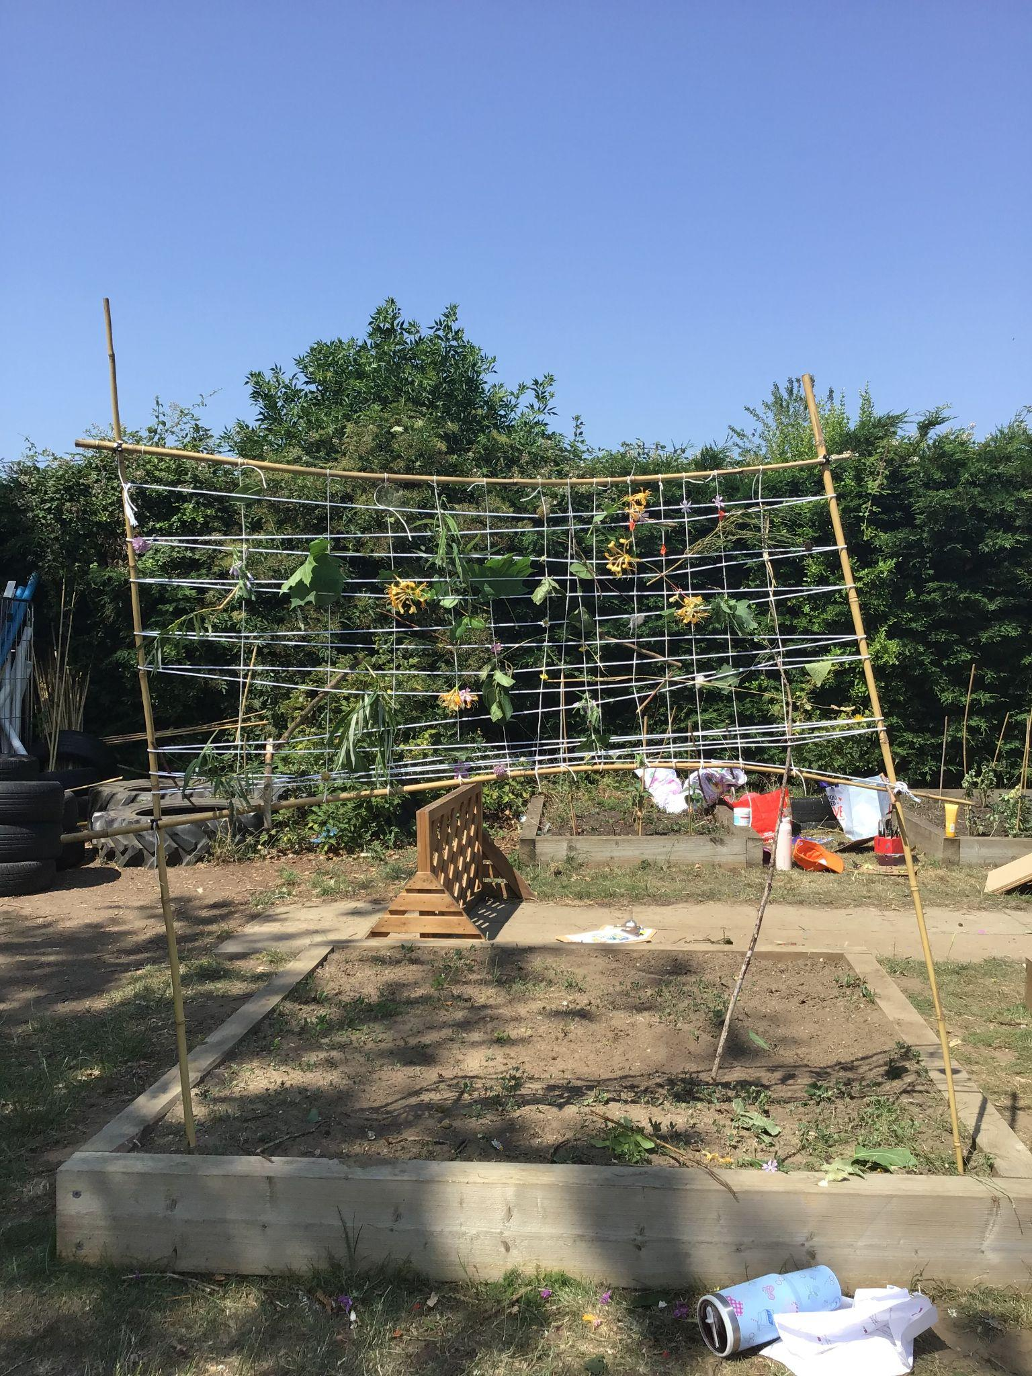
Year 1
On Backpack day we had great fun making dens, making and eating fruit kebabs, getting crafty and pond dipping! The children had conversations about where the different fruit came from.

Slide 5
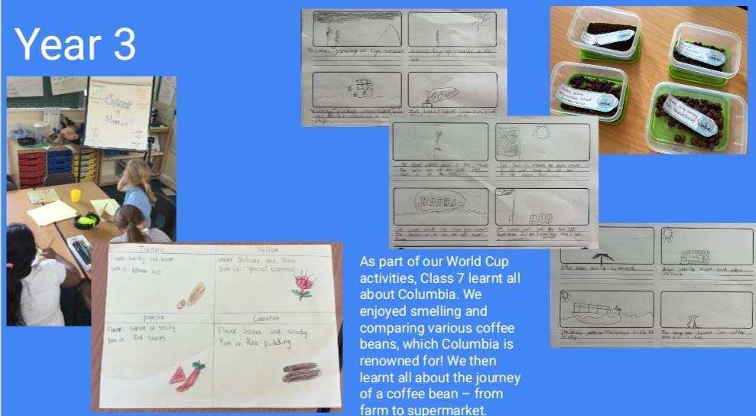

Slide 6
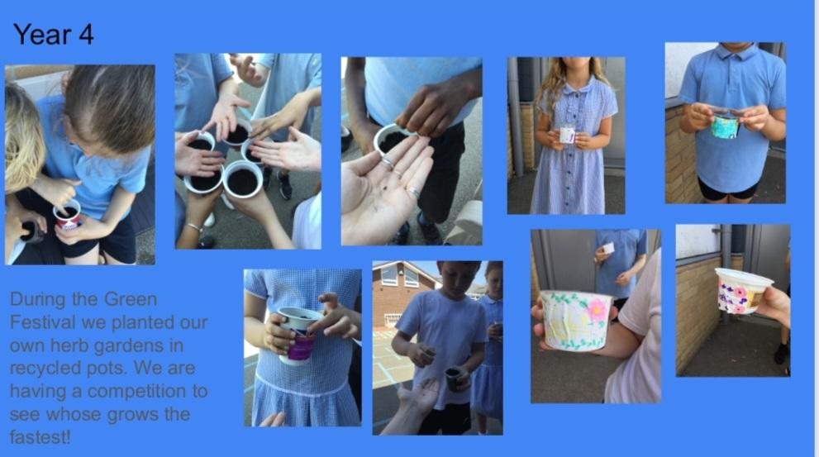

Slide 7
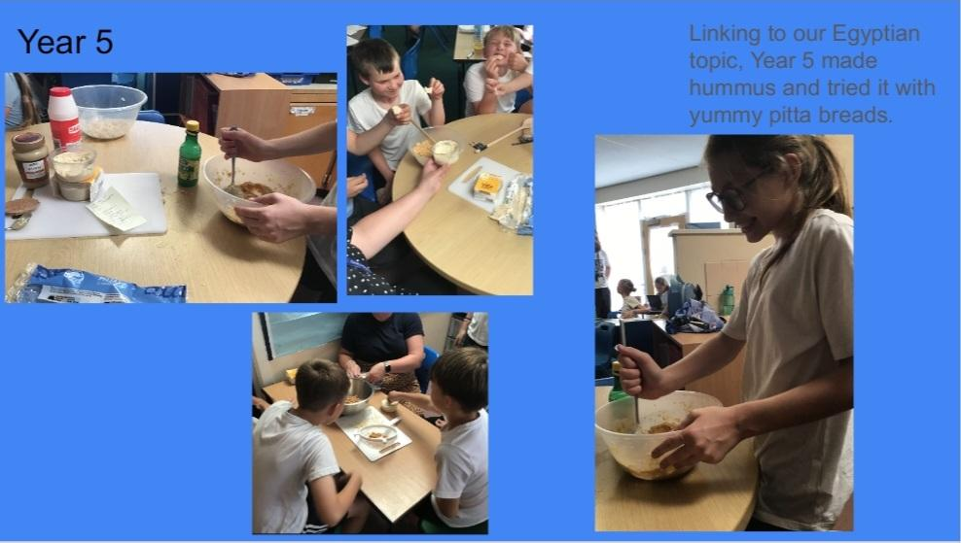

Slide 8
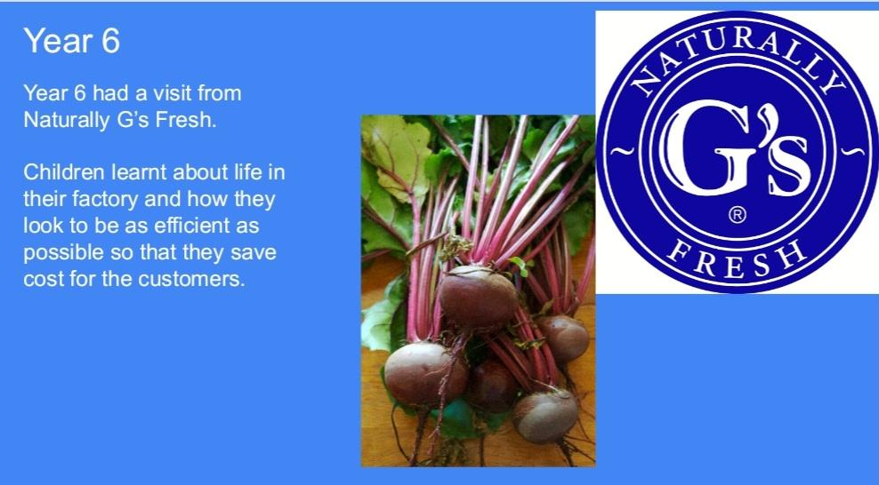

Slide 9











Word Wizard Winners:
Year 3 - Class 8 (126,238)
Year 4 - Class 10 (187,735)
Year 5 - Class 12 (288,280)
Year 6 - Class 13 (382, 065)
about insects and habitats
Fred says ‘Well done’ to Mrs Darnell’s phonics group, you’ve been working hard to read your red words speedily!
These books about gardens and growing?

Slide 10


GREAT TALKING…
This food week, try asking these questions to your child. Make sure you model your own answer for them to see such as
“I would rather eat breakfast for dinner because I love cereal, especially weetabix with blueberries and banana on top!”
We are aiming for 97% attendance.
This week, our classes with the highest attendance are…
KS1 - Class 4 91.33%
KS2 - Class 7 95.36%
WELL DONE
Can you think of your own questions?

Slide 11



Rec Vision Screening Tuesday 30th June
Swimming Gala Thursday 2nd July
Yr 3 Burwell House 8th - 10th July
Yr 1 Church Farm trip 2nd July
Summer Concert Wed 1st July 1:30-3pm
Jump up Day Tuesday 14th July 9.30-10.30
Summer Fair Wednesday 15th July 2-4pm
Reception trip to Sandringham 16th July
Last day of term Friday 17th July - whole school picnic
Training Day Monday 20th July - SCHOOL AND NURSERY CLOSED

Slide 12



Cavalry Website
Contact us:
Cavalry Primary School
Cavalry Drive
March
Cambridgeshire
PE15 9EQ
office@cavalryprimary.org
Tel: 01354 652814

