Slide 1



12th June 2026
  Alien crash landing
  Egyptian coin bags

Slide 2

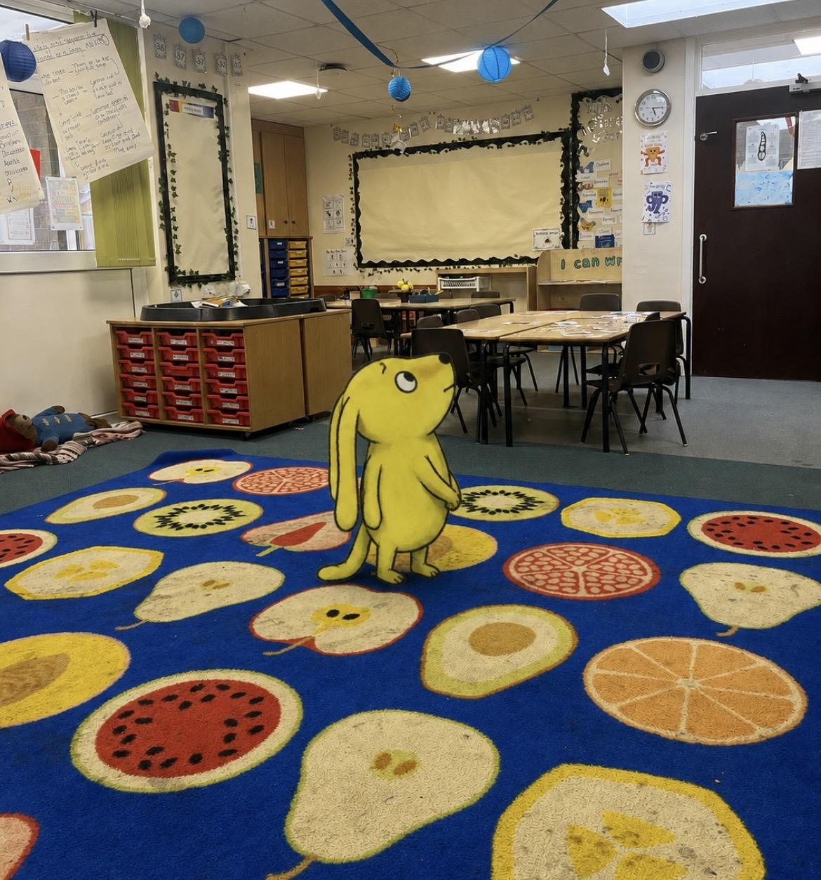
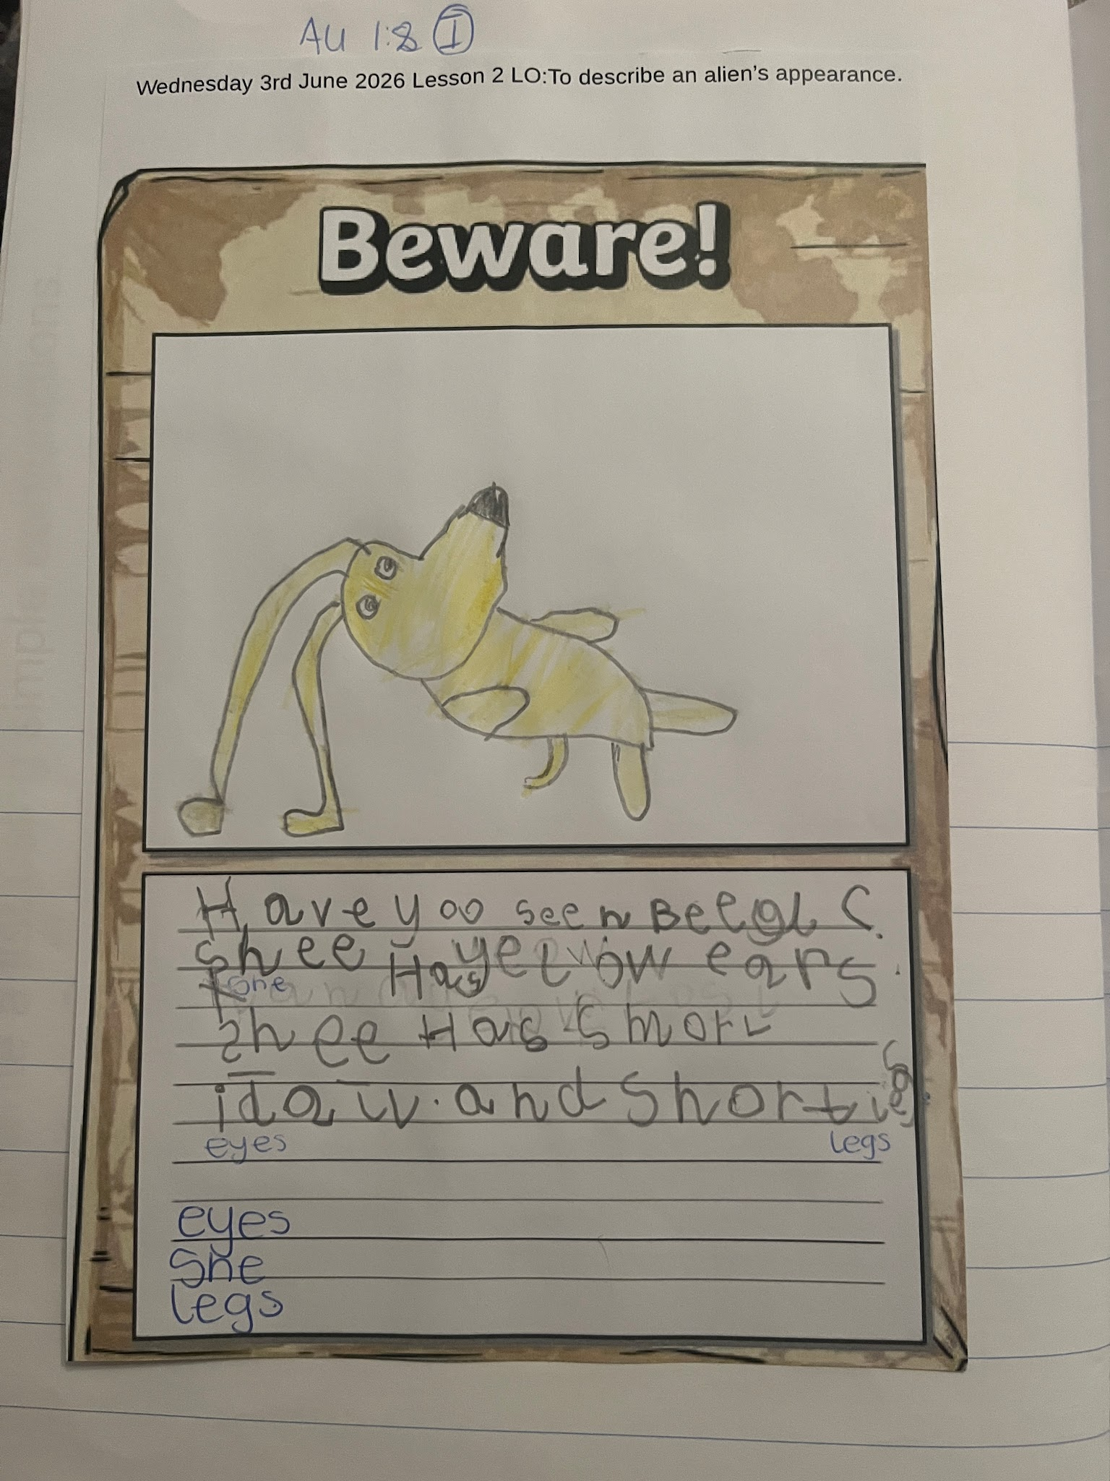
Year 1
An alien crash landing has happened at Cavalry this week in year 1. The alien in question is called Beegu . Year 1 have been investigating ways that we can help Beegu get home. This has included making posters to help pupils keep an eye out for her.

Slide 3
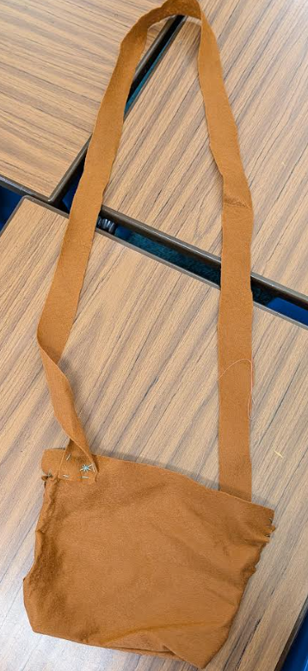
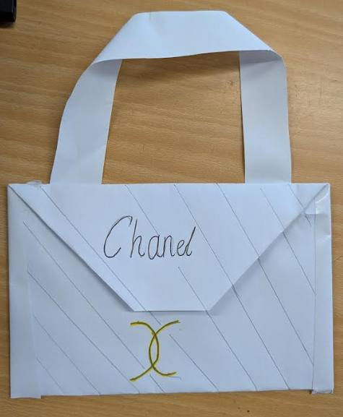
Year 5
After creating design ideas and making paper versions, Year 5 have been using needles, thread and felt to craft their own, unique Egyptian coin bags linking to all our learning in History! These bags would be ideal for trade back thousands of years ago but can still serve a useful purpose today!

Slide 4







Word Wizard Winners:
Year 3 - Class
Year 4 - Class
Year 5 - Class
Year 6 - Class
Miss Jones recommends ‘Little Turtle and the Changing Sea’.
It is such a beautiful and thought-provoking story that follows a young turtle on an important journey through the ocean, gently introducing themes of friendship, resilience and caring for our environment.
I won't give too much away, as our lovely Year 1 children will have the chance to read and enjoy this wonderful book next week!
Fred says ‘Well done’ to all of Year 1!!! You completed your phonics quizzes this week and did fantastic! Super proud of you all.
Mr Popeley recommends…
To Be a Cat by Matt Haig -
This funny and thoughtful story centres around Barney, who wishes he could escape his problems by becoming a cat, only to discover that life looks very different from another point of view…

Slide 5

We are aiming for 97% attendance.
This week, our classes with the highest attendance are…
KS1 - Class 4 97.67 %
KS2 - Class 12 97.1%
WELL DONE

Slide 6



Cavalry Food Festival 22nd -26th June
Nursery Summer Festival Weds 24th June
1-2.30pm
Summer Fair Friday 26th June 3.30 - 5pm
Rec Vision Screening Tuesday 30th June
Swimming Gala Thursday 2nd July
Yr 3 Burwell House 8th - 10th July
Yr 1 Church Farm trip 2nd July
Summer Concert Wed 1st July 1:30-3pm
Jump up Day Wednesday 15th July 9.30-10.30
Reception trip to Sandringham 16th July

Slide 7



Cavalry Website
Contact us:
Cavalry Primary School
Cavalry Drive
March
Cambridgeshire
PE15 9EQ
office@cavalryprimary.org
Tel: 01354 652814

