Slide 1
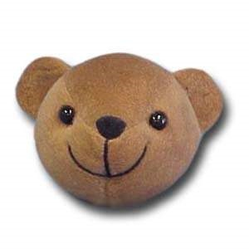
Teddy Turns

Slide 2
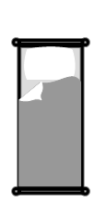
A whole turn
Teddy starts by facing the bed, he turns all the way around on the spot and ends up facing the bed again!
A whole turn is where you turn all the way around and end up facing the same way!

Slide 3
A half turn
A half turn is where you turn on the spot to face the opposite way!
Teddy starts by facing the bed, he decides to complete half a turn and ends up facing the armchair!

Slide 4
Left
Right
Can you copy Teddy?

Slide 5
Quiz
Is this a whole turn or half turn?
Whole turn

Slide 6
Quiz
Is this a whole turn or half turn?
Half turn

