Slide 1



1st May 2026
  Life cycles
  Brilliant biographies

Slide 2

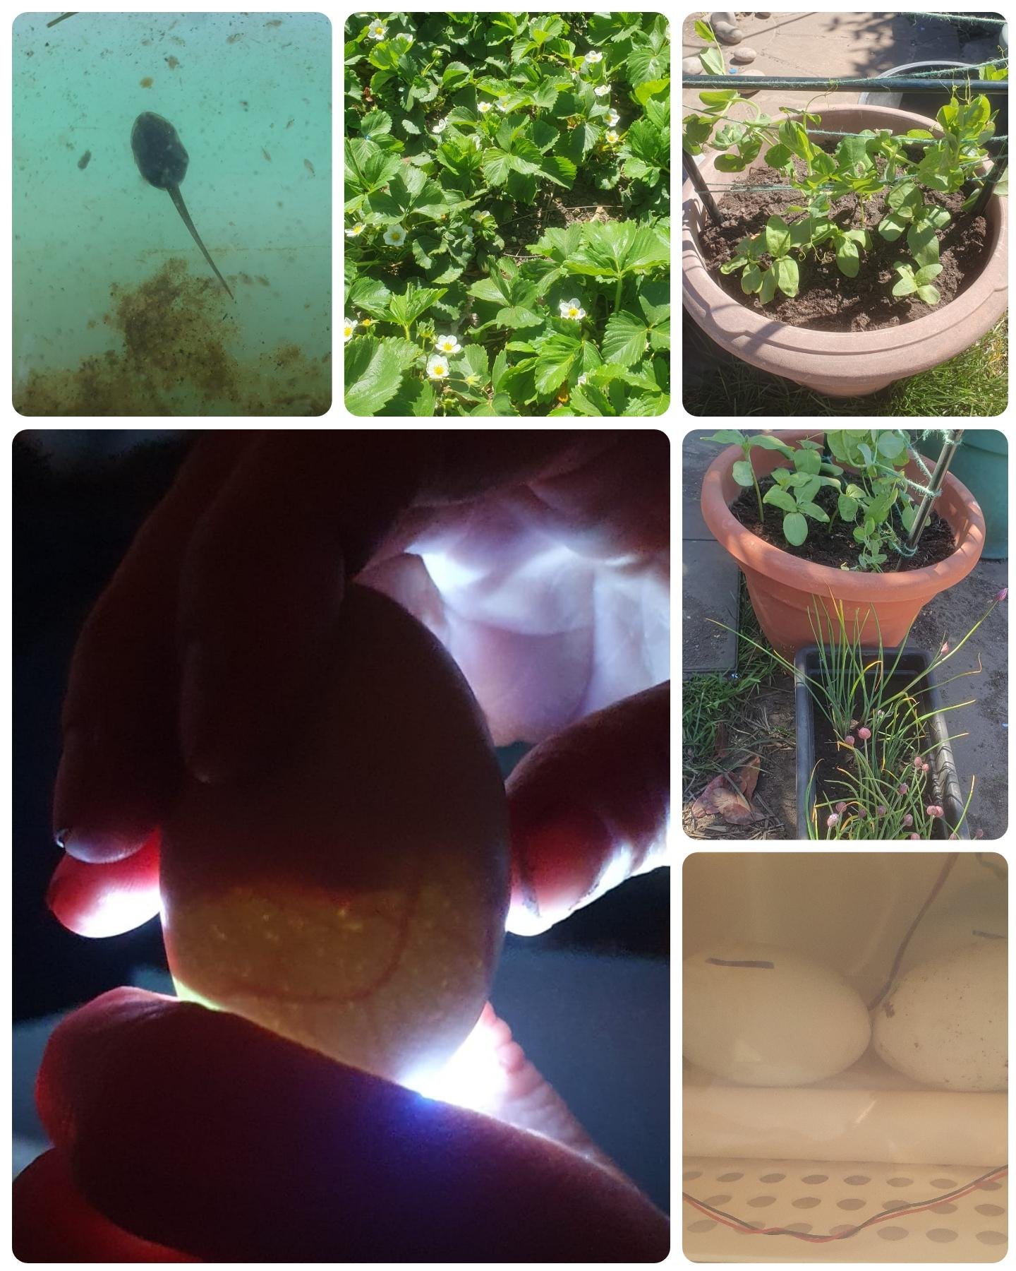
Reception
Our Reception pupils have been learning about different life cycles, how different things grow and change. Six weeks ago they planted some seeds. These are now growing and they have noticed different leaves. We have strawberries, peas, beans, chives, potatoes, cucumbers and tomatoes. We can't wait to harvest them during our food festival!
We have also been watching as our frogspawn grew and changed into tadpoles. They have developed very round bodies and long tails but no legs yet.
Finally, we have had six eggs in an incubator for the past 18 days. We have watched as the incubator slowly rotates the eggs and kept an eye on the temperature and humidity but now it's almost time for them to hatch. This bank holiday the chicks should hatch and we can't wait to see how many we get. We tried ‘candling’ the eggs and were excited to see veins which means that there should be a chick present!
What an EGG-CITING time it is in Reception!

Slide 3
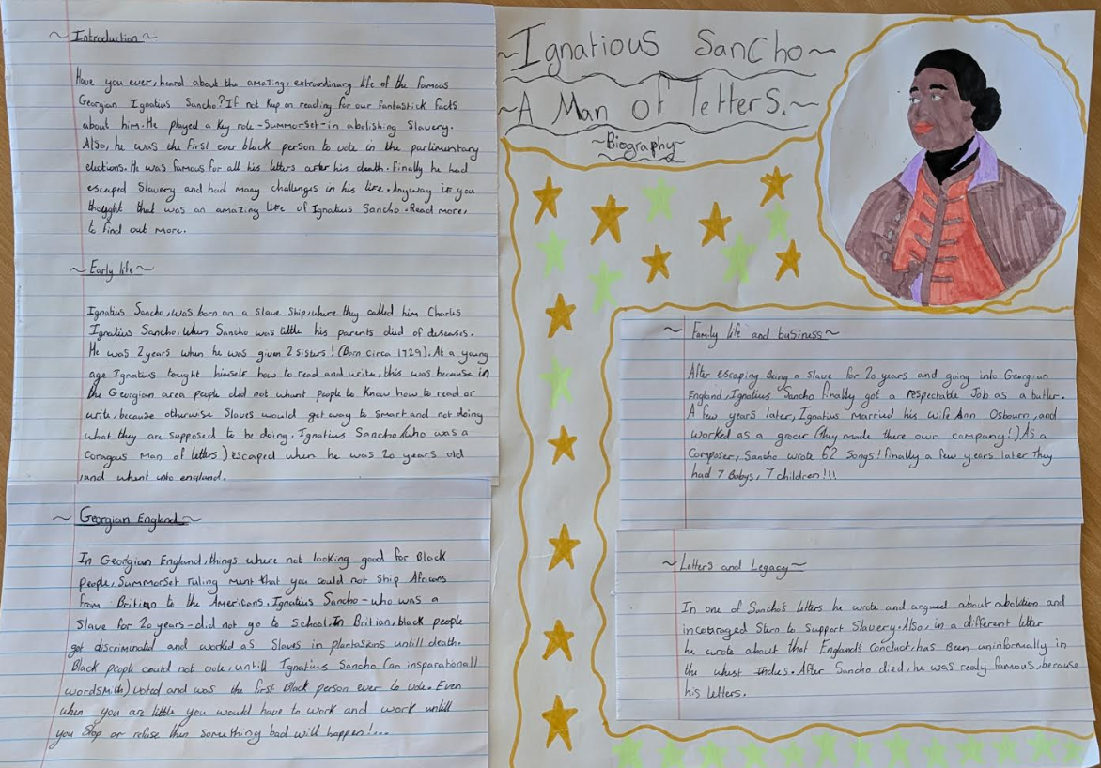
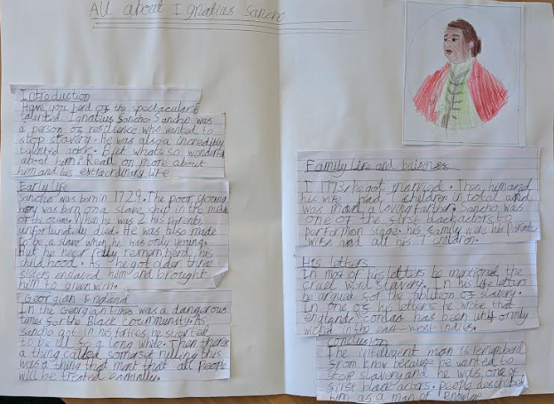
Year 5
Year 5 have produced some absolutely fantastic pieces of publishing. Coming off the end of our historical detective book in English, the children have created these brilliant and unique biographies of protagonist Ignatius Sancho - who was a real abolitionist and writer in the Georgian times.

Slide 4







Word Wizard Winners:
Year 3 - Class 7 (38,892)
Year 4 - Class 10 (172,274)
Year 5 - Class 11 (193,082)
Year 6 - Class 13 (399,026)
Mrs Banks recommends
The Night Pirates by Peter Harris.
An exciting adventure about a little boy who joins a group of pirates on their adventures!
Fred says ‘Well done’ to Mrs Elsey’s group for their speedy Fred talk!
Mrs Wilson-Pearce recommends…
Loki: A Bad God’s Guide to Being Good.
Loki, the trickster God, has been banished to Earth by Odin to live as an 11 year old boy. In order to go back home, he has to go to school and do good deeds. A great series of books!

Slide 5


March Town Cricket Club is an ECB Clubmark accredited cricket club. This means the club is recognised as a safe, rewarding and fulfilling place for participants of all ages. As part of our junior cricket offer we run ECB national programmes called All Stars (aged 5-8 years) and Dynamos (aged 8-11 years). These offer an excellent introduction to cricket and provide the starting point for progressing through our age group teams all the way into our men’s and women’s teams. We run the programmes on Sunday mornings at the club and start on 10 May.
You can find out more about, and sign up for, All Stars and Dynamos by following the links. Just enter your postcode and it will show you all the local centres delivering the programmes. The cost for All Stars is £50 and for Dynamos £40 (we are a little cheaper than other clubs for Dynamos). The links will tell you what you can expect for your money but if you have any questions please contact Mark Deas, MTCC junior secretary on mdeas1965@outlook.com.
We are aiming for 97% attendance.
This week, our classes with the highest attendance are…
KS1 - Class 6 100%
KS2 - Class 9 98.62%
WELL DONE

Slide 6


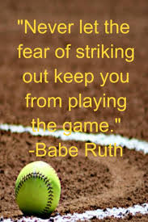
May Bank Holiday Monday 4th May
Year 4 Viking Day Thursday 7th May
SATS Week (Year 6) Week Beg 11th May
PTFA Summer Disco Thursday 21st May
LAST DAY THURDSAY 21st May
TRAINING DAY - SCHOOL CLOSED 22nd May
HALF TERM Monday 25th - Friday 29th May
New Reception Parents Sept 2026 meeting
Thursday 4th June 6pm
Cavalry Food Festival Week 22-26th June
Summer Fair 26th June

Slide 7



Cavalry Website
Contact us:
Cavalry Primary School
Cavalry Drive
March
Cambridgeshire
PE15 9EQ
office@cavalryprimary.org
Tel: 01354 652814

