Slide 1
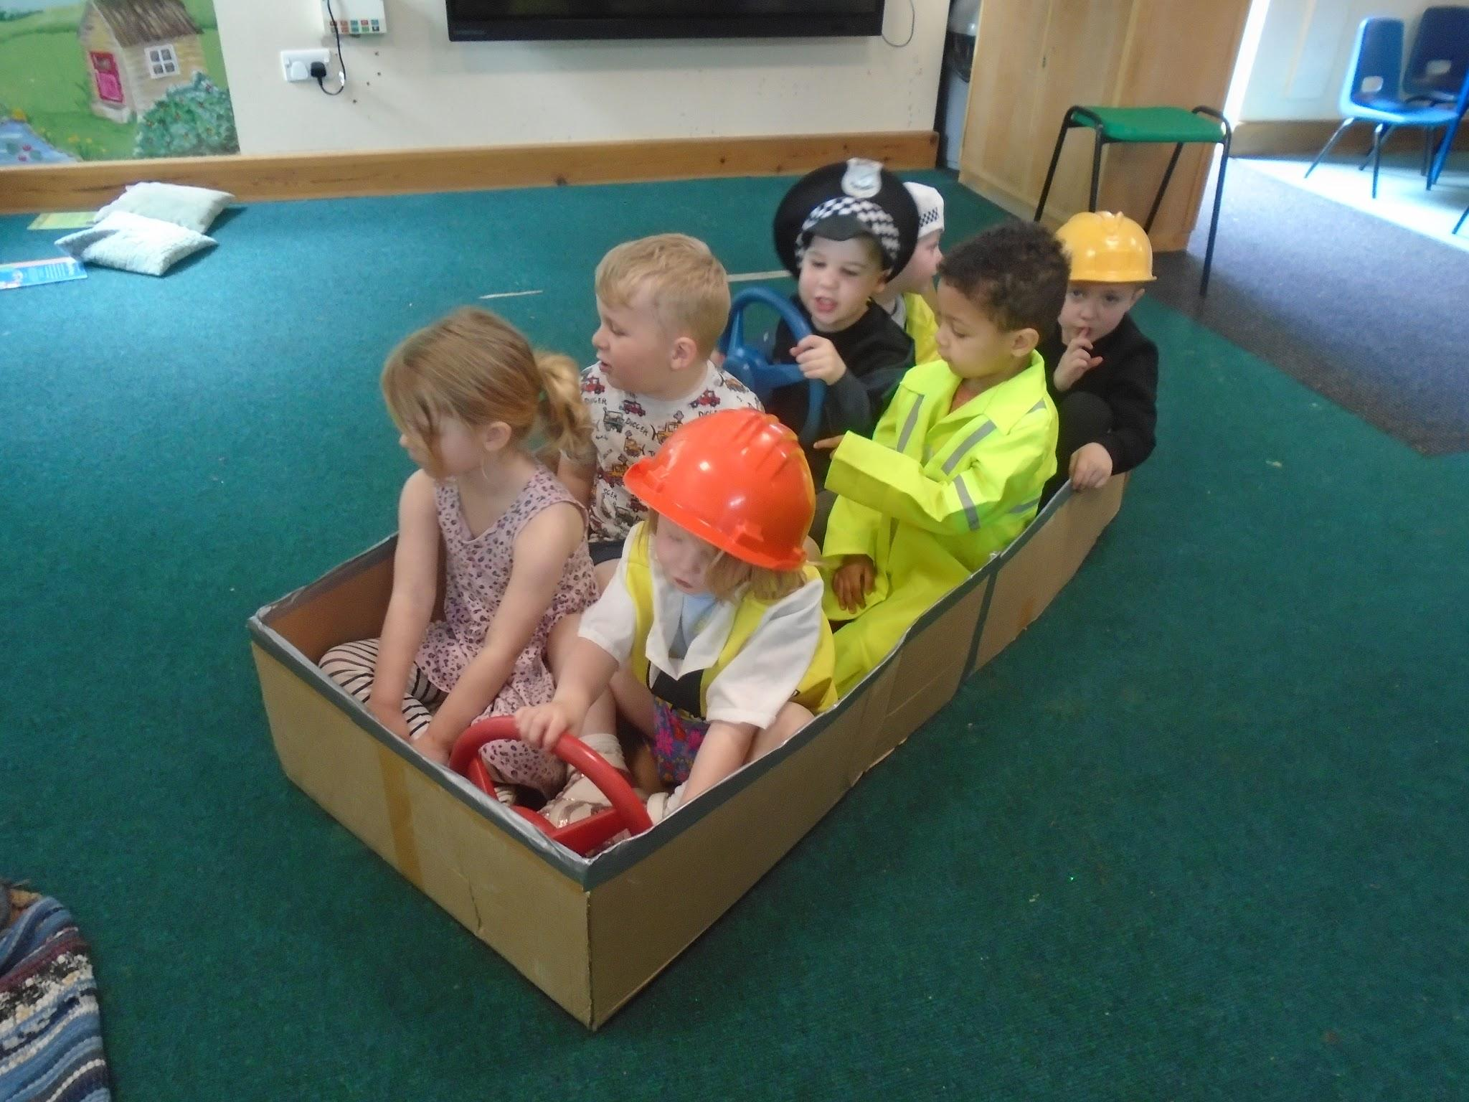
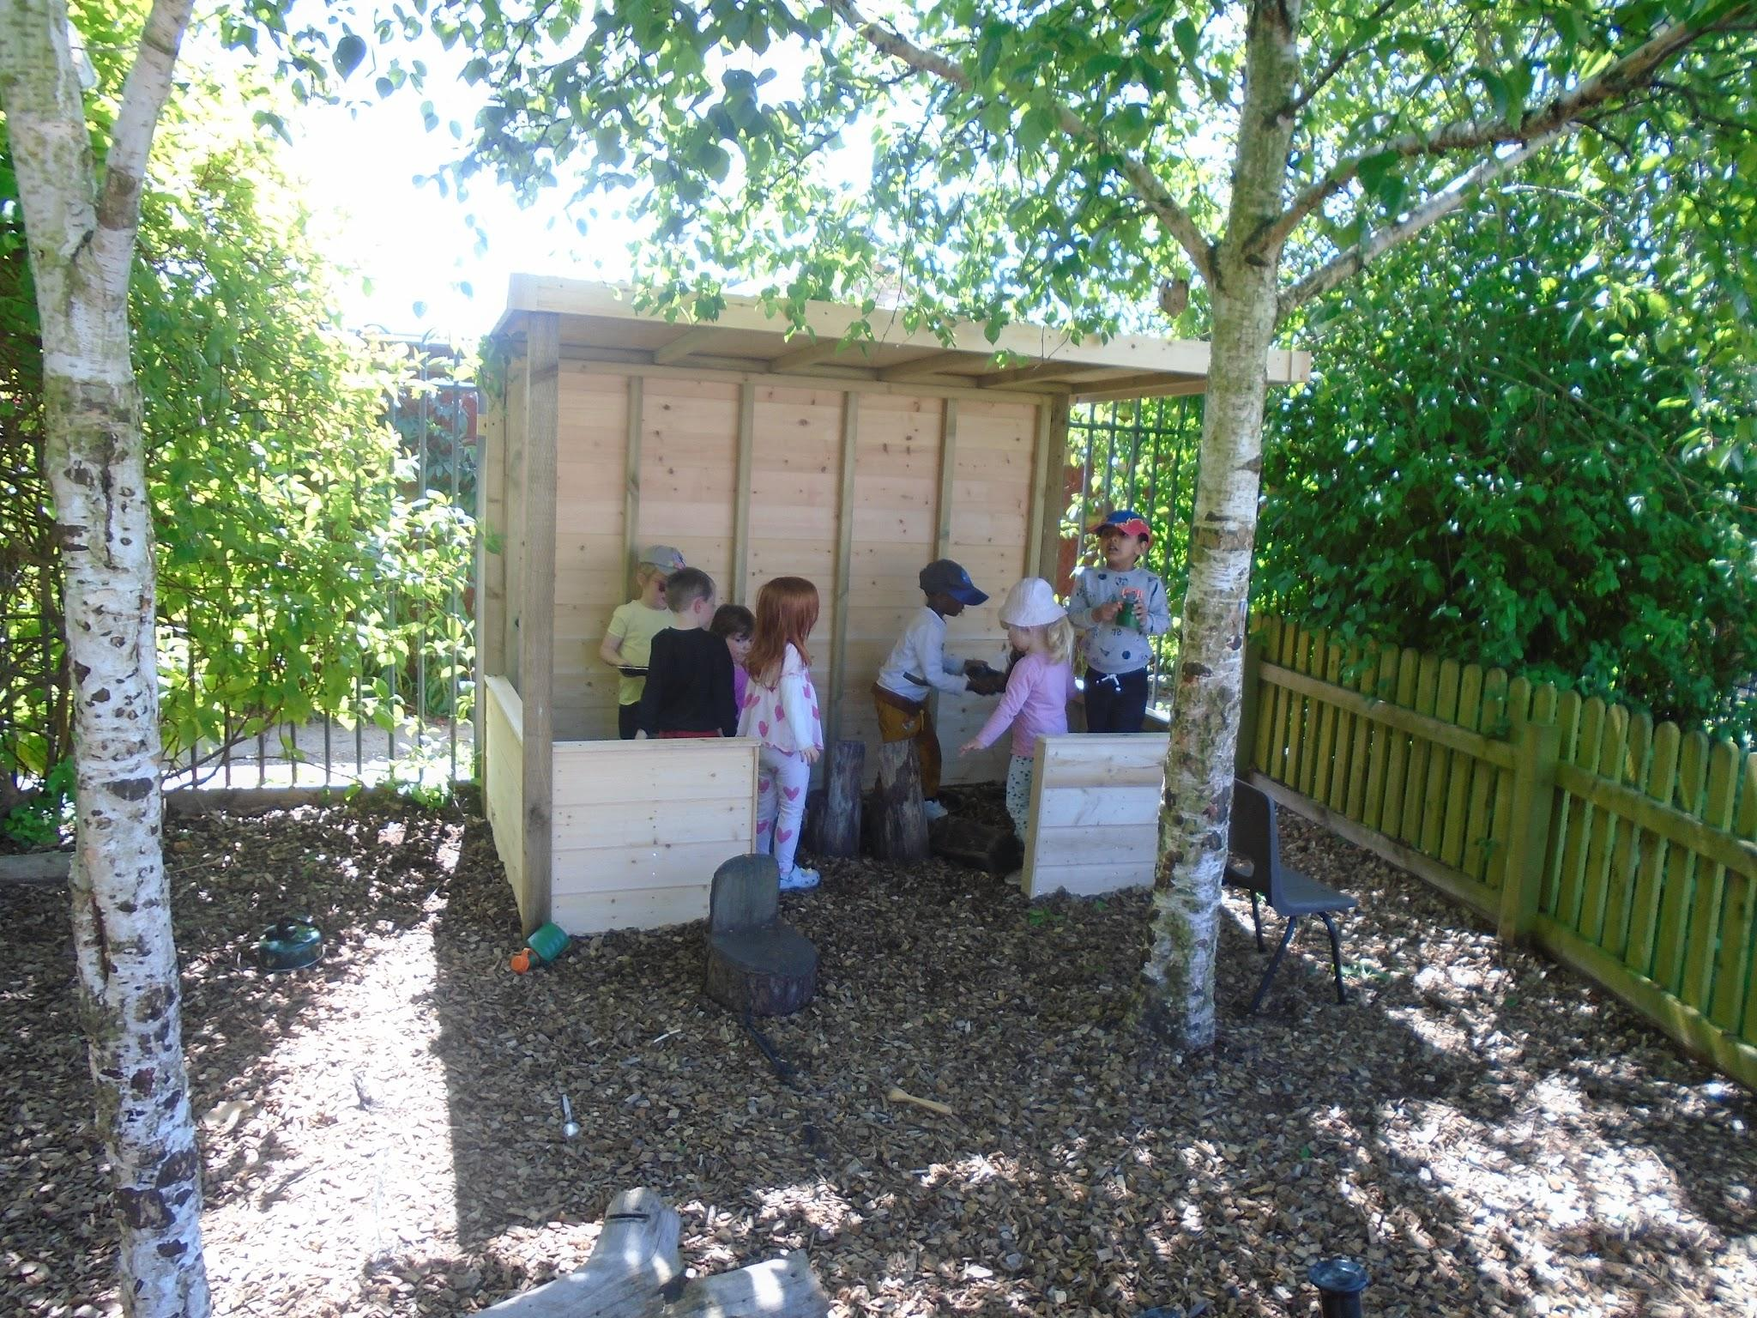
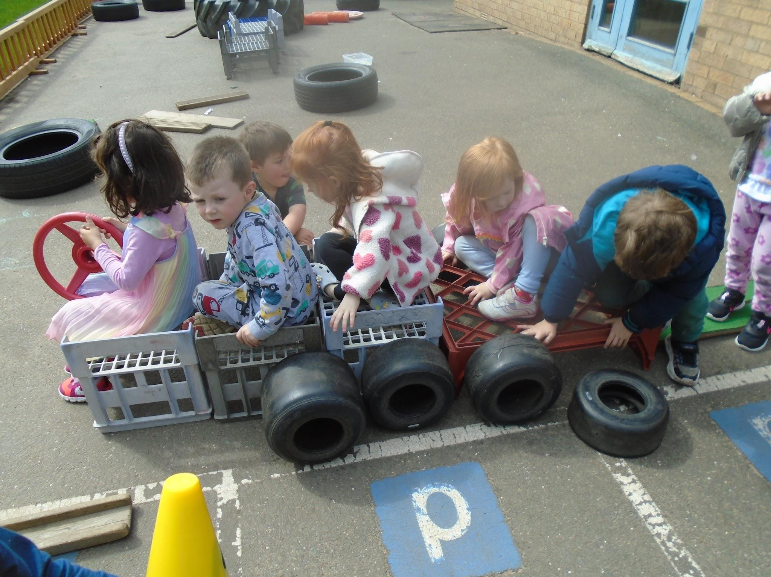
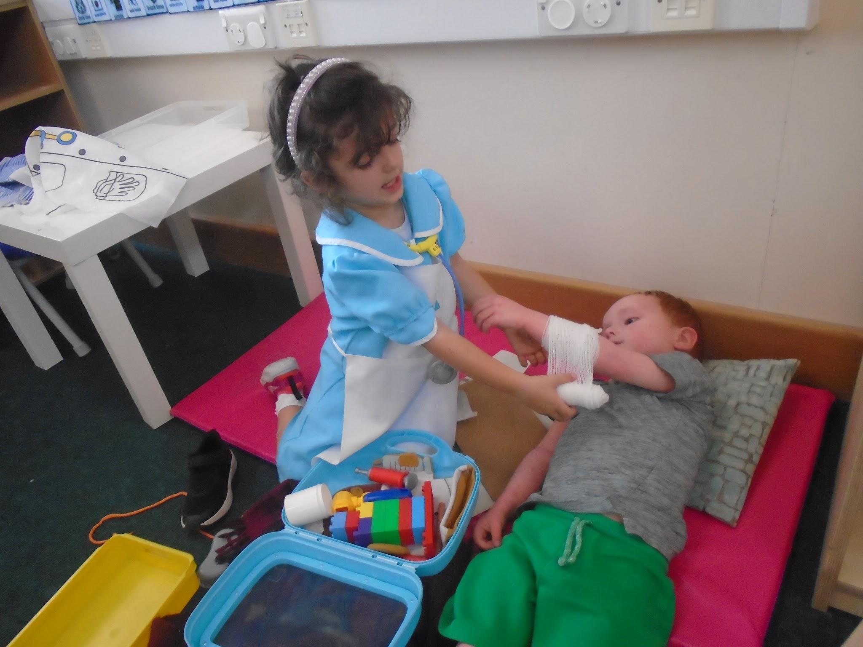
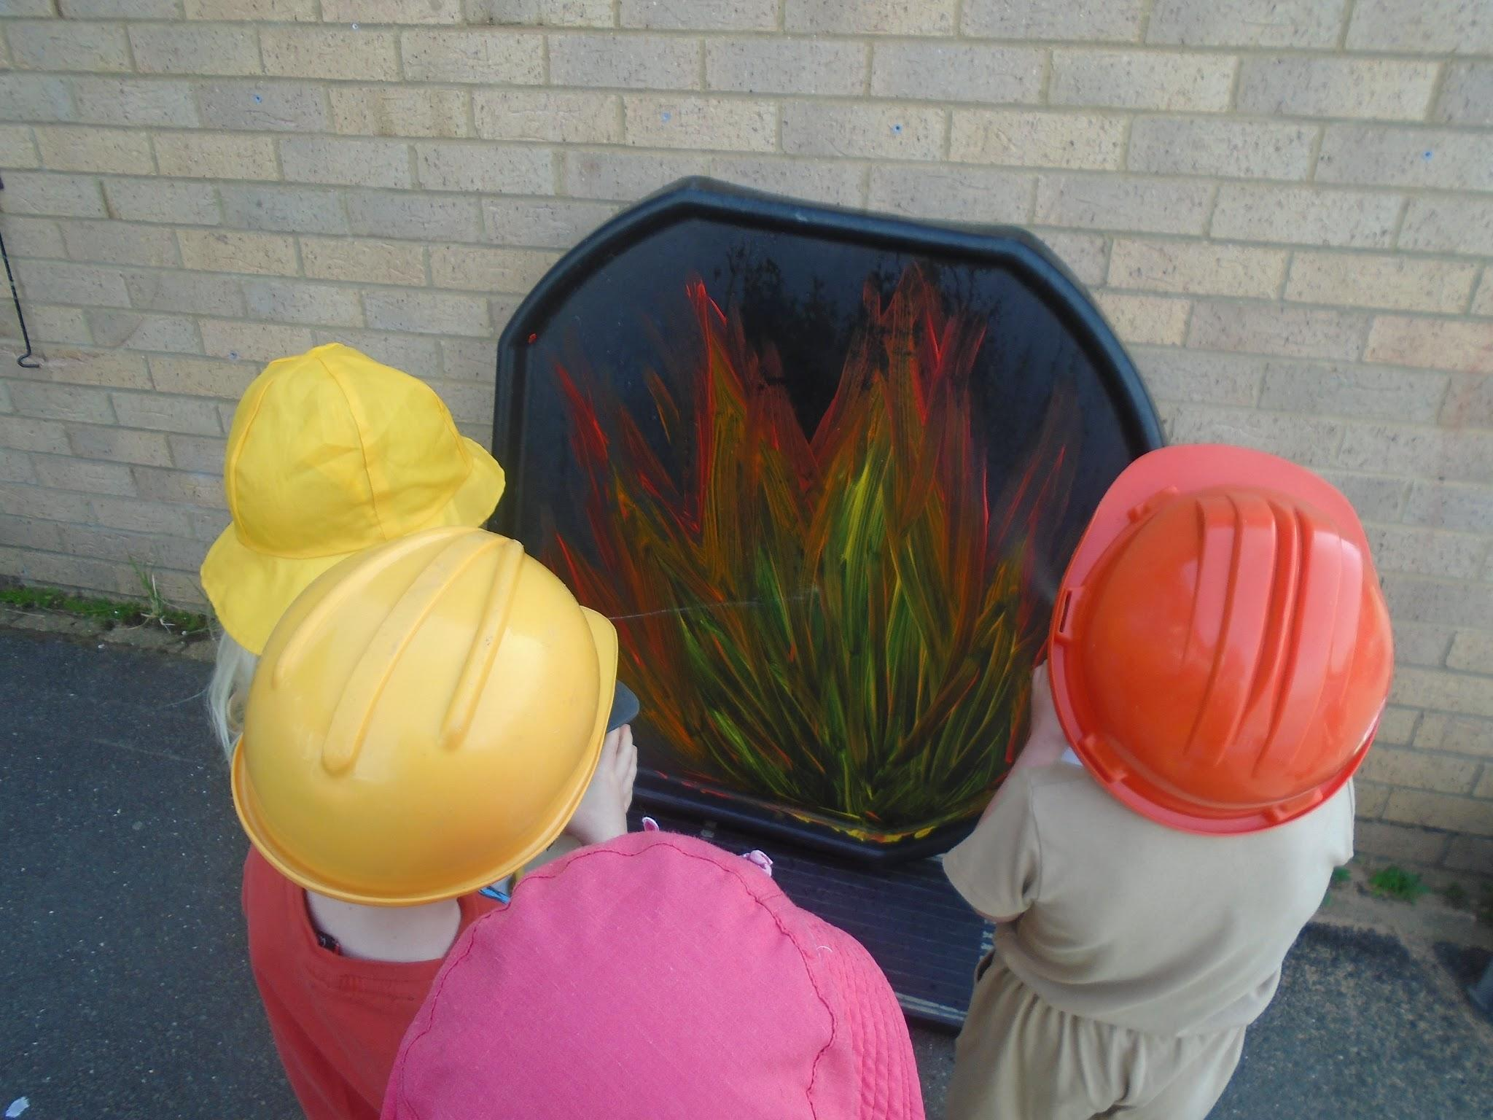
Cavalry Newsletter 13.05.2024
Last week in Nursery
We have been learning about people who help us. Last week we focused on the police, fire and ambulance services. We’ve had firefighters using spray bottles to put out the fire, nurses bandaging up patients and children turning a cardboard box into various emergency vehicles!
We’ve had a new arrival in the bark area! This new bike shed creates a space for Nursery to store their bikes but also a nice shaded area for small world and role play activities.The children have really enjoyed exploring this new area
Outside the children have been creating emergency vehicles with the crates and tyres and designing their own detective badges to use for their role play.

Slide 2
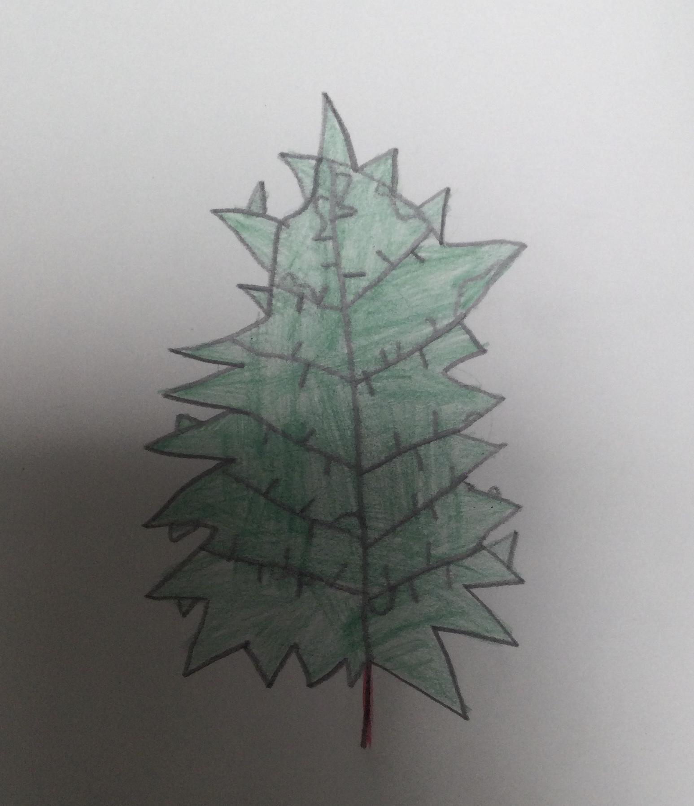
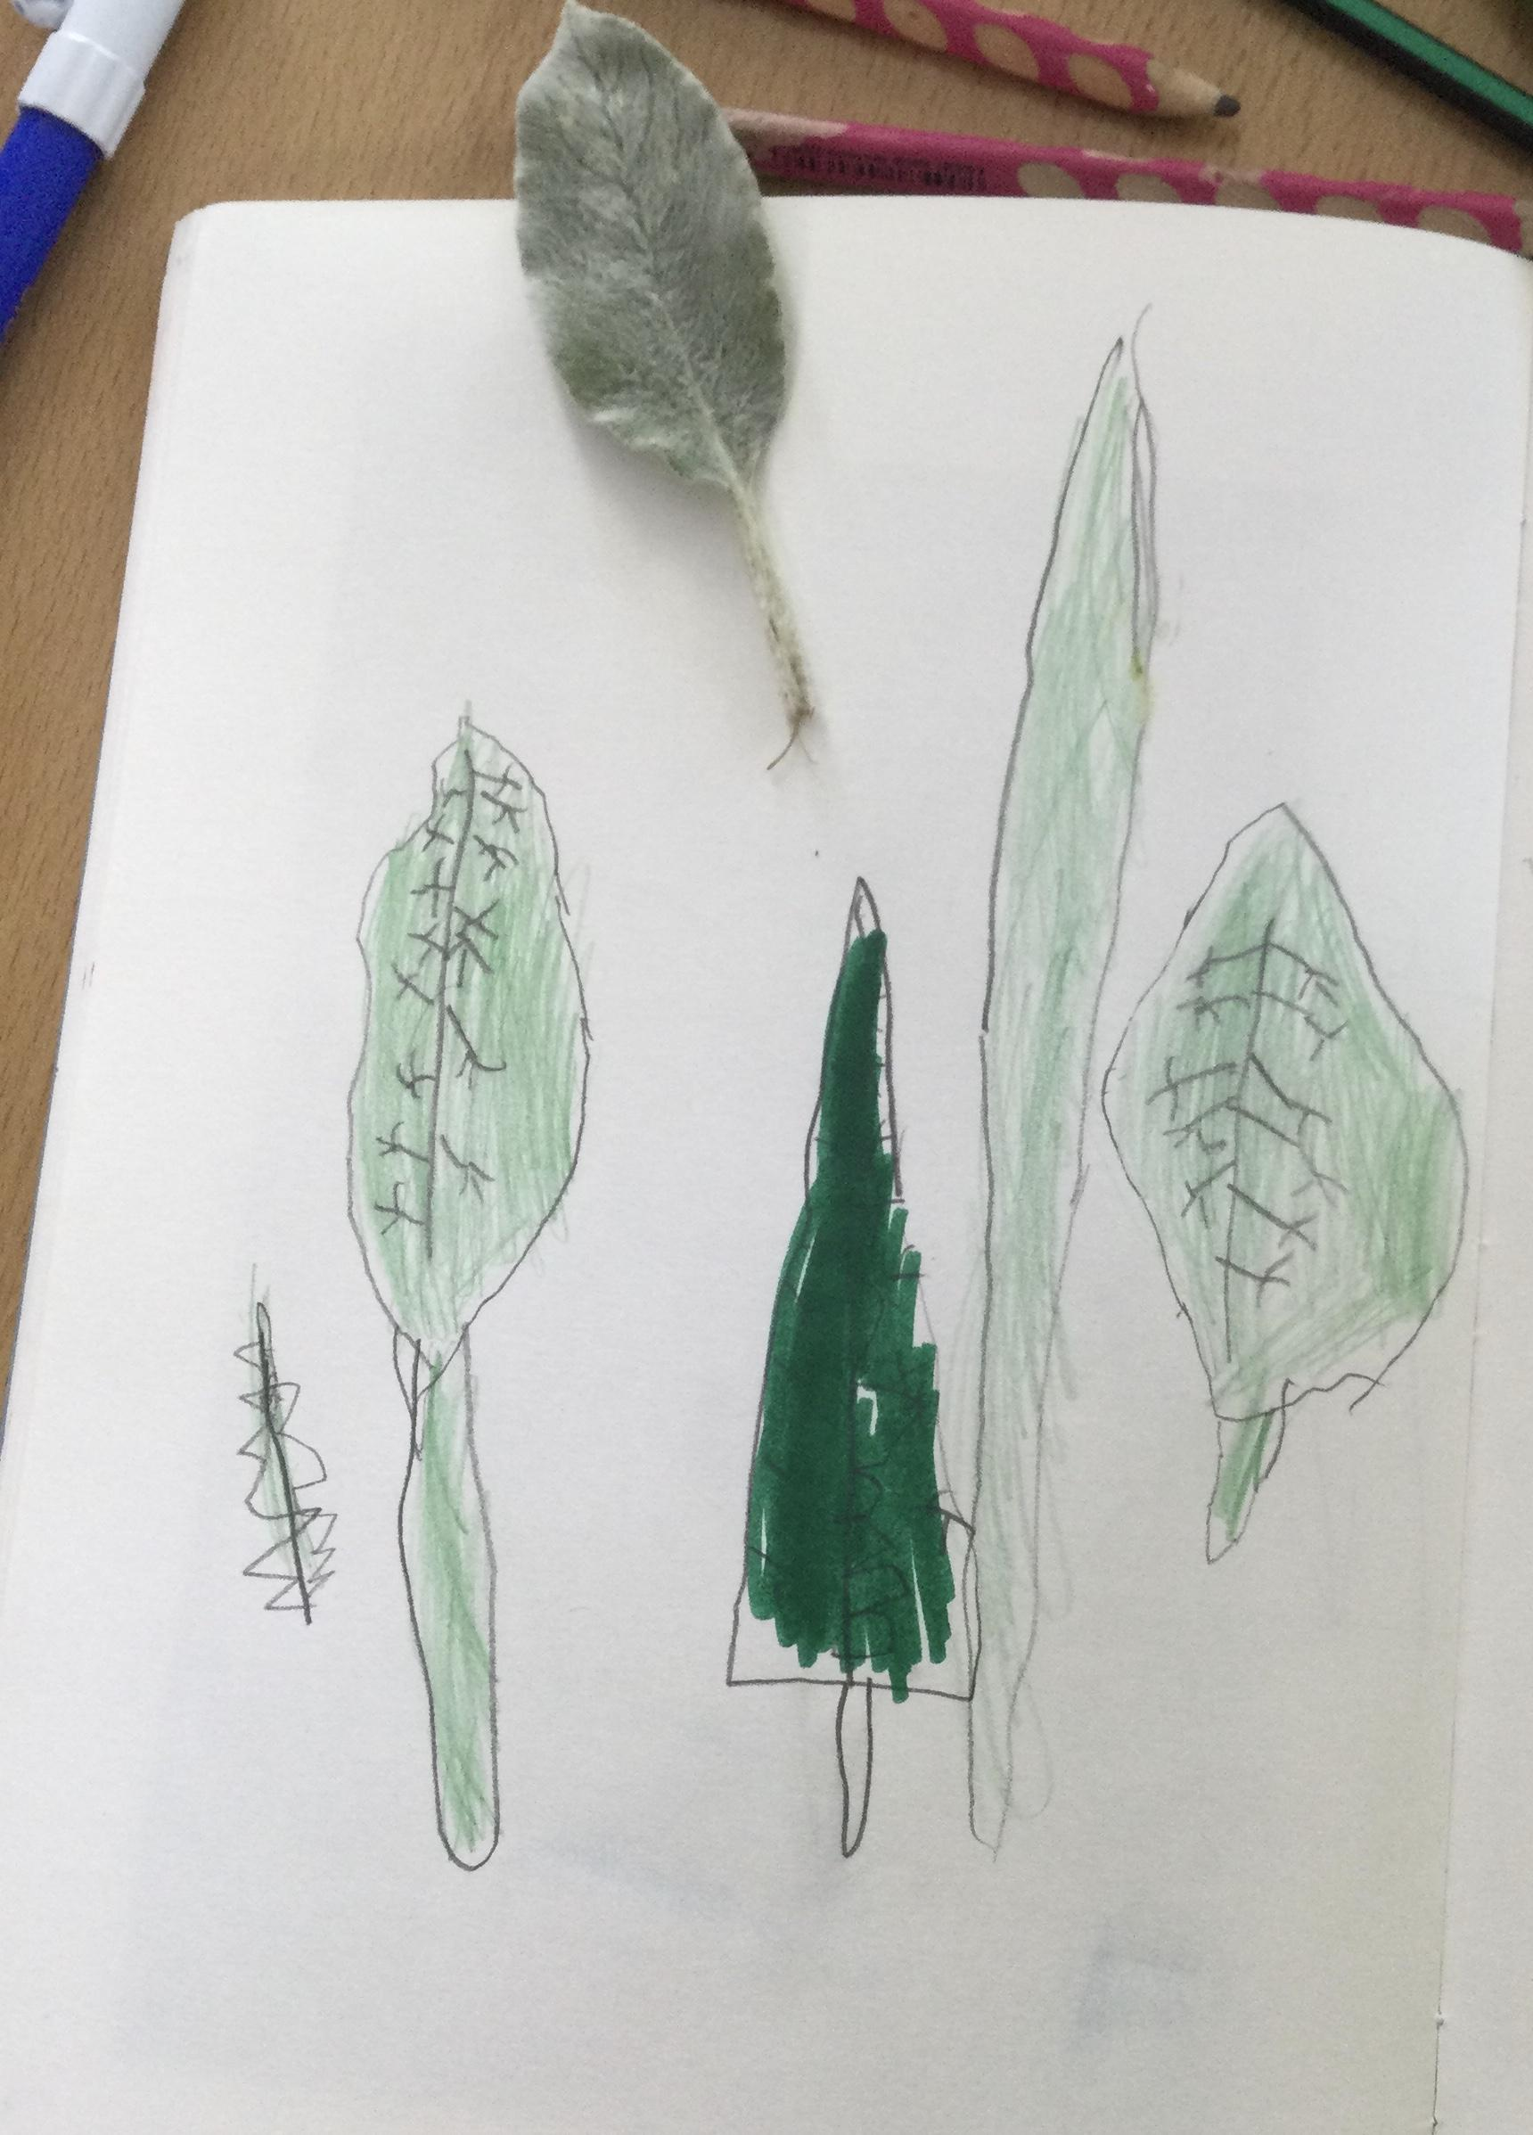
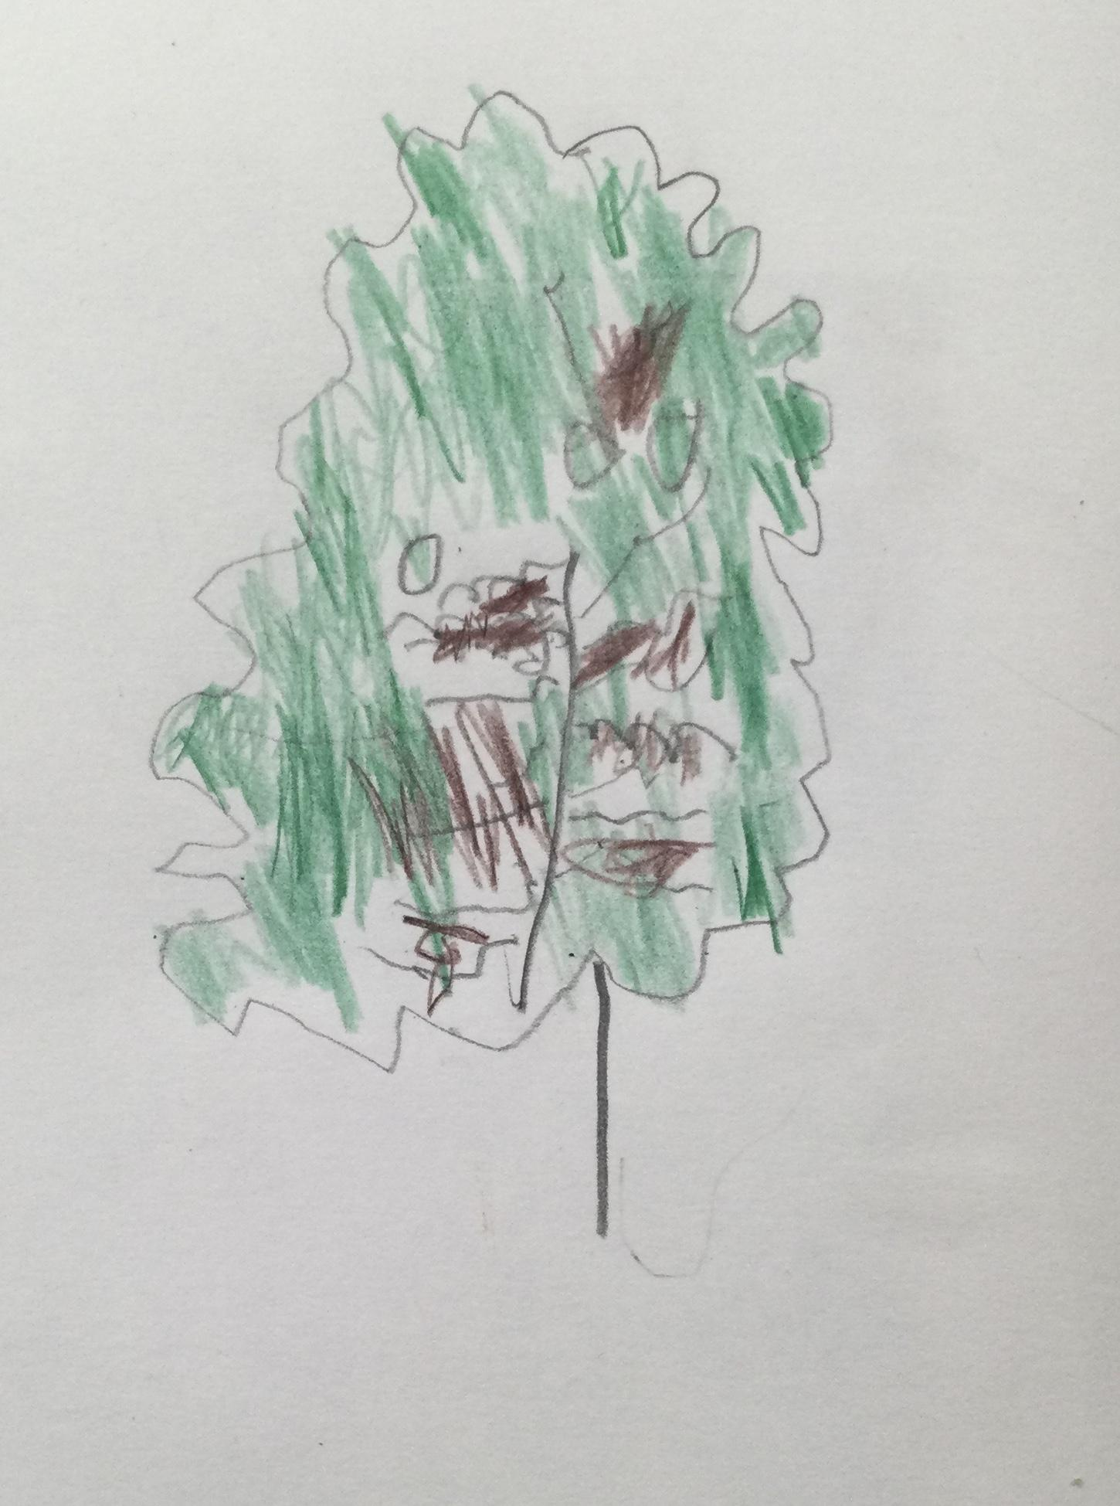
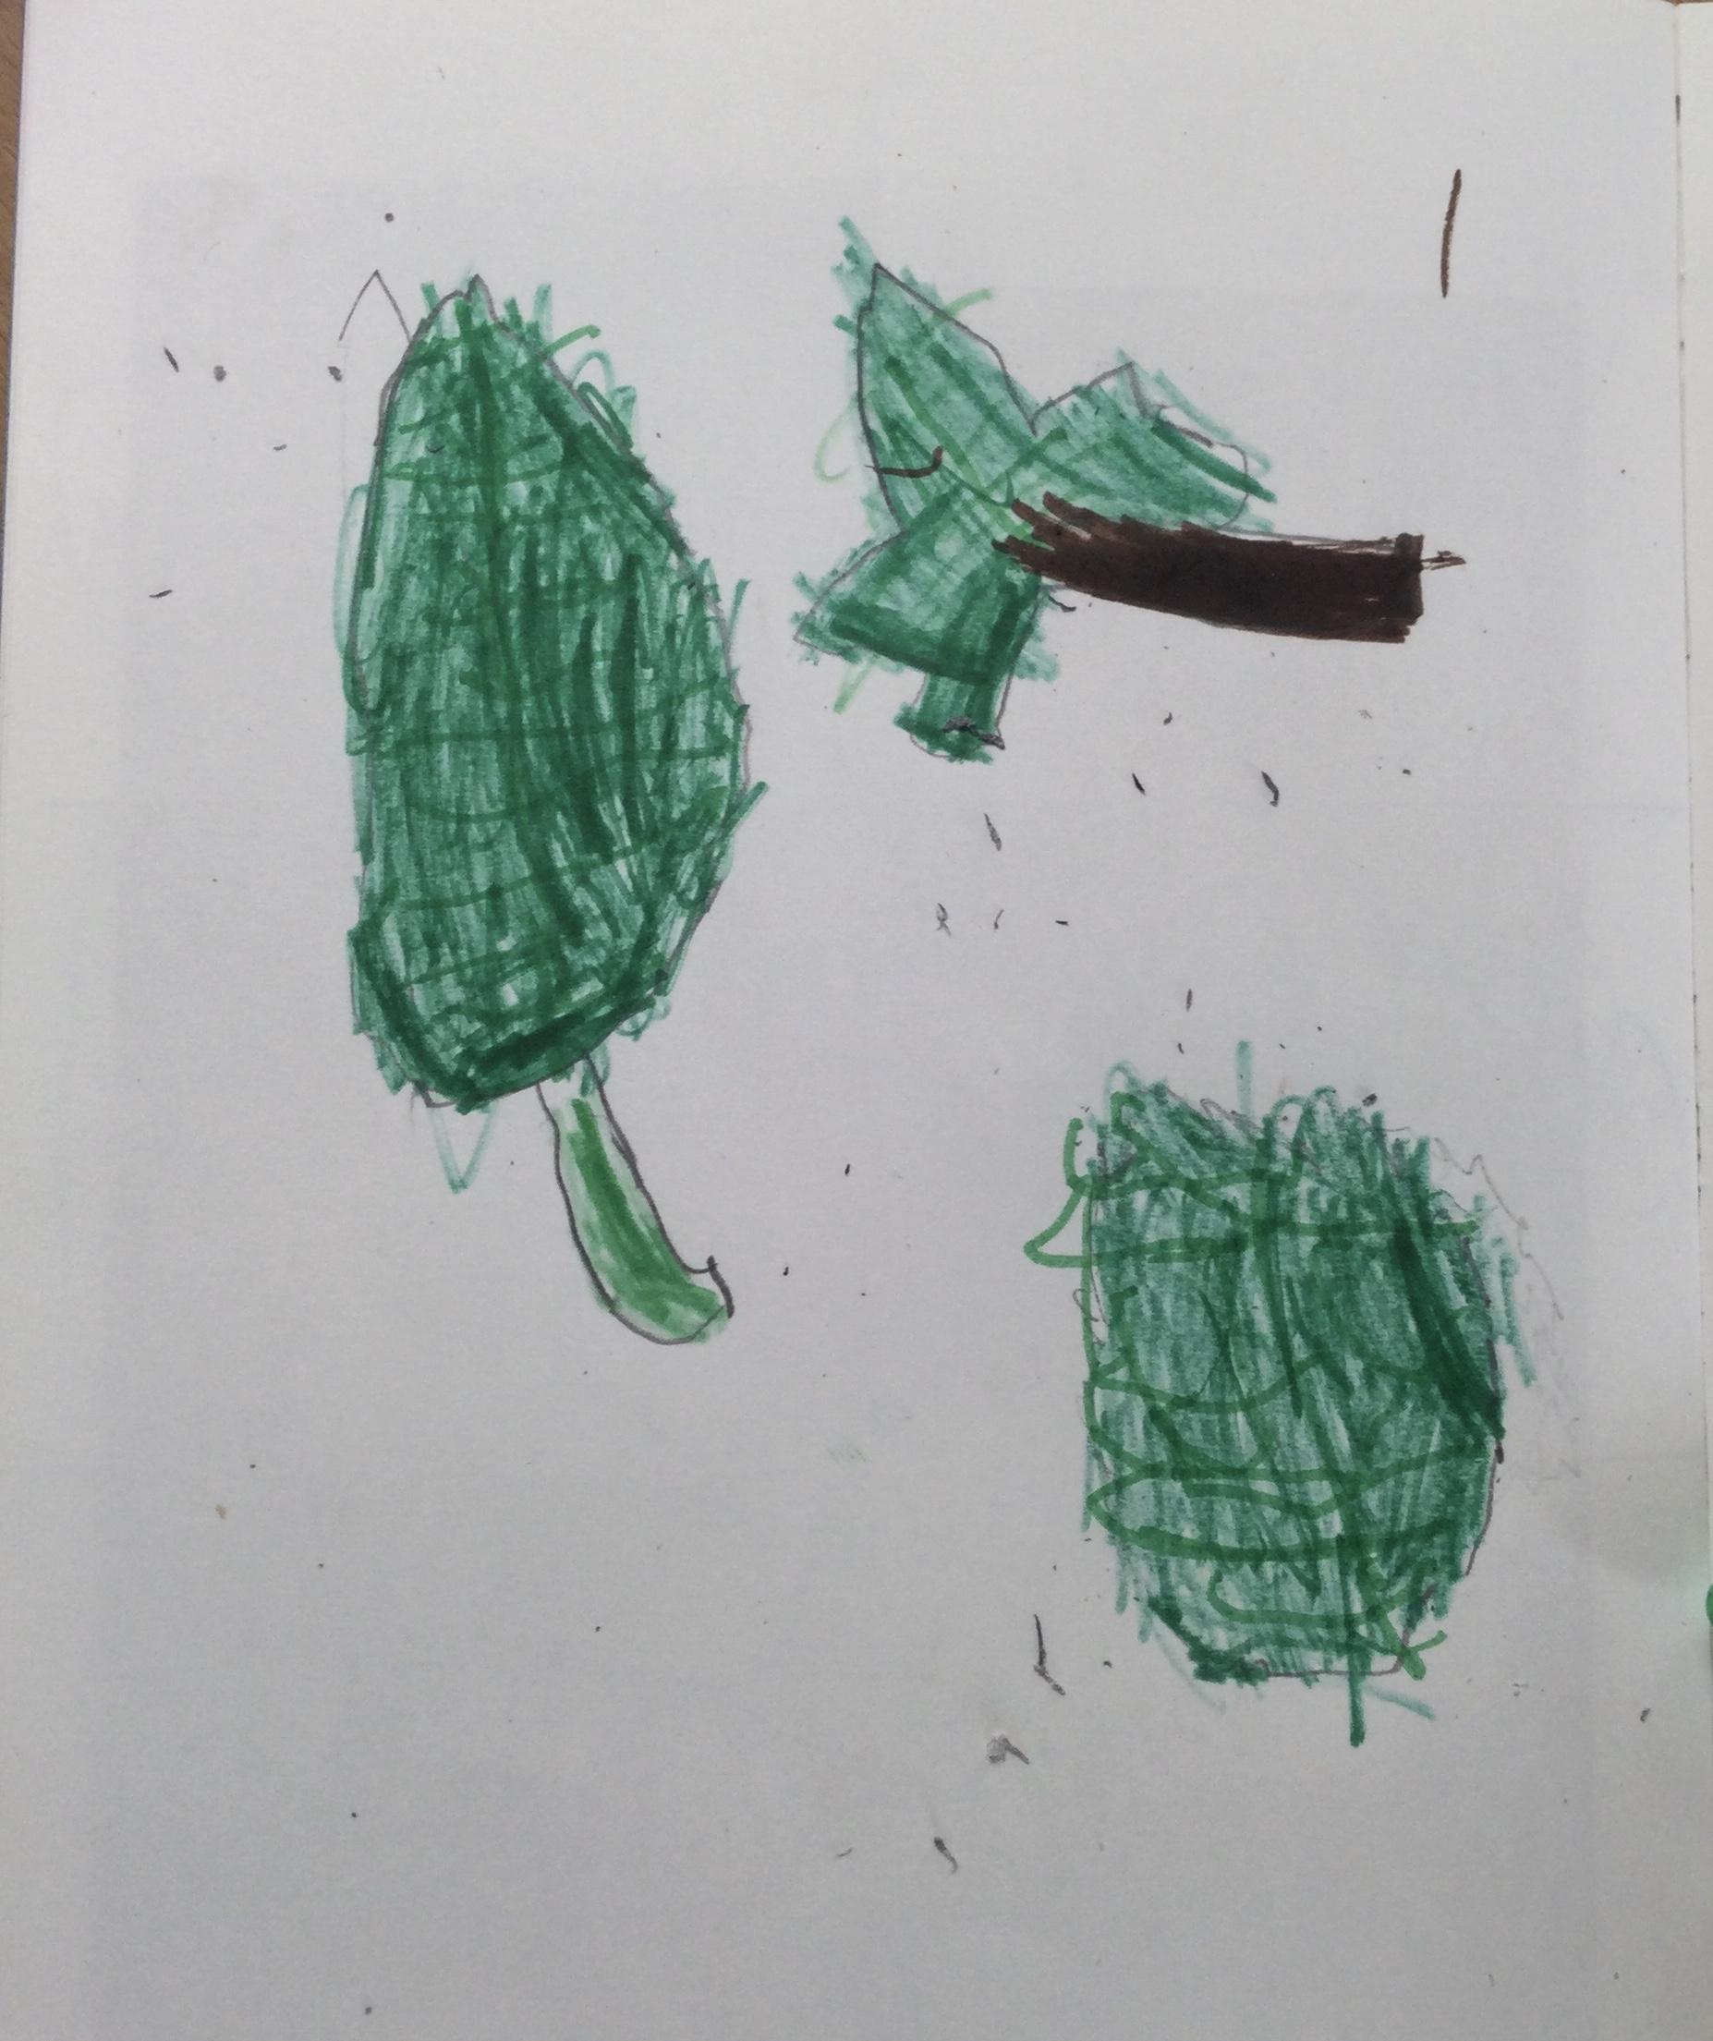
Last week in Year 1:
We did some observational drawing of leaves outside. We
looked very carefully at the outlines and the texture of
the leaves.

Slide 3
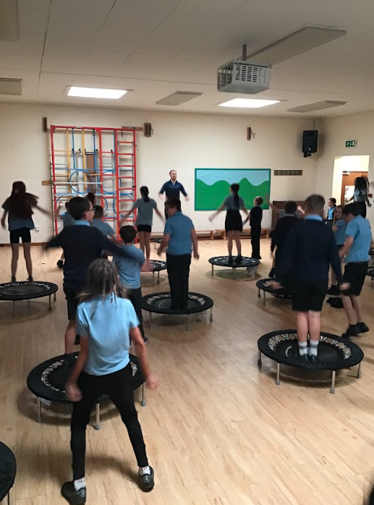
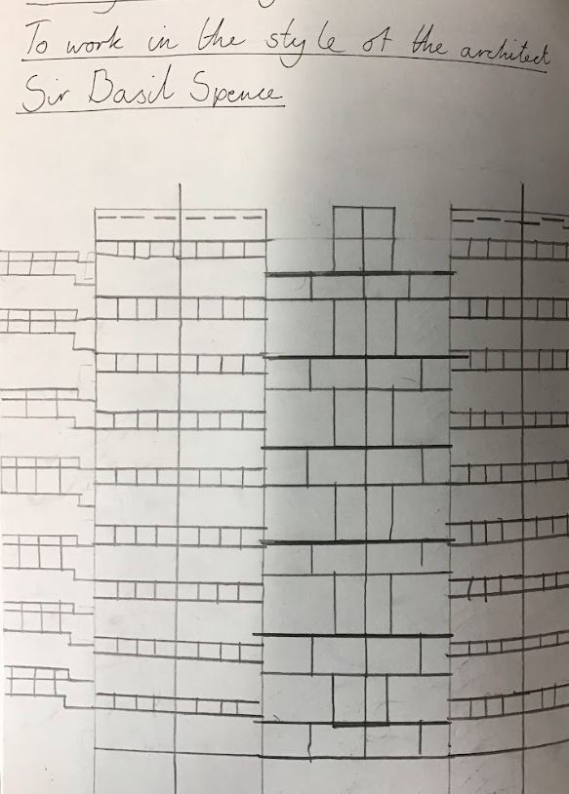
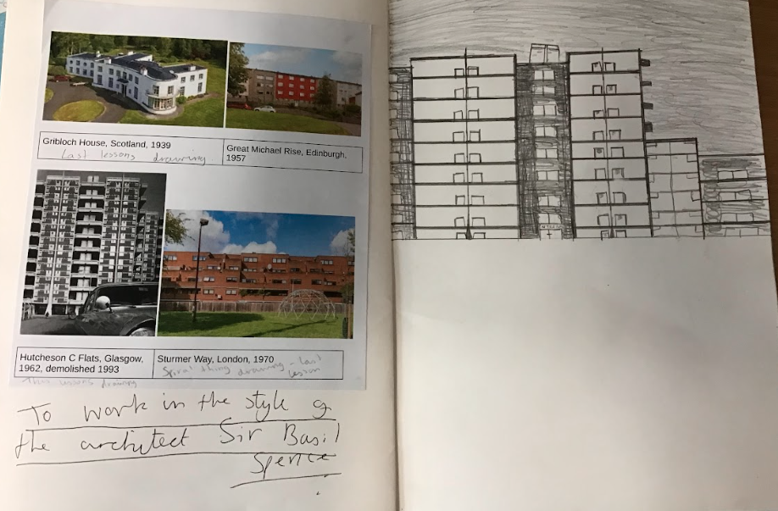
Last week in Year 6:
We’re so proud of our Year 6 pupils. They did so well with SATs revision last week. Lots of focus on their work, but also time for some exercise and treats.
In Art, Year 6 studied Sir Basil Spence and his work on architecture.

Slide 4
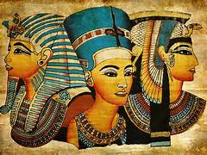
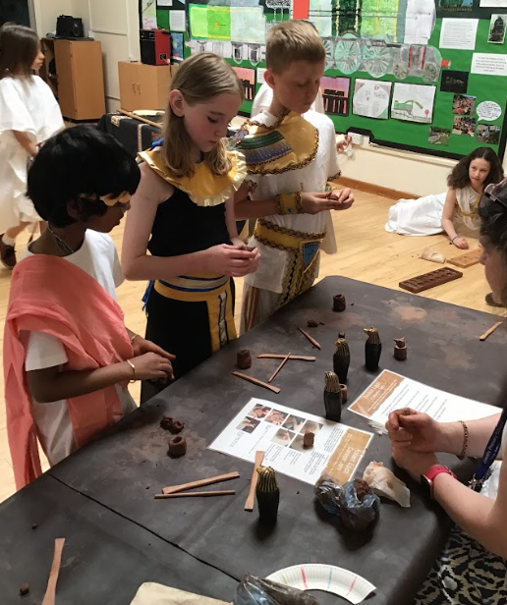
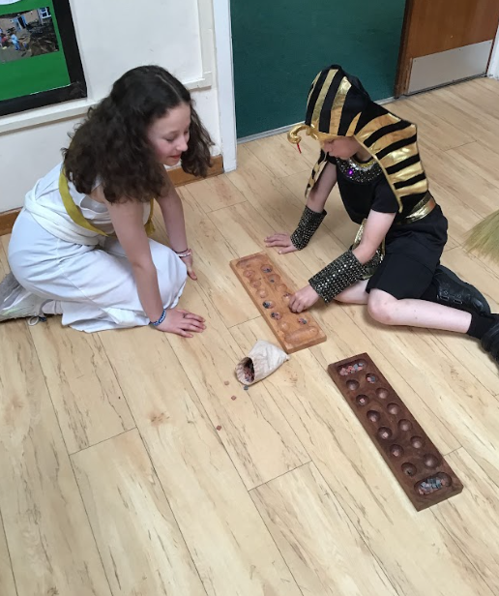
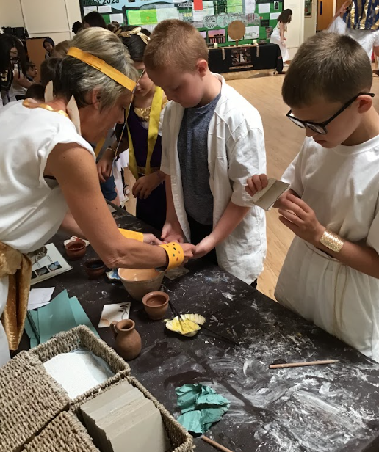
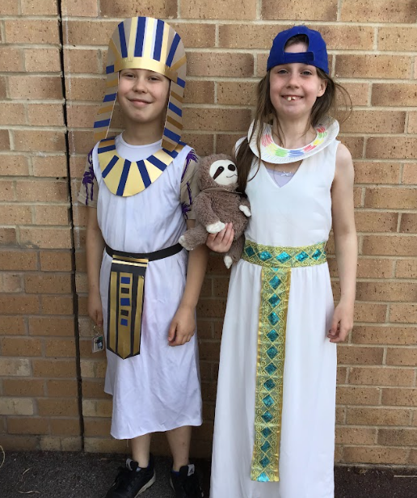
Egyptian Day - Year 5 Friday 10th May
Year 5 had a fantastic day, immersing ourselves in the world of Ancient Egypt.
We spent the morning in an Egyptian market, creating lots of offerings for the gods. Then, we had an afternoon of being entertained with some plays and an indecisive bull! We did however, have to be careful of the secret police, and employ a royal taster to check our feast was safe to enjoy.

Slide 5
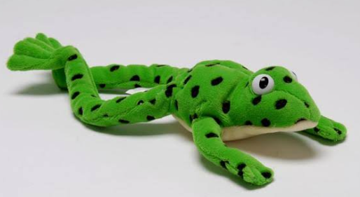
Have you read….?
Class 8 really enjoyed…
Aesop's Fables this week such as:
Reading news:
Brilliant Books:
Class 5 have loved reading Tiddler.
A wonderful story about a little fish that loves to tell tall tales, however, no one believes him when he actually gets into a bit of trouble!
Word Wizards:
This week the classes with the most ‘accurate quizzes’ in Y4/5/6 were:
Class 10 - 81%
Class 12 - 90%
Class 14 - 93%
Fred says ‘fantastic work!’ to all the children in Mrs Poole’s phonics group. A week of WOW words and WOW spellings! Keep up the good work. Maybe write the shopping list for your grown-ups at home?

Slide 6
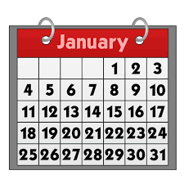
Dates for your calendar:
Monday 20th May @ 2.15pm- EYFS Sports Day
Tuesday 21st May @ 2pm- KS2 Sports Day
Wednesday 22nd May @ 9am- Year 3 & families to Meet the Artist
Wednesday 22nd May @ 2.15pm- KS1 Sports Day
Friday 24th May- Year 6 trip to Duxford
Friday 24th May- Last day of half term
Monday 3rd June- BACK TO SCHOOL
Year 6 to visit Fire Station- Thursday 6th June
Phonics Screening Check- Wk beg. 14th June
Year 4 Legend of the Fens- Tuesday 18th June
Year 4 Author Visit- Friday 24th June
Summer Fair- Saturday 29th June
All term dates for 2024 and 2025 are available on the school website. Please remember that holidays in term time are not authorised unless there are very exceptional circumstances and you may receive a penalty notice if your child misses school.

