Slide 1



21st May 2026
  Minibeasts
  Clay sunflowers
  Pompeii

Slide 2

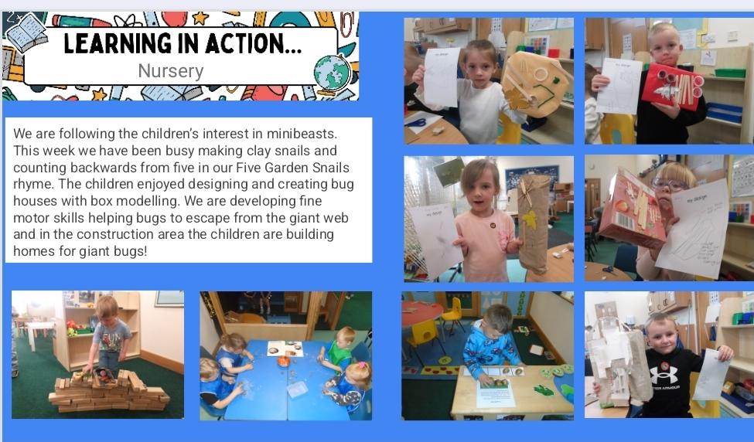
Nursery

Slide 3
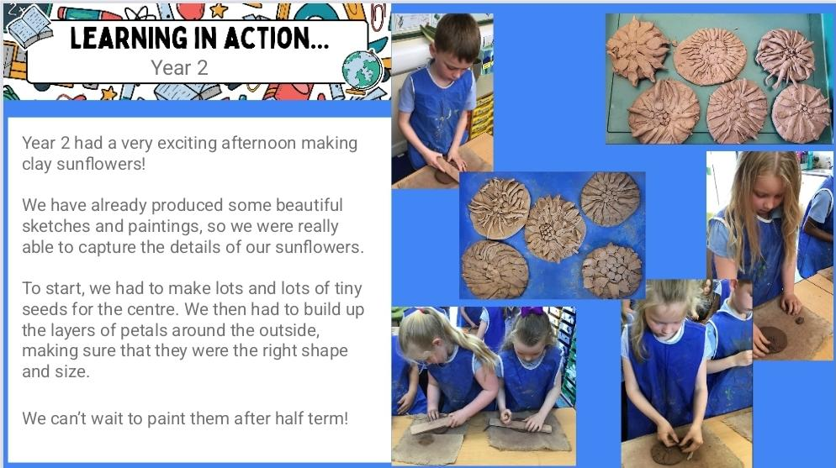
Year 2

Slide 4
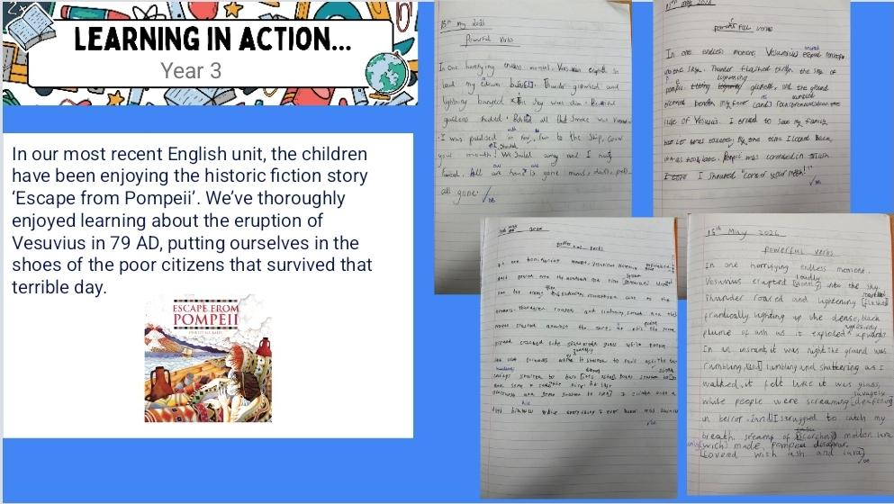
Year 3

Slide 5


Slide 6


We are still looking for food heroes to come into school to talk about/ demonstrate food growing, production and sustainability for our food festival. We are also interested in hearing from stall holders for our summer fair. Can you help?
We are aiming for 97% attendance.
This week, our classes with the highest attendance are…
KS1 - Class 5 96.68%
KS2 - Class 11 97.5%
WELL DONE

Slide 7


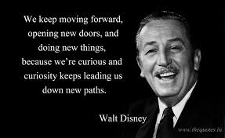
HALF TERM Monday 25th - Friday 29th May
Year 6 to the fire station 3rd June
Year 2 March-Ely train journey 3rd June
New Reception Parents Sept 2026 meeting
Thursday 4th June 6pm
Non uniform day for donations for summer fair
Friday 5th June
KS2 Sports Day Weds 10th June 1.45-3pm
Nursery/ Rec Sports Day Thurs 11th June 2.15-3pm
KS1 Sports Day Fri 12th June 2.15-3pm

Slide 8



Cavalry Website
Contact us:
Cavalry Primary School
Cavalry Drive
March
Cambridgeshire
PE15 9EQ
office@cavalryprimary.org
Tel: 01354 652814

