Slide 1



12th September 2025
Observational drawings
Place value
New dates

Slide 2

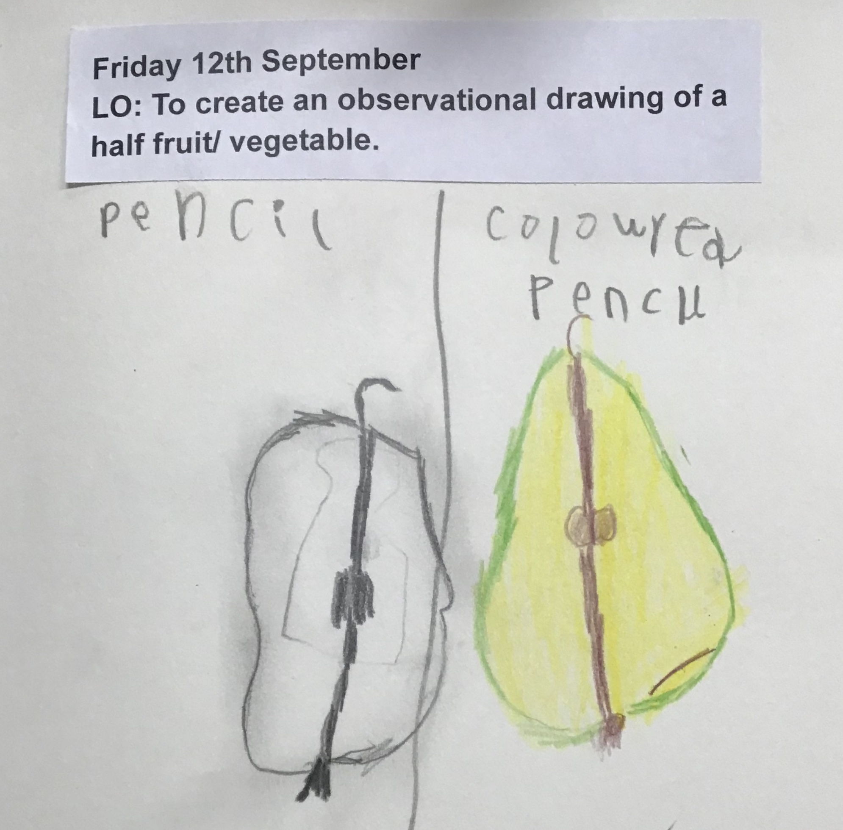
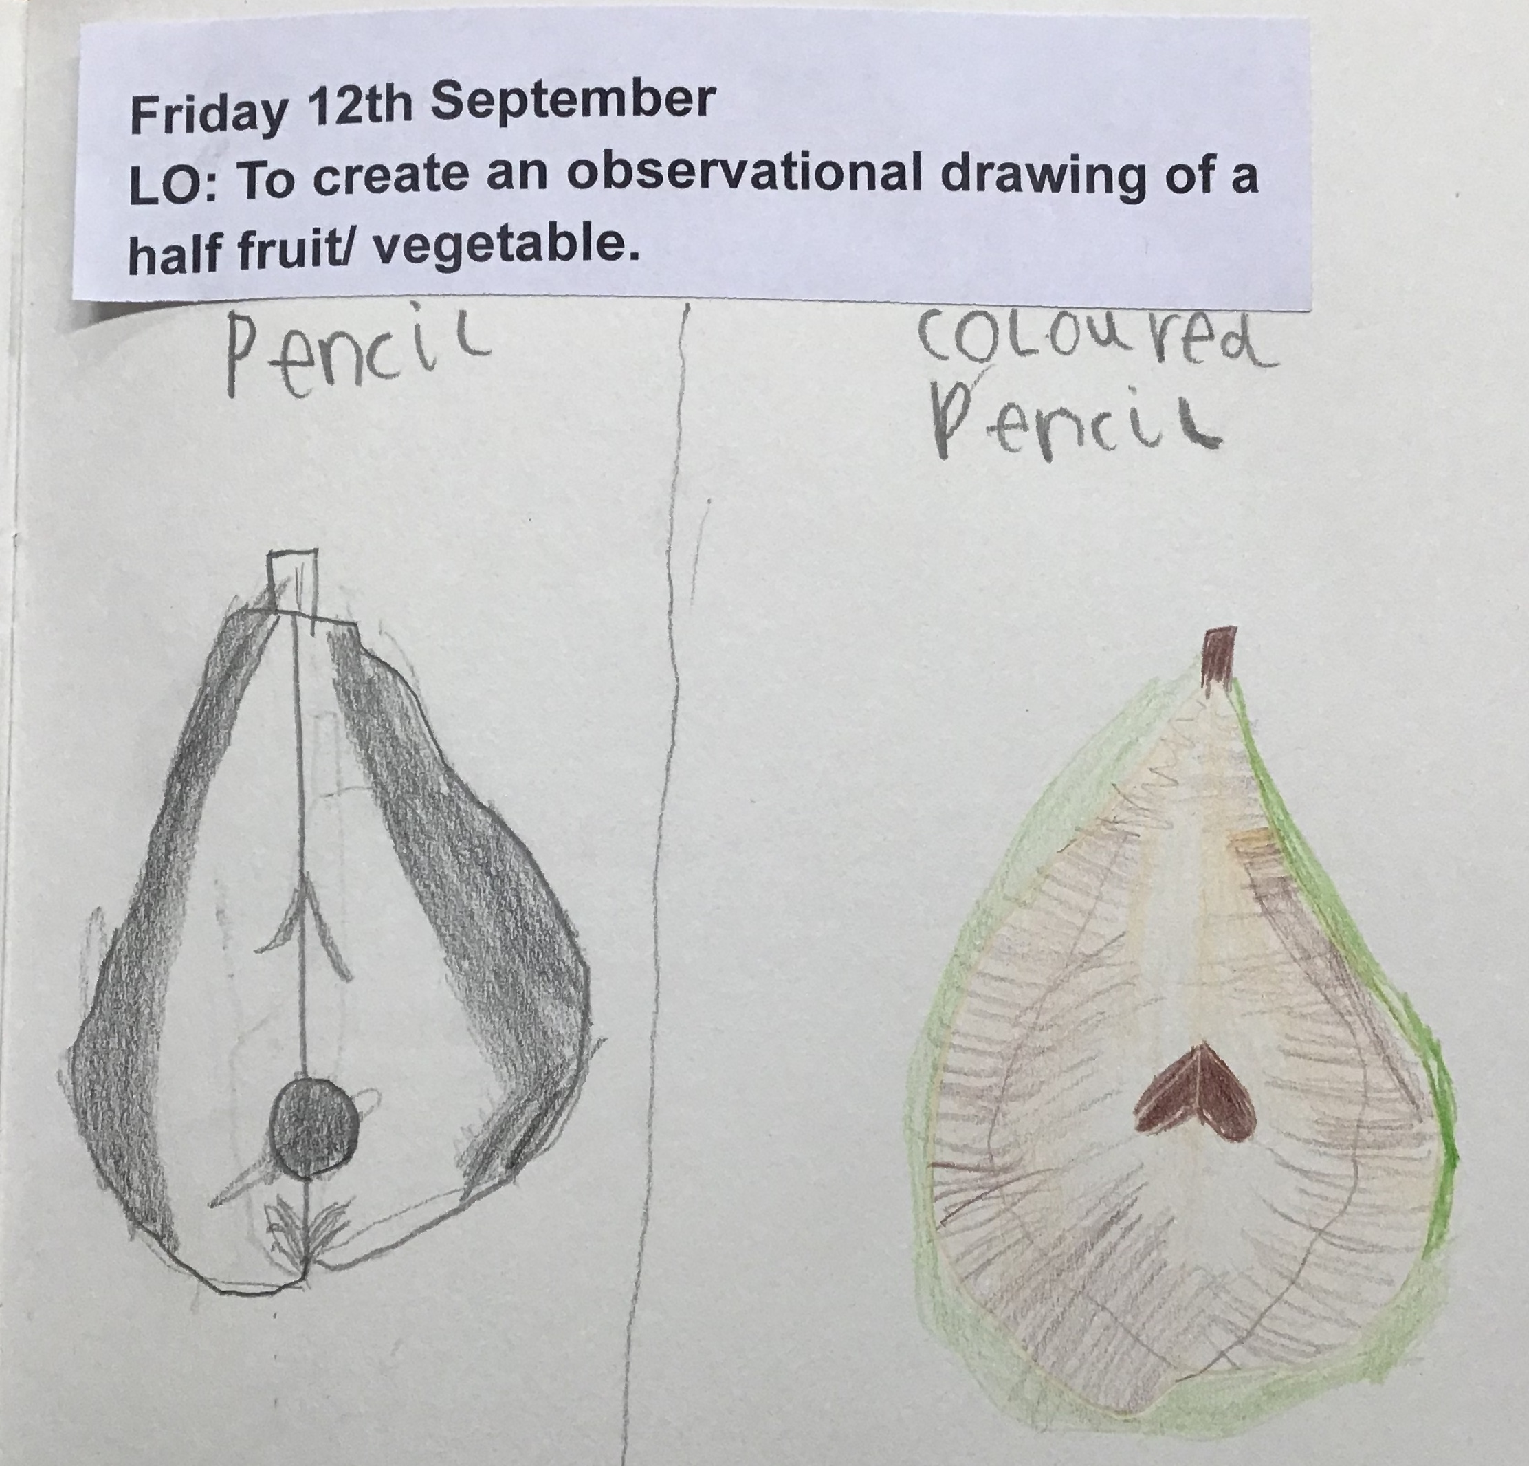
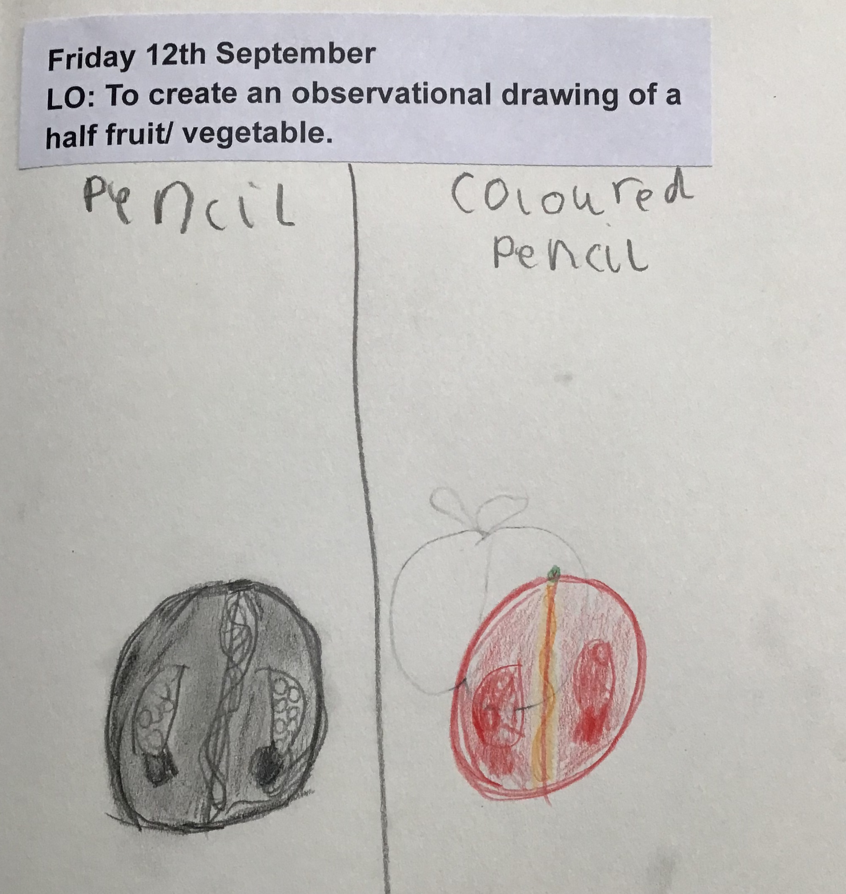
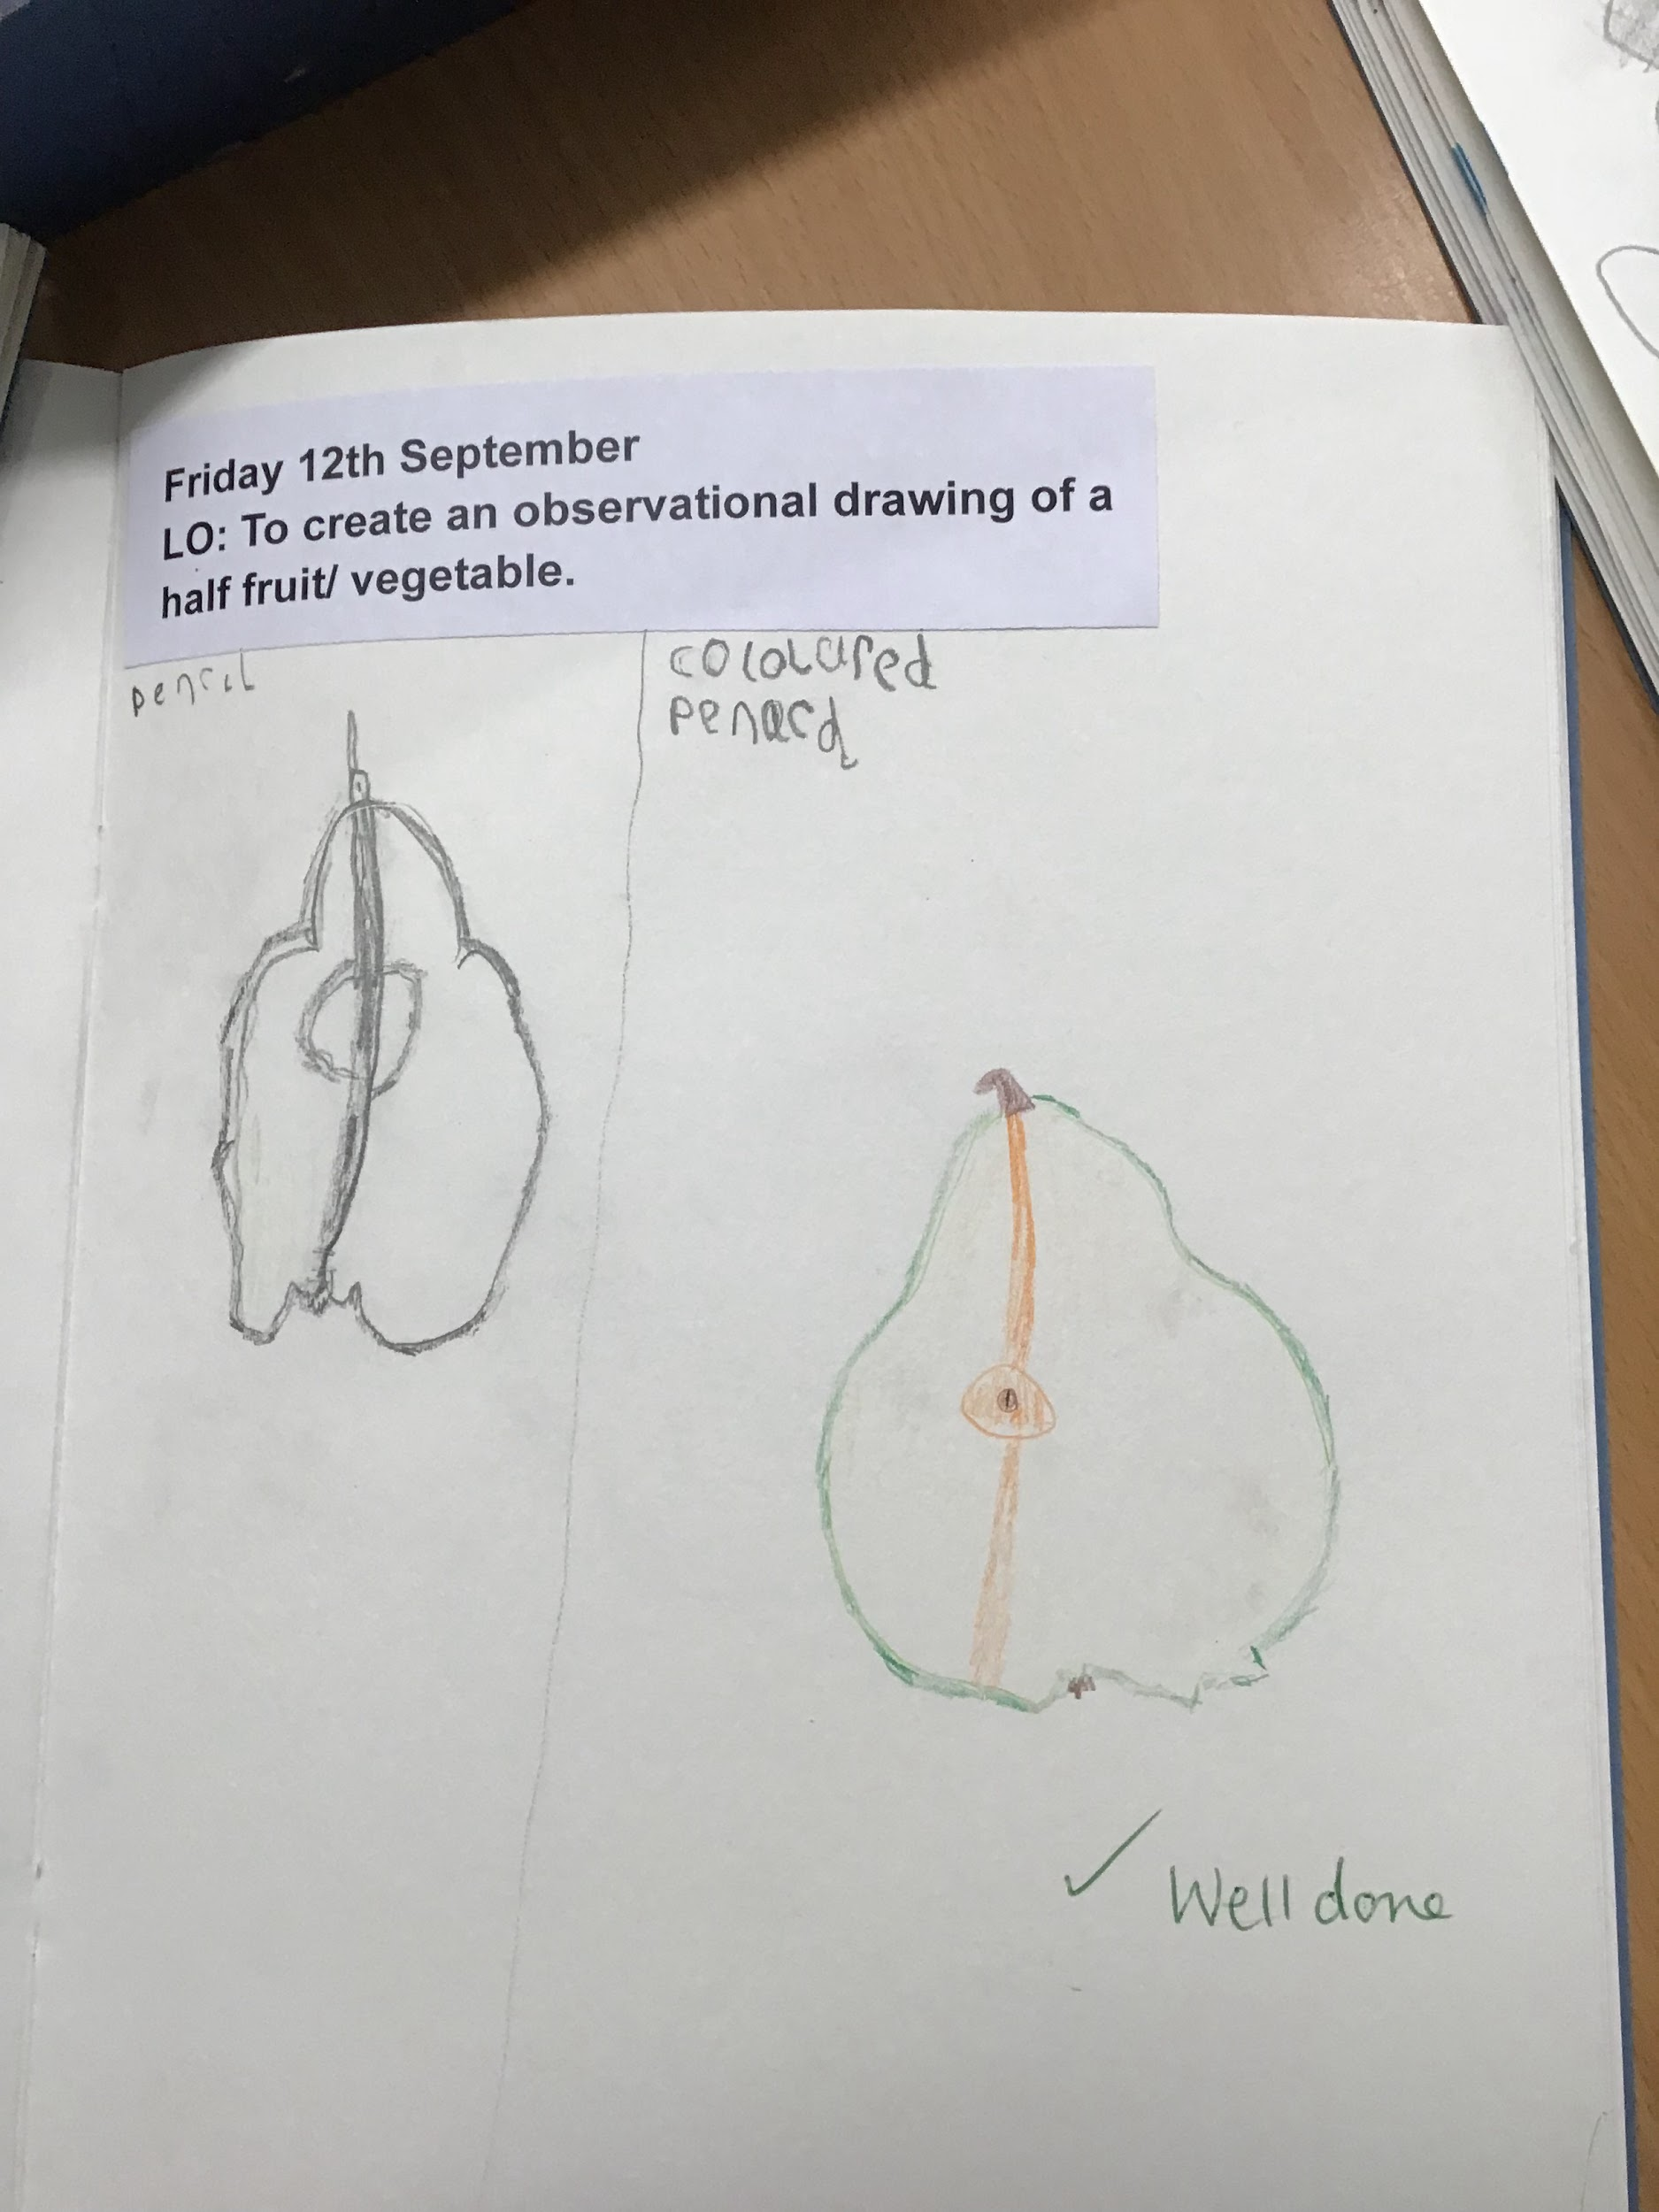
In art this week, Year 2 have been completing some observational drawings of fruits in preparation for their artist study on Orla Kiely.
When completing their drawings, the children focussed on the light and dark areas of their fruit, and used B pencils and dark coloured pencils to help define the shading of their drawings.
The children have made some amazing life drawings! Miss Hickford and Mrs Witts were very impressed!!
Year 2

Slide 3
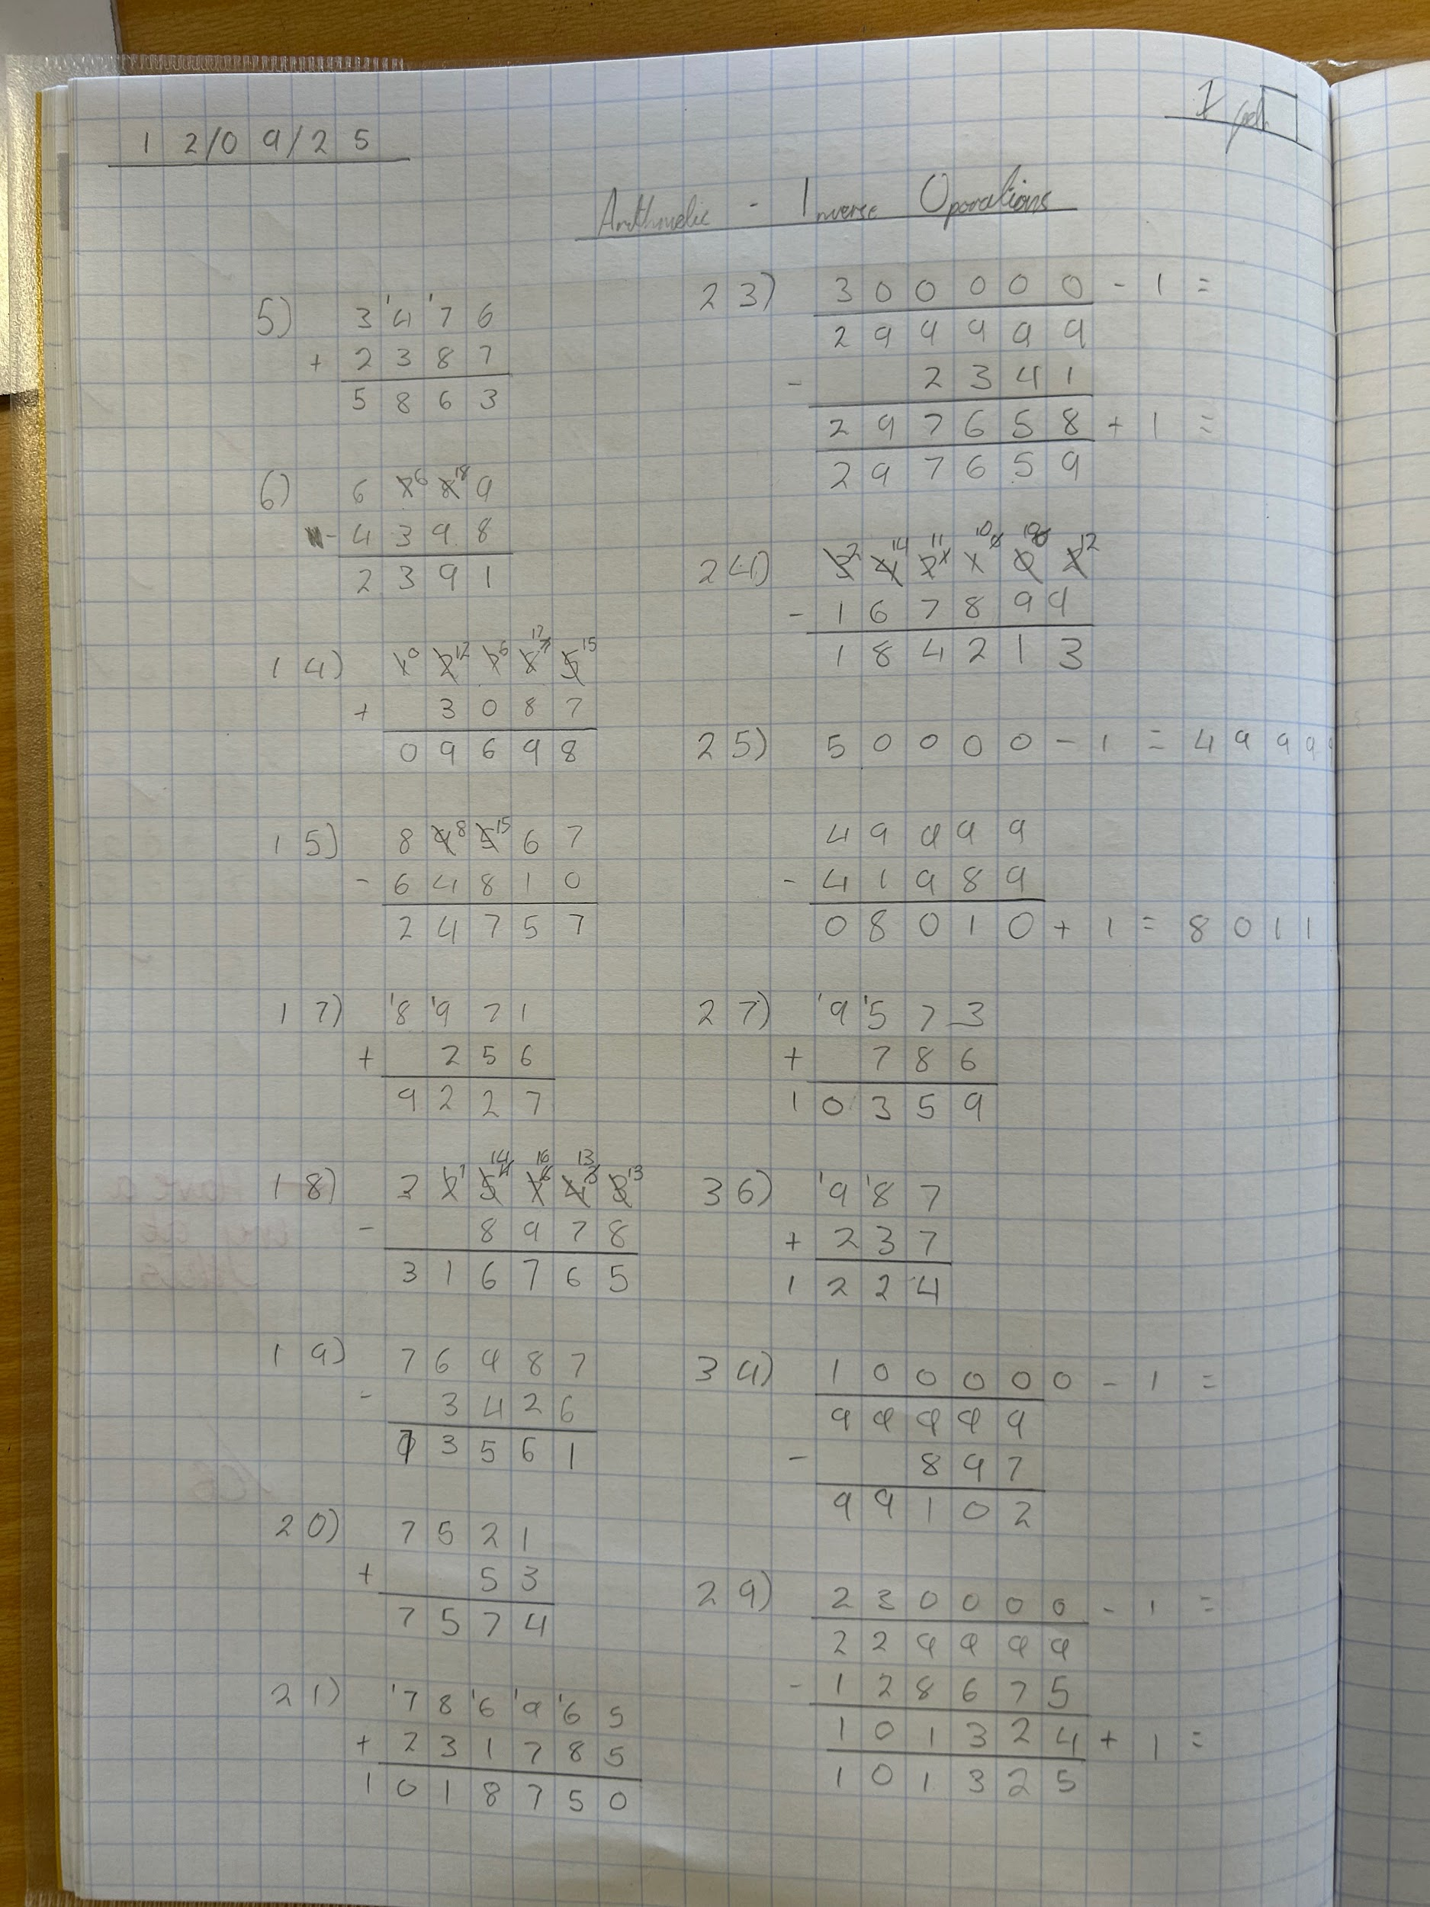
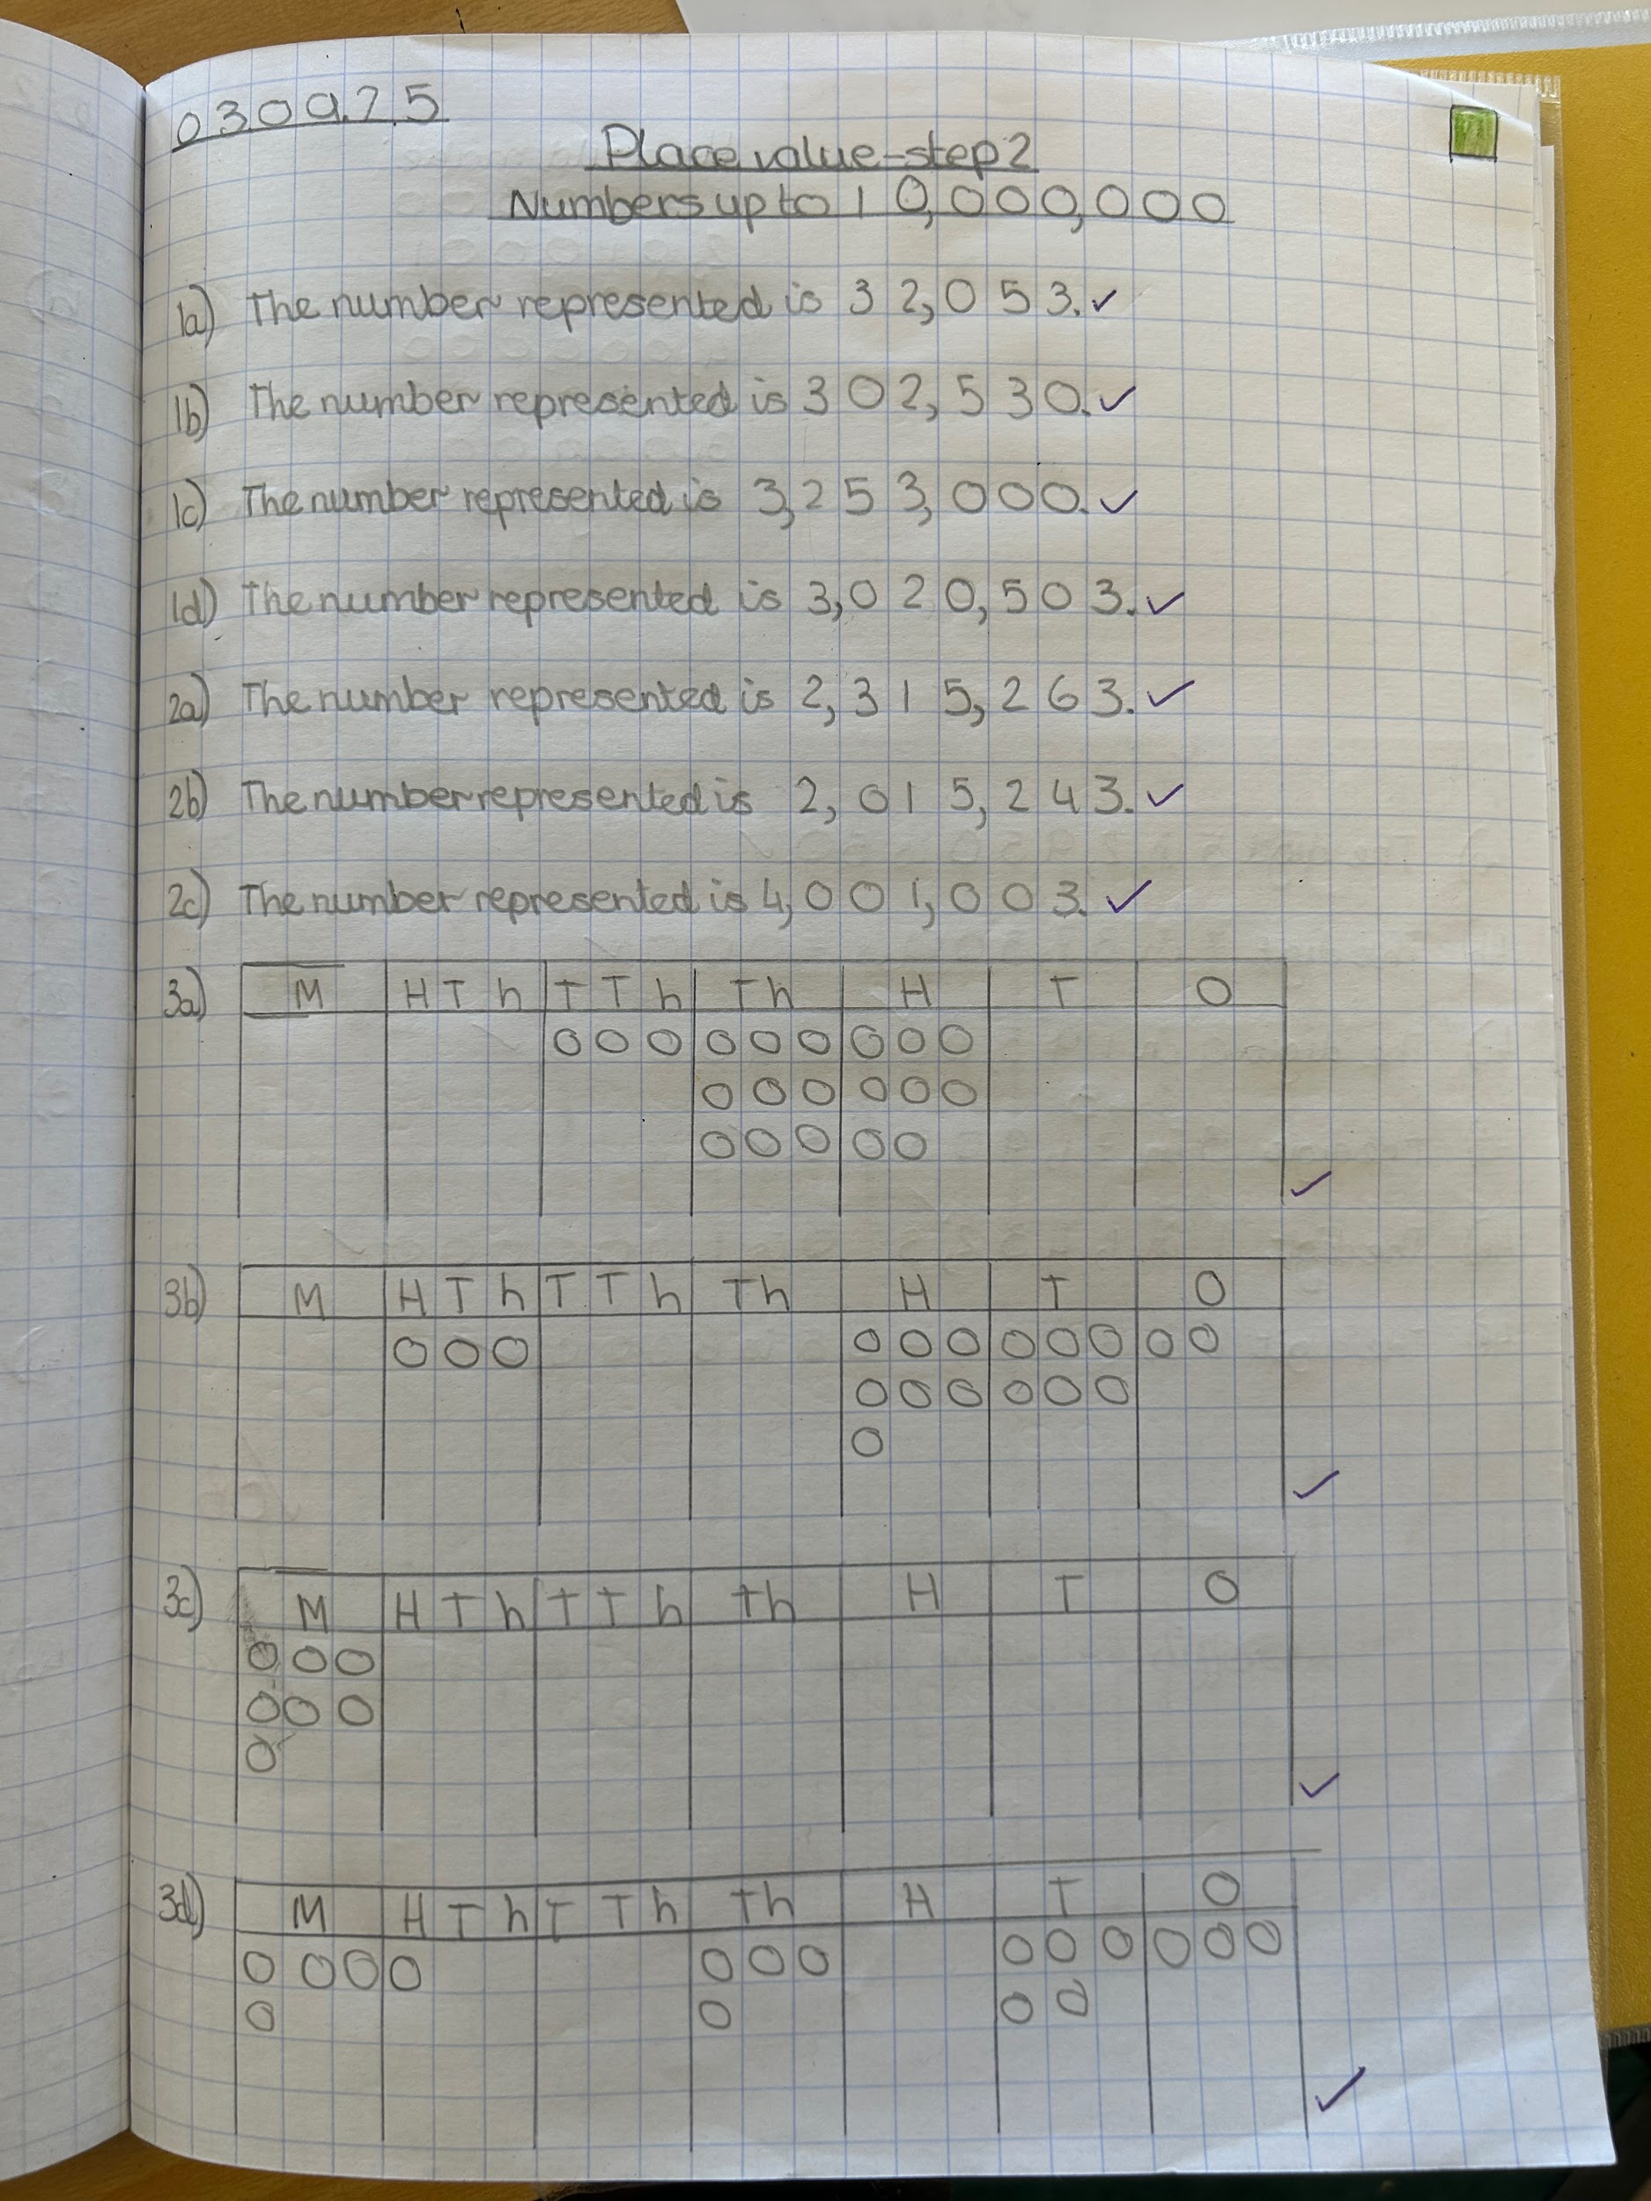
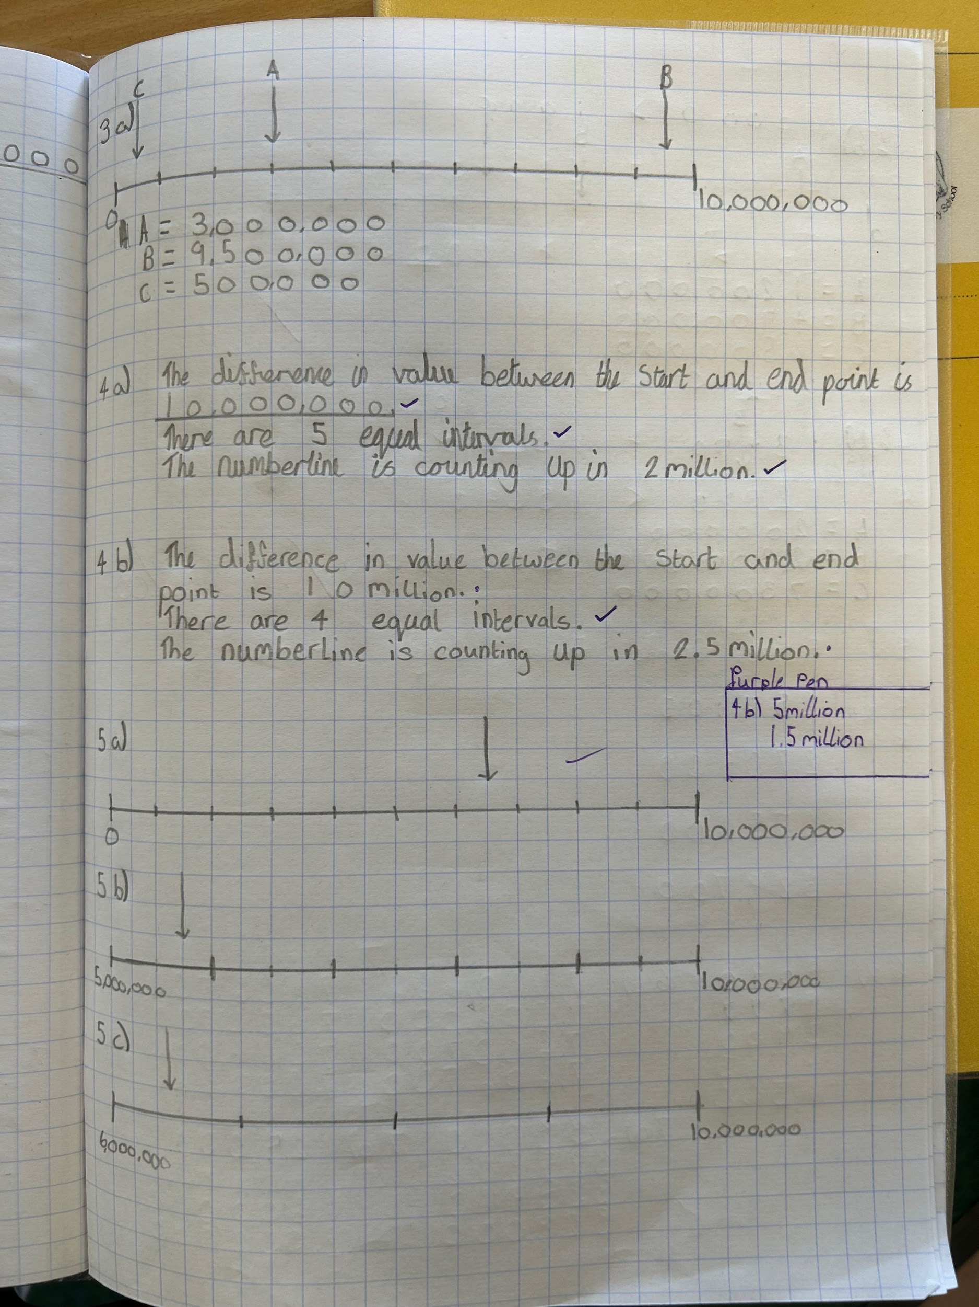
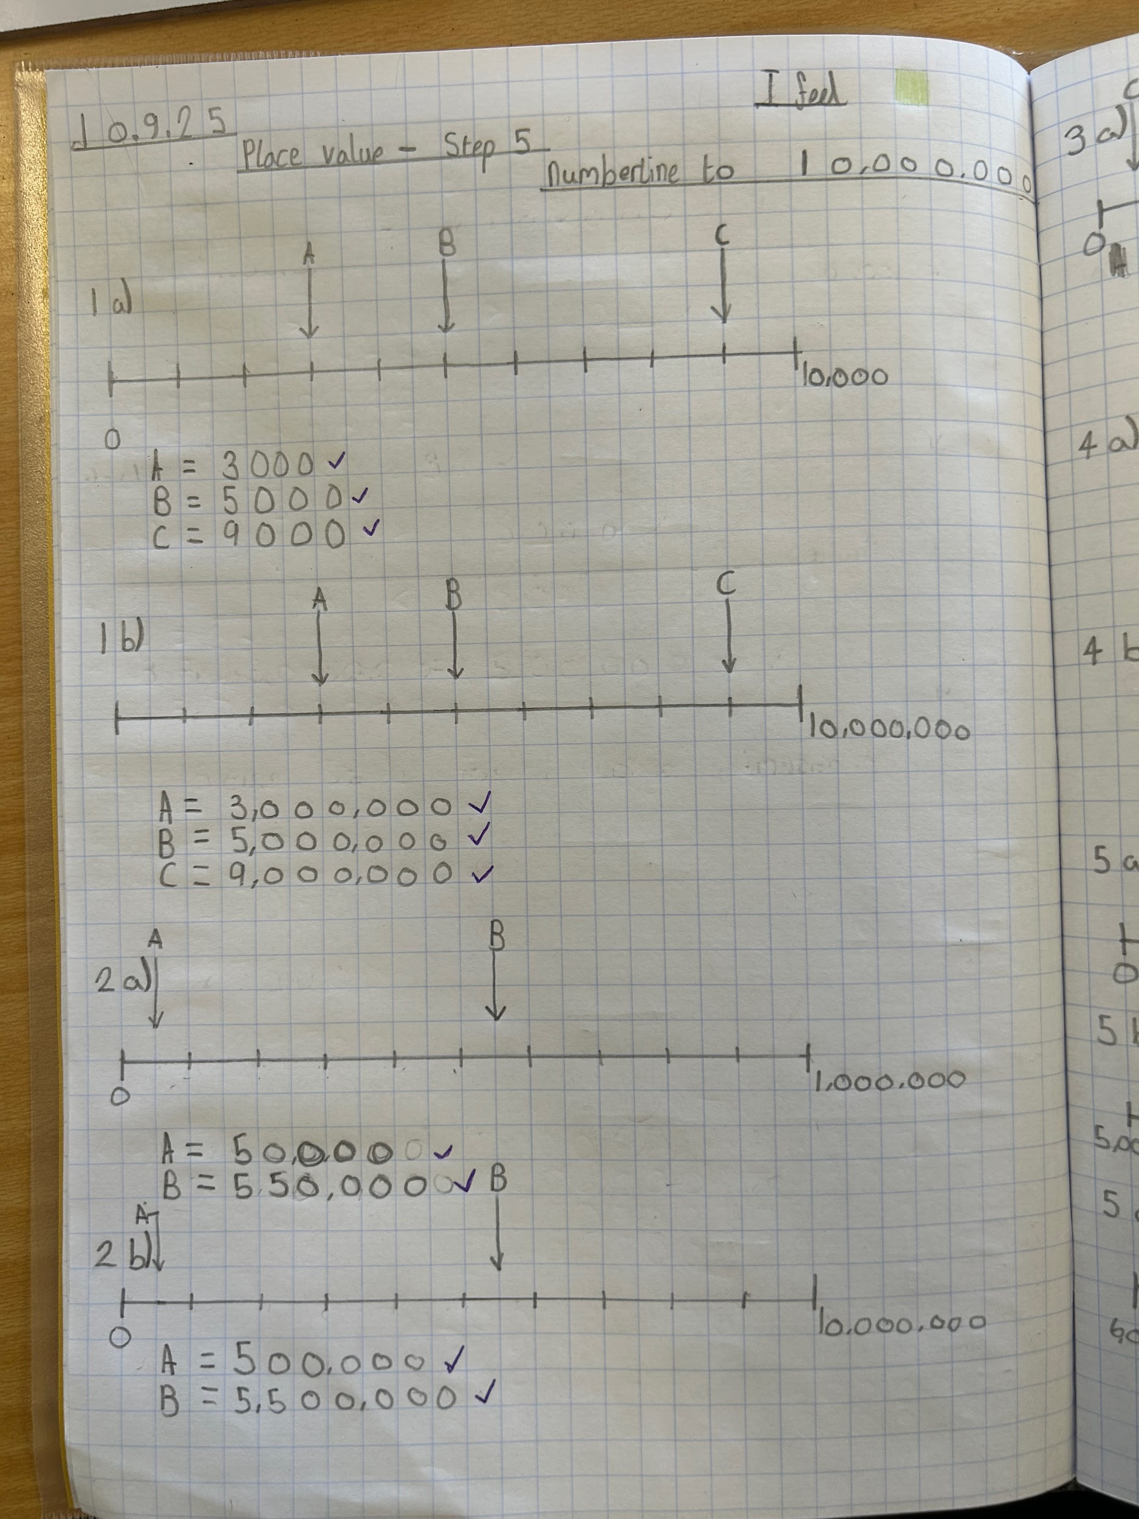
Year 6
In Year 6, children have worked brilliantly on their first maths unit of place value. The presentation in all books has been exceptional. We are really proud of all of you!

Slide 4







Word Wizards:
We will start counting words next week so keep reading and quizzing!
Well done to Reception who started their phonics this week and have worked really hard to learn the first 5 sounds!
Mr Brown suggests 'Swimming Against the Storm'.
Determined to save the land, Eliza and her younger sister Avery secretly go searching in the swamp for the dangerous, wolf-like loup-garou.
Mrs Witts says…
A little boy is followed by a worry monster. It tries to stop him from having fun, until one day his Gran helps him…

Slide 5

We are aiming for 97% attendance.
This week, our classes with the highest attendance are…
KS1 - Class 5 98.33%
KS2 - Class 12 98.44%
WELL DONE

Slide 6



Clubs to start W/C 15th September PTFA Meeting Mon 15th Sept 5.15pm PTFA Meet and Greet 29th Sept 5.15pm Harvest Festival (Foodbank Collection) Monday 6th October School Photographs Tues 14th October Parents’ Evening Weds 15th October (3.30-6pm) Thurs 16th October (4.40-7pm)
‘Show Racism the Red Card’ Day Friday 17th October Halloween Discos Thursday 23rd Oct (KS1 5-6pm) (KS2 6.15-7.15pm) Last day of half term Thurs 23rd October TRAINING DAY - Friday 24th October

Slide 7
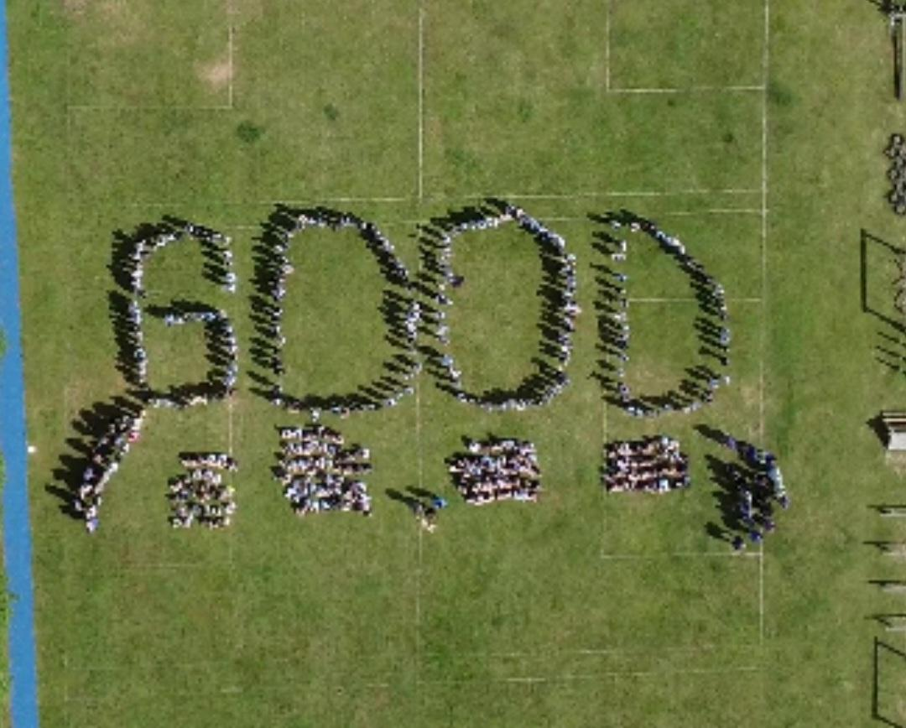


Cavalry Website
Contact us:
Cavalry Primary School Cavalry Drive March Cambridgeshire PE15 9EQ
office@cavalryprimary.org
Tel: 01354 652814

