Slide 1


5th May 2026
Making Playtime Brilliant: Our New Four-Card Strategy

Slide 2
Dear Families,
The Summer Term has got off to a whizzy start with a lot of exciting things to share with you.
If you peeked over the school gates during lunchtime, you’d see exactly what makes our school special: energy, imagination, and a lot of running around! To ensure every child feels safe and included, we are thrilled to launch our new Four-Card Behaviour Strategy.
This system is designed to provide clear boundaries while celebrating the wonderful choices our children make every day.
Here is how it works…
Notes:
u

Slide 3

1. The Gold Card: Acknowledge & Celebrate
We want to shine a light on our "Helpful Heroes." This card is for the child who instinctively picks up a dropped coat or invites a lonely peer to join their game.
The Reward: When a staff member shows a child a Gold Card, it’s an immediate "well done." The child will then receive a special lunchtime award or takes that praise back to class to earn a credit point.
For children who go ‘over and above’ by doing something really special, their name will be entered into a golden book and the entry read out during our weekly achievement assembly.

Slide 4

2. The Purple Pause: Intervene Early
Sometimes, play gets a little too high-octane. We look for "The Look" in a child’s eyes—where things are getting frantic, but no rules have been broken yet.
The Talk: A staff member will call a "Purple Pause" and ask: "This game is getting a bit fast; how can we make it safer?" *
The Outcome: Children agree on a new rule together, supported by the adult, and continue their play safely.

Slide 5

3. The Yellow Card: Reflect & Redirect
This is for persistent rule-breaking, such as continuing to play-fight after being asked to stop. It’s a moment for a "reset" through one of three small sanctions:
Walk and Talk: Walking with a Midday Supervisor or Teacher for 5 minutes to calm down.
Service to our Community: Helping the school by picking up five pieces of equipment or tidying the shed.
Zone Change: Moving from a high-energy area (like the football pitch) to a quiet zone for the rest of the break.

Slide 6

4. The Red Card: Safety First
Reserved for behaviour that is "beyond the playground" and requires immediate intervention.
The Action: Staff will not argue or negotiate. Using a calm voice, they will state: "That is a Red Card behaviour. You need to go to [SLT Member Name] now."
Follow-up: To ensure we have the full story, the supervisor provides a written account of the incident to a member of the Senior Leadership Team before the end of the lunch break.
Action: A phone call home will be made.

Slide 7
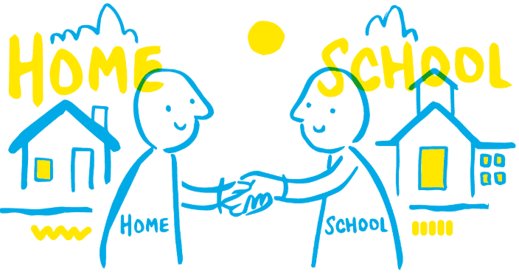
How You Can Help
Which of the four cards do you think your child will be most excited to tell you about?
You are our greatest partners in this. You can support the new strategy at home by asking your child if they saw any "Gold Card" moments today or discussing how a "Purple Pause" can help keep games fun for everyone.
We are excited to see our playground transform into an even more vibrant and respectful environment.
Thank you for your continued support in helping our children grow, both inside and outside the classroom.
Warm regards,
Mrs Edwards

Slide 8


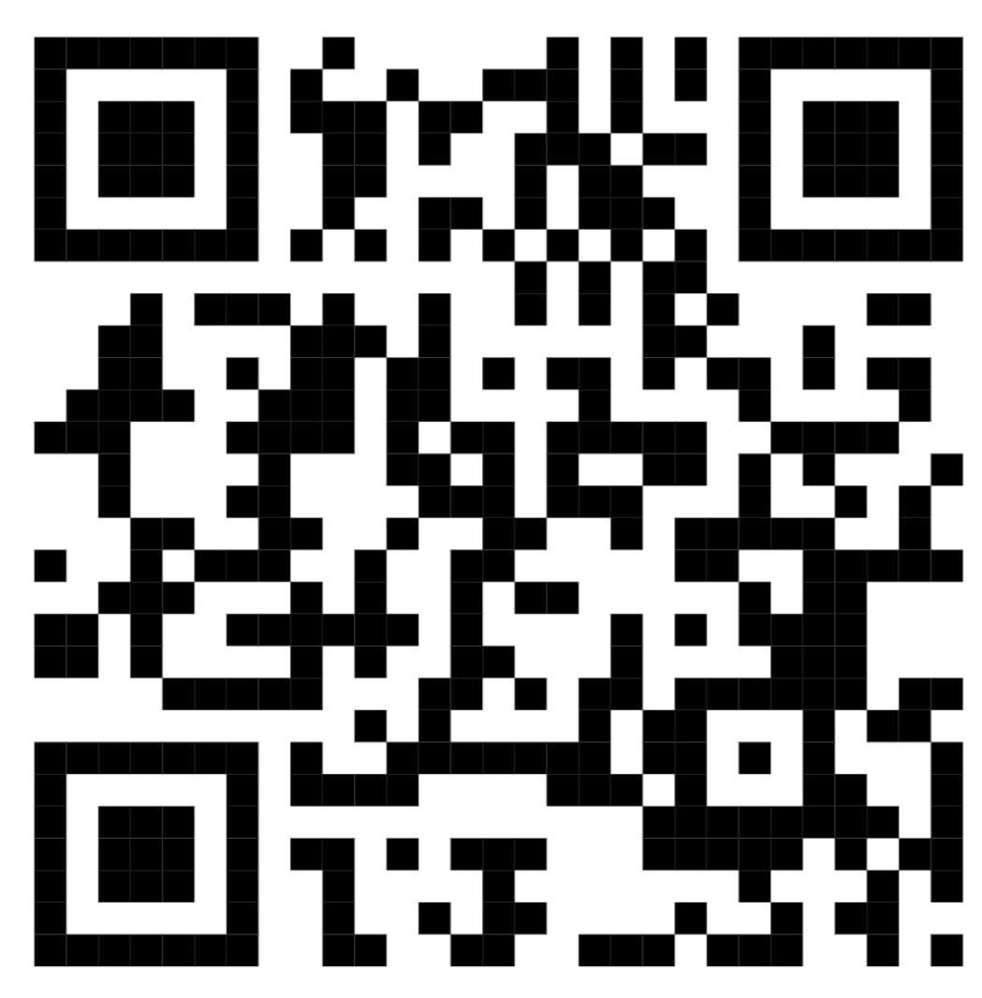
Cavalry Website
Contact us:
Cavalry Primary School
Cavalry Drive
March
Cambridgeshire
PE15 9EQ
office@cavalryprimary.org
Tel: 01354 652814

